Slide 1
COMP 2000 Object-Oriented Design
David J Stucki
Otterbein University

Slide 2
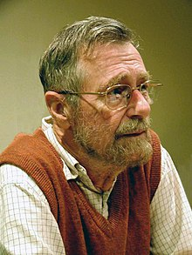
Edsger W. Dijkstra
“If debugging is the process of removing software bugs, then programming must be the process of putting them in.”

Slide 3
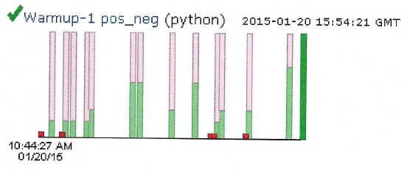
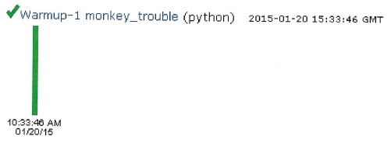
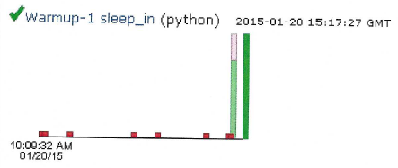
ALERTS
Lab 1 Debrief
Questions?
CodingBat: Feedback
Don’t forget to finish these up by Tuesday before lab
Read Weisfeld Chapter 1
You should join CS Club!!

Slide 4
Variables
Variables are used to store data in Java
All variables must be declared:
When a variable is declared, it can also, optionally, be assigned at the same time:
int value;
double inches = 4.96;

Slide 5
Types
All variables have a type, which comes before the name of the variable in the declaration:
Unlike dynamic languages like Python or JavaScript, the type of a variable never changes
Types determine:
Legal values you can put in a variable (like integers or text)
Operations you can do on those variables (like addition or concatenation)
Types come in two flavors: primitive types and reference types
int value;

Slide 6
Primitive types
Java has 8 primitive types:
 | Type | Bytes | Range | Purpose
Integer | byte | 1 | -128 – 127 | Tiny integers
 | char | 2 | Many Unicode characters | Characters
 | short | 2 | -32,768 – 32,767 | Small integers
 | int | 4 | -2,147,483,648 – 2,147,483,647 | Normal integers
 | long | 8 | -9,223,372,036,854,775,808 – 9,223,372,036,854,775,807 | Large integers
Floating-point | float | 4 | (±) 1.4 × 10⁻⁴⁵ – 3.4 × 10³⁸ | Low precision math
 | double | 8 | (±) 4.9 × 10⁻³²⁴ – 1.8 × 10³⁰⁸ | High precision math
Other | boolean |  | true, false | Logic

Slide 7
Primitive type ranges
Java has relatively strong typing
Understand why you're making a cast, and try not to make casts for no reason
Remember that all the primitive numerical types in Java are signed
Strange things can happen
byte x = -128;
x *= -1;
System.out.println(x); //output?

Slide 8
Special double values
The integer types only have the values in the range listed
No other values are possible, certainly not null
The double and float types have a few special values:
float | double | Meaning
Float.NaN | Double.NaN | Not a representable number, such as the square root of a negative number
Float.NEGATIVE_INFINITY | Double.NEGATIVE_INFINITY | Too negative of a value, larger than can be represented, such as -5.0/0.0
Float.POSITIVE_INFINITY | Double.POSITIVE_INFINITY | Too positive of a value, larger than can be represented, such as 7.0/0.0

Slide 9
Basic math operations
+ adds
- subtracts
* multiplies
/ divides (integer division for int type and floating-point division for double type)
% finds the remainder
Order of operations holds, and parentheses can be used to clarify

Slide 10
Shortcut notation
Java has a number of shortcuts for common operations
Shortcut | Meaning |  | Shortcut | Meaning
x += y; | x = x + y; |  | x++; | x = x + 1; (return old value)
x -= y; | x = x - y; |  | ++x; | x = x + 1; (return new value)
x *= y; | x = x * y; |  | x--; | x = x – 1; (return old value)
x /= y; | x = x / y; |  | --x; | x = x – 1; (return new value)
x %= y; | x = x % y;

Slide 11
Shortcut notation
These shortcuts are almost the same as combinations of other operators, but they don't have the same type-checking:
And know what you're doing with ++:
int i = 0;
while( i < 10 )
i += 0.1; //legal but crazy DON’T
int i = 0;
i = i++; //legal but crazy DON’T
i = ++i; //legal, crazy, different result DON’T

Slide 12
Reference types
There are an unlimited number of reference types, including:
Object
String
Scanner
All arrays
Any type that begins with an uppercase letter
Any type that isn't one of the 8 primitive types
Reference types do not use operators (except for = and == and + [for String concatenation])
Instead, we interact with reference types with methods

Slide 13
Strings
The String type is immutable in Java
You can never change a String, but you can create a new String
The second line creates a new String:
This approach can be very inefficient:
When a lot of concatenation is expected, use StringBuilder
String stuff = "When in the course of human events ";
stuff += "it becomes necessary...";
String values = "";
for (int i = 0; i < 1000000; i++)
values += i;

Slide 14
Case sensitivity
Java is a case-sensitive language
Class is not the same as class
System.out.println("Word!"); prints correctly
system.Out.Println("Word!"); does not compile

Slide 15
Whitespace
Java generally ignores whitespace (tabs, newlines, and spaces)
is the same as:
You should use whitespace effectively to make your code readable
System.out.println("Hello, world!");
System.out.
println( "Hello, world!");

Slide 16
Comments
There are three kinds of comments
Single line comments use //
Multi-line comments start with a /* and end with a */
System.out.println("Hi!"); // this is a comment
System.out.println("Hi!"); /* this is
a multi-line
comment */

Slide 17
Documentation comments
The third kind of comment is a documentation comment, aka JavaDocs
These comments look like multi-line comments but have an extra asterisk at the beginning: /**
Documentation comments have special syntax inside of them that allows the programmer to make notes about the program that the jdk can recognize and used to generate documentation
/**
* This method peels carrots.
* @param carrot the carrot to peel
* @return the peeled carrot
* @author Barry Wittman
*/
public Carrot peelCarrot(Carrot carrot) {
// Do stuff
}

Slide 18
Control structures
Java control structures come in two categories
Selection (making a choice):
if statements
switch statements
Repetition (loops):
while loops
for loops
Enhanced for loops
do-while loops

Slide 19
if statement
if( condition ) {
statement1a;
statement2a;
…
}
else {
statement1b;
statement2b;
…
}
The condition is any statement that evaluates to a boolean
If the condition is true, the code inside the first body will execute
If it's false, the code inside the else body will execute
Braces for both the if and the else are optional if there is only a single statement
The else part is optional as well

Slide 20
switch statement
switch( data ) {
case value1:
statement1;
break;
case value2:
statement2;
…
case valueN:
statementN;
default: statementdefault;
}
The data that you are performing your switch on must be either an int, a char, a String, or an enum
The value for each case must be a literal
Execution will jump to the first case that matches
If no case matches, it will go to default
If there is no default, it will skip the whole switch block
Execution will continue until it hits a break

Slide 21
Loops
Allow us to repeatedly execute code
Care must be taken to run exactly the right number of times
Not too many
Not too few
Not an infinite number
Not zero (unless that's what should happen)
Loops come in three flavors:
while loops
for loops
do-while loops

Slide 22
while loops
Used when you don't know how many times a loop will run
Runs as long as the condition is true
Syntax:
while( condition ) {
// Statements
// Braces not needed for single statement
}

Slide 23
for loops
Used when you do know how many times a loop will run
Still runs as long as the condition is true
Syntax:
for(initialize; condition; increment) {
// Statements
// Braces not needed for single statement
}

Slide 24
Enhanced for loops
Used to iterate over the contents of an array (or other collection of data)
Similar to for loops in Python
The type must match the elements of the array (or other collection)
Syntax:
for(type value : array) {
// Statements
// Braces not needed for single statement
}

Slide 25
Enhanced for loop example
Method to find largest value in an array
public double findLargest(double[] numbers) {
double largest = numbers[0];
for(double number : numbers) {
if(number > largest)
largest = number;
}
return largest;
}

Slide 26
Enhanced for loop rules
It's common that you want to iterate over an entire list
Enhanced for loops are great for that but not as flexible as other loops
You have to loop over everything (unless you use break), and you can't look at the previous or next elements
You can never change the values in the list with an enhanced for loop
It can only read the values
int[] array = new int[100];
for(int value : array)
value = 25; // Does nothing!

Slide 27
do-while loops
Used infrequently, mostly for input
Useful when you need to guarantee that the loop will run at least once
Runs as long as the condition is true
Syntax:
do {
// Statements
// Braces not needed for single statement
} while( condition );

Slide 28
Definition of an array
An array is a homogeneous, static data structure
Homogeneous means that everything in the array is the same type: int, double, String, etc.
Static (in this case) means that the size of the array is fixed when you create it
Unlike Python lists, you cannot extend, consume, or resize an array

Slide 29
Declaration of an array
To declare an array of a specified type with a given name:
Example with a list of type int:
Just like any variable declaration, but with []
type[] name;
int[] list;

Slide 30
Instantiation of an array
When you declare an array, you are only creating a variable that can hold an array
To use it, you have to create an array, supplying a specific size:
This code creates an array of 100 double values
double[] list;
list = new double[100];

Slide 31
Accessing elements of an array
You can access an element of an array by indexing into it, using square brackets and a number
Once you have indexed into an array, that variable behaves exactly like any other variable of that type
You can read values from it and store values into it
Indexing starts at 0 and stops at 1 less than the length
list[9] = 138.7;
System.out.println(list[9]);

Slide 32
Length of an array
When you instantiate an array, you specify the length
You can use its length member to find out
The indexes of an array and its length are always int values, no matter what the elements inside the array are
double[] list = new double[42];
int size = list.length;
System.out.println("List has " + size +
" elements"); //prints 42

Slide 33
Two dimensional array
To declare a two dimensional array, we just use two sets of square brackets ([][]):
Doing so creates a variable that can hold a 2D array of ints
As before, we still need to instantiate the array to have a specific size:
int [][] table;
table = new int[5][10];

Slide 34
Static Methods
Static methods allow you to break your program into individual pieces that can be called by each other repeatedly
Advantages:
More modular programming
Break a program into separate tasks
Each task could be assigned to a different programmer
Code reusability
Use code over and over
Even from other programs (like Math.sqrt())
Less code (and error) duplication
Improved readability
Each method can do a few, clear tasks
Well named method are self-documenting

Slide 35
Return type and parameters
A method takes in 0 or more parameters and returns 0 or 1 values
A method that doesn’t return a value is declared as a void method
Definition syntax:
public static type name( type arg1, type arg2, … ) {
//statements
//braces are always required!
}

Slide 36
Calling syntax
Proper syntax for calling a static method gives first the name of the class that the method is in, a dot, the name of the method, then the arguments
If the method is in the same class as the code calling it, you can leave off the Class. part
If it is a value returning method, you can store that value into a variable of the right type
Class.name(arg1, arg2, arg3);

Slide 37
Binding example
int a = 10;
int x = 3;
int y = add( 5, a ); //y contains 15 now
No connection between the two different x's and y's
public static int add(int x, int y){
int z = x + y; //5 + 10
return z;
}

Slide 38
Binding
When a method is called, the arguments passed into the method are copied into the parameters
The names for the values inside the method can be different from the names outside of the method
Methods cannot change the values of the arguments on the outside for primitive types
Methods can change the values inside of arrays and sometimes inside of object types
But they can't change which array or object the reference is pointing to

Slide 39
Next Time...
The Object-Oriented Paradigm

