Slide 1
COMP 2000 Object-Oriented Design
David J Stucki
Otterbein University

Slide 2
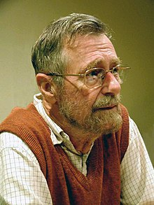
Edsger W. Dijkstra
“Object-oriented programming is an exceptionally bad idea which could only have originated in California.”

Slide 3
Edsger W. Dijkstra
“Object oriented programs are offered as alternatives to correct ones”

Slide 4
Course Information
Syllabus
Course Web Site
Curriculum

Slide 5
Computer Science Curriculum
4210
Language Instruction
You are here
3100
Software Engineering
Java
4100
CS Practicum
4220
User Interface Design
1500
1800
Computing in Python
Python
3200
Languages and Machines
4230
Applied AI
1600
Intro to Programming
Java
2000
OO Design
Java
2100
Data and Algorithms
Java
2400
Computer Systems
3400
Networking and OS
4240
Mobile Computing
3600
Database Systems
4280
Parallel and Distributed
OR
MATH 1700
Calculus I
MATH 2500
Linear Algebra
3700
Web Development
4290
Special Topics
MATH 1240
Statistics I
MATH 2240
Statistics II
MATH 1230
Discrete Math
2230
Foundations of CS
4500
Algorithm Design

Slide 6
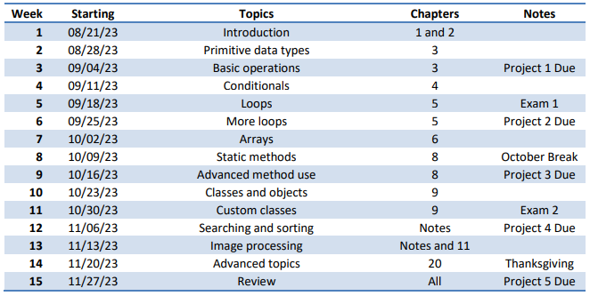
Course Information
Syllabus
Course Web Site
Curriculum
COMP 1600: What do you already know?
Java
Java 17
IntelliJ
Lab: What was the SOP in 1600?

Slide 7
Course Content
Main Topics
Object-Oriented Paradigm
Class Design
Object-Oriented Software Design
Design by Contract
Design Patterns
User Interface Design
UML (Unified Modeling Language)
Things You'll Learn Along the Way (JIT)
Intermediate Java
Interfaces
Inheritance
Exceptions
Graphical user interfaces (GUIs)
Testing & Debugging
Recursion
File and network I/O
Java Collections Framework (JCF)
Regular expressions

Slide 8
Bloom’s Taxonomy of Cognitive Learning
Evaluation
Synthesis
Analysis
Application
Comprehension
Knowledge

Slide 9
Flowcharts for COMP 2000 (with thanks to Dr. Wittman)
Flowchart for success:
Read textbook before class
Participate in class and ask questions
Practice programming what we talk about
Work on labs and projects
Come to exams prepared
Flowchart for failure:
Come to class without reading anything
Ask no questions in class
Don't practice at home
Finish the projects without understanding them
Skim the chapters before the exam

Slide 10
Lab Tomorrow
Java Warmup: Brush off the cobwebs and polish out the rust...

Slide 11
Next Time...
Java Review: Start Concurrent Chapters 3-6 & 8-9

