Slide 1
COMP 1600
Introduction to Programming
David J Stucki
Fall 2025

Slide 2
There does not now, nor will there ever exist, a programming language in which it is the least bit hard to write bad programs.
— L. Flon
Notes:
1

Slide 3
Alerts
Read chapter 4
Project 1 questions?
  Tomorrow's lab period will be project time
  Due this Friday!

Slide 4
Review
Last time we looked at the last set of primitive operators
  char
  String

Slide 5
Classes
A class is the mechanism that Java uses to create data types beyond the eight primitive types.
  It is the pattern or blueprint for how to create objects
  Think of it as an object factory
Classes allow you to create more complex types of data
  Collections (e.g., a String is a collection of characters)
  Models of things in the world (e.g., a Student or a Vehicle)
  Compositional type (e.g., a complex number)

Slide 6
Objects
An object is an instance of a class.
  It represents one particular entity whose type is the class
  Think of it as a box that knows things and can do things
Objects have four attributes
  An identity What it IS individually
  A state What it KNOWS
  A class (or data type) What KIND it is
  A set of behaviors What it DOES

Slide 7
Reference Variables & Objects
You can assign objects to variables
However, the variable doesn't contain the object (like it would for primitive values)
Rather, the variable holds a reference to the object (it's identity)
So you can still think of the variable as a box, it just contains a different sort of value
Fun with References
(Pointer Fun with Binky!)
String number = "345";
int value = Integer.parseInt(number);
(String)
"345"
number
(int)
345
value

Slide 8
Classes and objects are useful
There are certain things that are difficult to do with the operations we've shown you
For example, how do you turn a String representation of a number like "847" into the actual int 847?
Wrapper classes!

Slide 9
Wrapper classes
Each primitive data type in Java has a wrapper class
We will focus on three:
  Integer
  Double
  Character

Slide 10
Integer class
The main uses of the Integer class are converting ints to and from Strings
To convert a String to an int, use the parseInt() method
To convert an int to a String, use the toString() method (or just concatenate)
String number = "345";
int value = Integer.parseInt(number);
int value = 543;
String number = Integer.toString(value);

Slide 11
Double class
The Double class is much like the Integer class
To convert a String to a double, use the parseDouble() method
To convert a double to a String, use the toString() method (or just concatenate)
String number = "-0.4581";
double value = Double.parseDouble(number);
double value = 6.02e23;
String number = Double.toString(value);

Slide 12
Character class
The Character class is mostly useful for getting information about a particular char
For example, you can find out whether a char is a digit, is a letter, is uppercase, or is lowercase by calling the isDigit(), isLetter(), isUpperCase(), or isLowerCase() methods, respectively
char c = '8';
boolean value = Character.isDigit(c); // true

Slide 13
Examples
Write a program that reads in an alphabetic character and tells you what position in the alphabet it has
Write a program that reads in an int value and says how many digits it contains

Slide 14
Conditional execution
So far we have only considered Java programs that do one thing after another, in sequence
Our programs have not had the ability to choose between different possibilities
Now, they will!

Slide 15
Behold!
The if-statement:
x is small will only print out if x is less than 5
In this case, we know that it is, but x could come from user input or a file or elsewhere
int x = 4;
if (x < 5) {
System.out.println("x is small!");
}

Slide 16
Anatomy of an if
Any boolean expression
The if part
if( condition ){
statements;
}
Executable statements

Slide 17
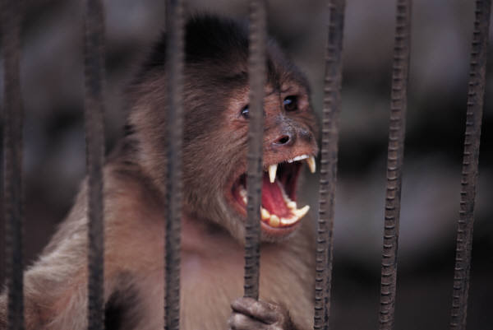
The idea of an if
A very natural if-then sort of relationship
If the condition is true, then do something
For example:
  If I win a million dollars,
  Then I’ll yodel like an insane Swiss monkey

Slide 18
Example using if
Write a program that prompts the user for the secret password
If they enter the word "eggplant", congratulate them for knowing the password

Slide 19
POP Quiz 2

Slide 20
Next time…
On Wednesday, we'll talk about
  More about if statements
  else clauses
  Conditions

