Slide 1
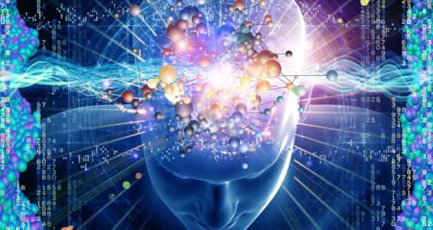
Thinking & Computation

Slide 2
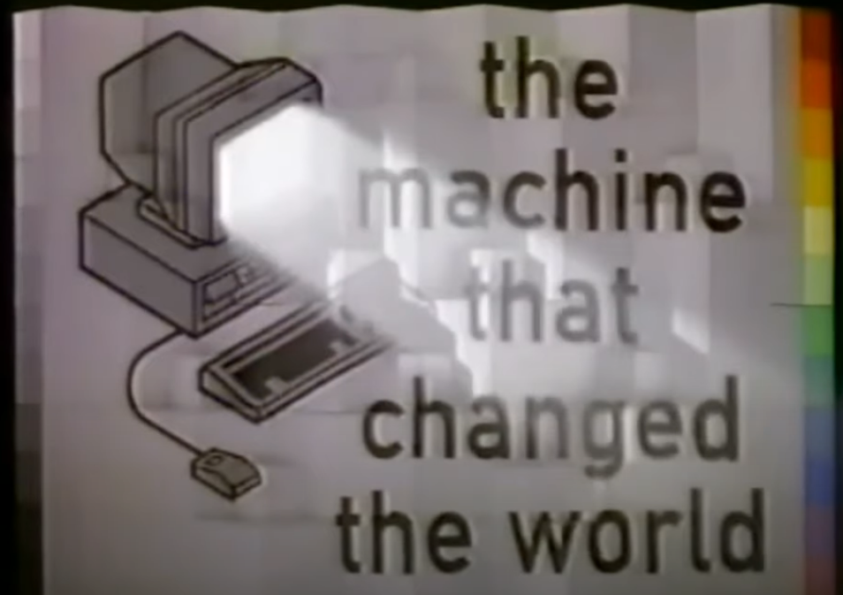
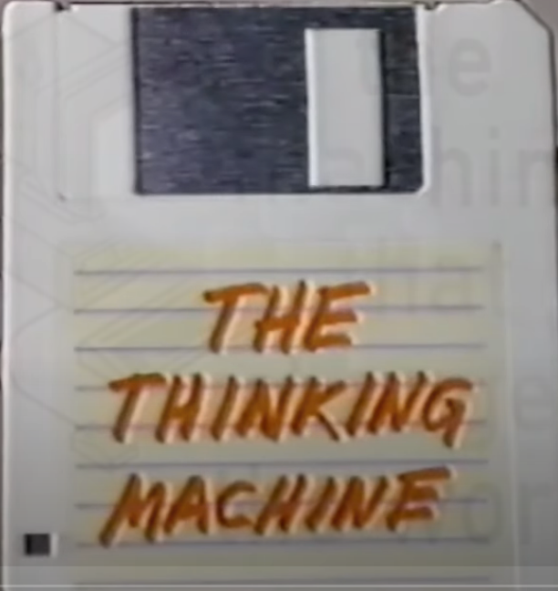
TMTCTW “The Thinking Machine”
https://youtu.be/enWWlx7-t0k
Discussion?

Slide 3
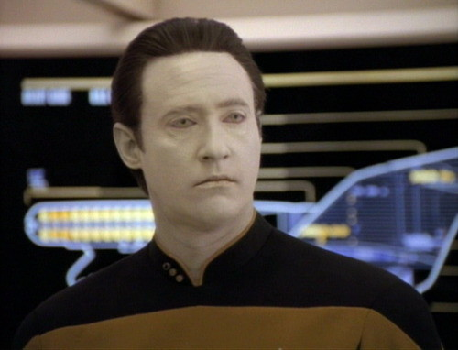
ST:TNG “Sentient Being”
https://www.youtube.com/watch?v=vjuQRCG_sUw
Discussion?

Slide 4
SyMBoLIc
REPRESENTaTIoN
“When some thing is allowed to stand for another”
  What does this mean?
Examples
  Corporate Logos Flags Mathematics
  Road Signs Music Facial Expressions
  Language Mascots Art
    Others?
Every aspect of human culture relies on the power of symbolic representation:
  Communication Education Business/Commerce
  History Government Technology
    Others?

Slide 5
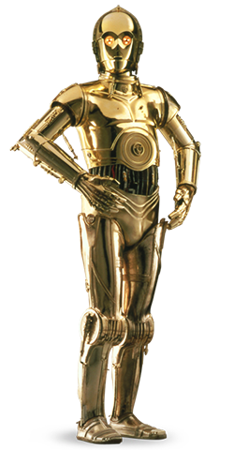

ABSTRacTIoN
A process of simplification that proceeds by ignoring irrelevant detail while focusing on what is important
One of the fundamental concepts in computer science
It is itself a by-product of symbolic representation, since symbols allow abstraction to take place
A road sign serves only as a compact abstraction of the law

Slide 6
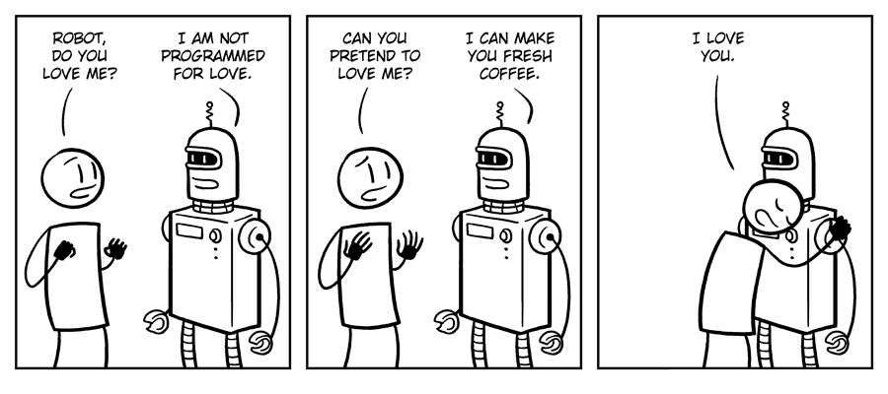
THoUgHT
Without symbolic representation would these be possible?
  Imagination
  Creativity
  Love
  Faith
  Thought
In other words, symbolic representation appears to be central to what it means to be human…

Slide 7
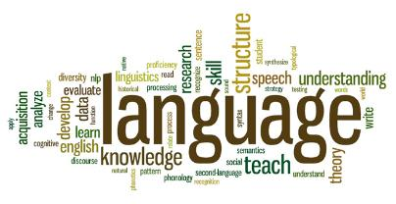
Perhaps the most important, and certainly one of the most sophisticated forms of symbolic representation
  Phonology : Sound, Stress, & Intonation
  Syntax : Structure or Form
  Semantics : Meaning
  Pragmatics : Use or Intention
Since the dawn of recorded history, until the middle of the 20th century, symbolic representation & language have been artifacts of living creatures, most notably humans.
Only recently has this monopoly been broken….

Slide 8
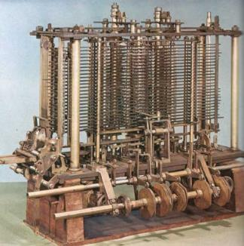
CoMPUTaTIoN
Machines historically have been designed with a specific purpose, which they are then dedicated to for as long as they function.
It wasn’t until Charles Babbage and Ada Lovelace worked on the Analytic Engine in the 1830s that this changed.
The Analytical Engine represents the simultaneous birth of general purpose computing and programming!
Unfortunately, it would be another 100 years
before Alan Turing would resurrect this idea
Today there are almost as many artificial
computer languages as there are natural
human languages.

Slide 9
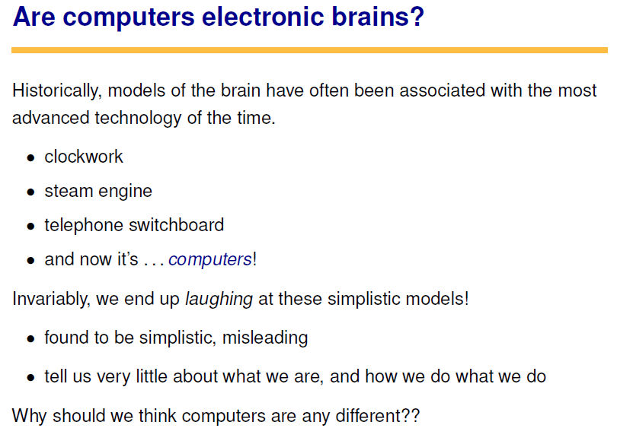

Slide 10
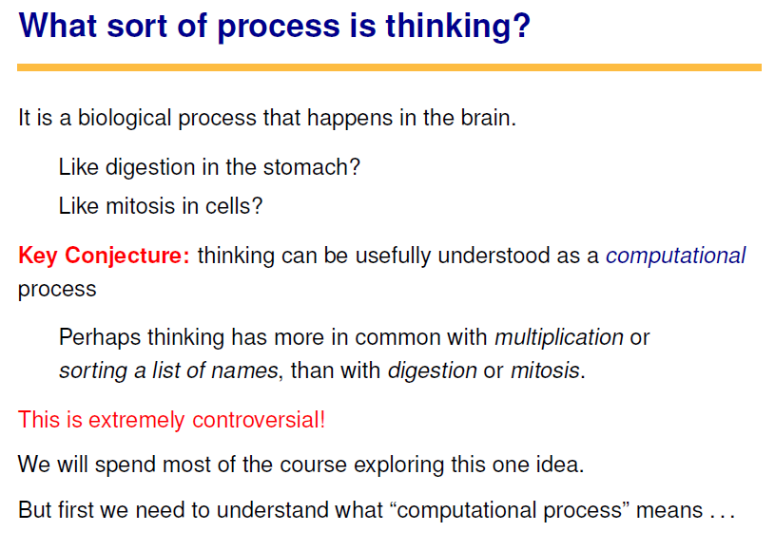

Slide 11
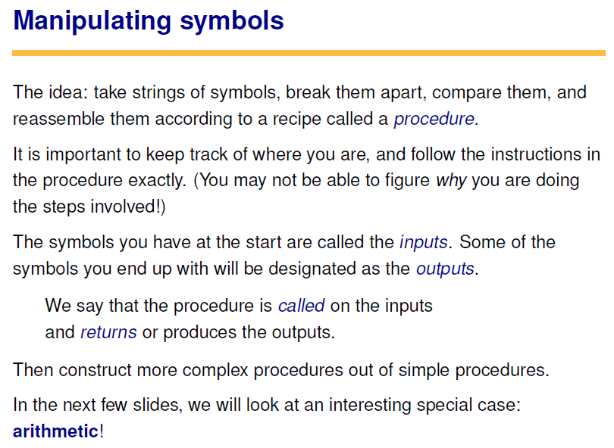


Slide 12
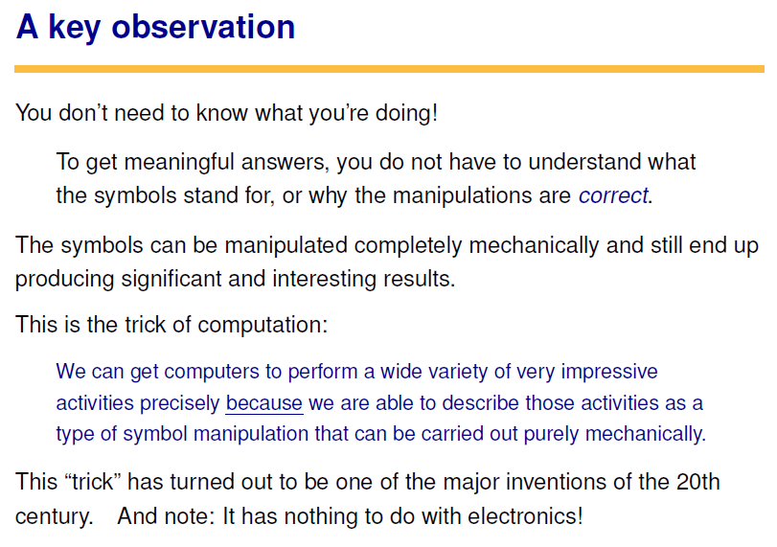

Slide 13
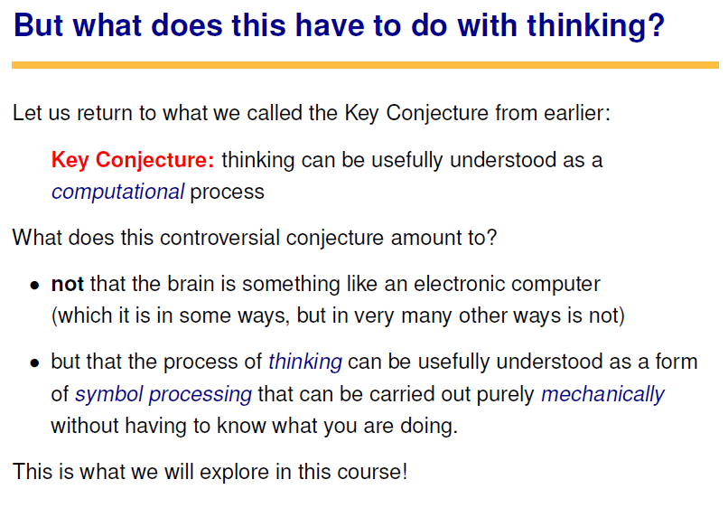

Slide 14
Other Objections
Hubert Dreyfus
  What Computers Can’t Do
John Searle
  The Chinese Room
  Computers lack understanding even if they pass the TT
Roger Penrose
  Based on Gödel’s Incompleteness, argues that human thought is inherently non-algorithmic
  Thoughts are quantum phenomena that emerge via
  micro-tubules in the structure of neurons

Slide 15
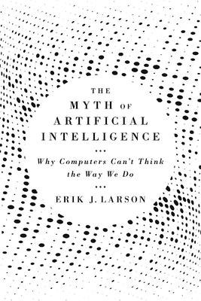
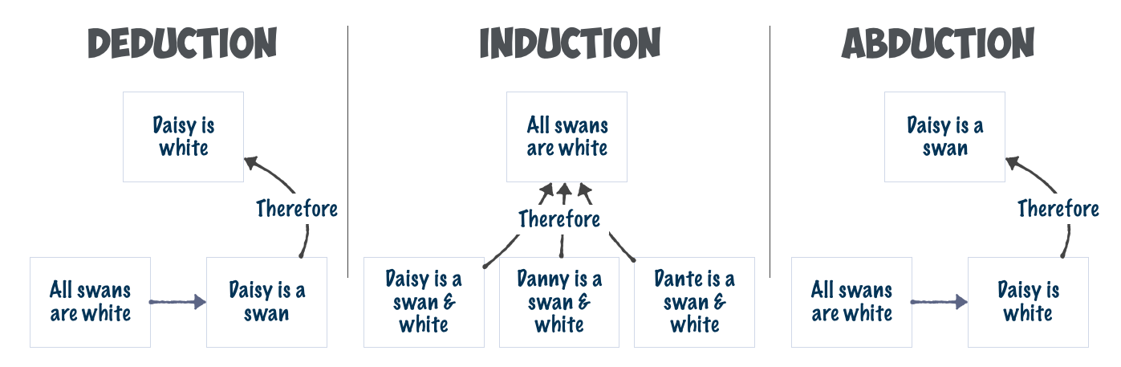
Other Objections
Erik J. Larson
  The Myth of Artificial Intelligence:
  Why Computers Can't Think
  the Way We Do
  Computer approaches to AI are
  based on deductive and inductive
  inference, but human intelligence
  also heavily relies on abductive
  inference

