Slide 1
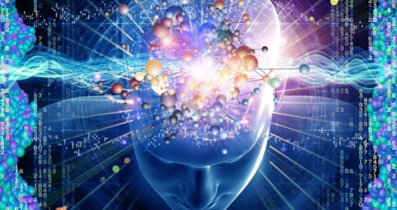
Thinking & Computation

Slide 2
ALERT
Assignment 10 due on Wednesday
Final Exam review on Wednesday

Slide 3
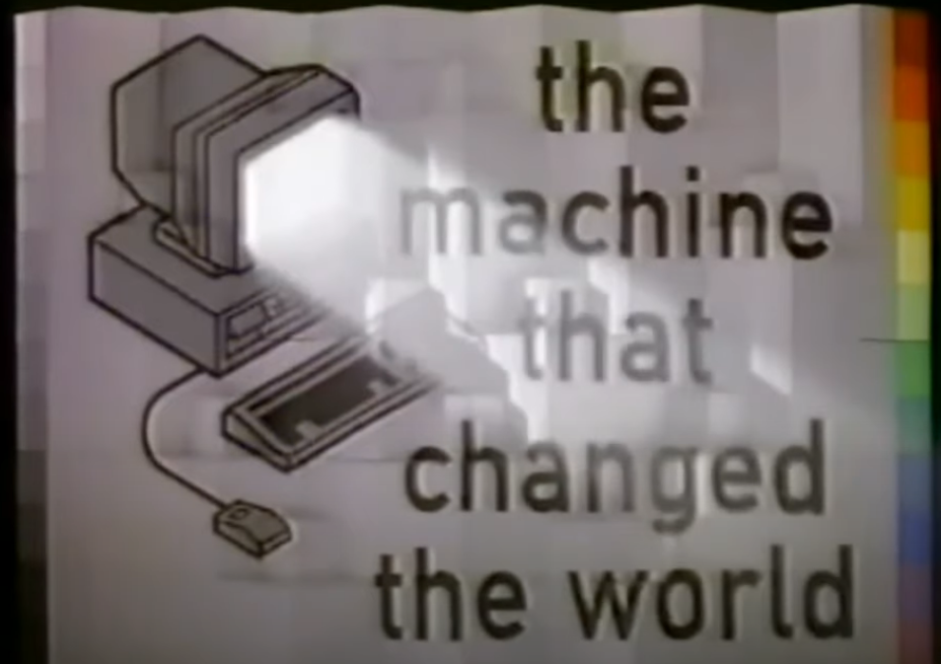
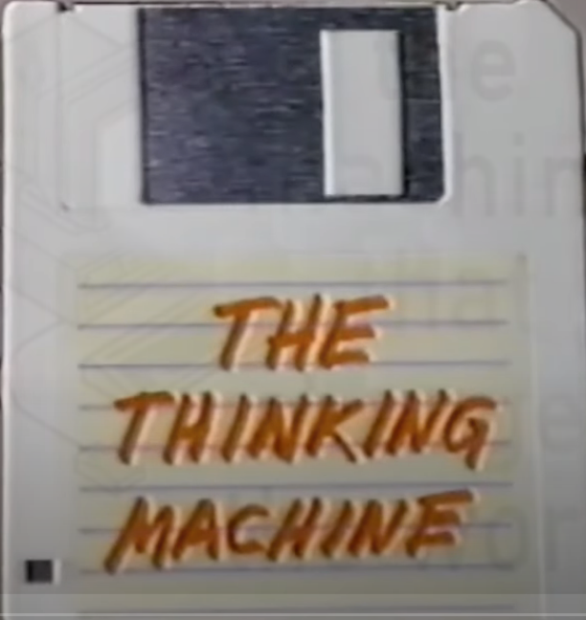
TMTCTW “The Thinking Machine”
https://youtu.be/enWWlx7-t0k
Discussion?

Slide 4
The Human Mind is Never Blank
If it were,
how would you know?

