Slide 1
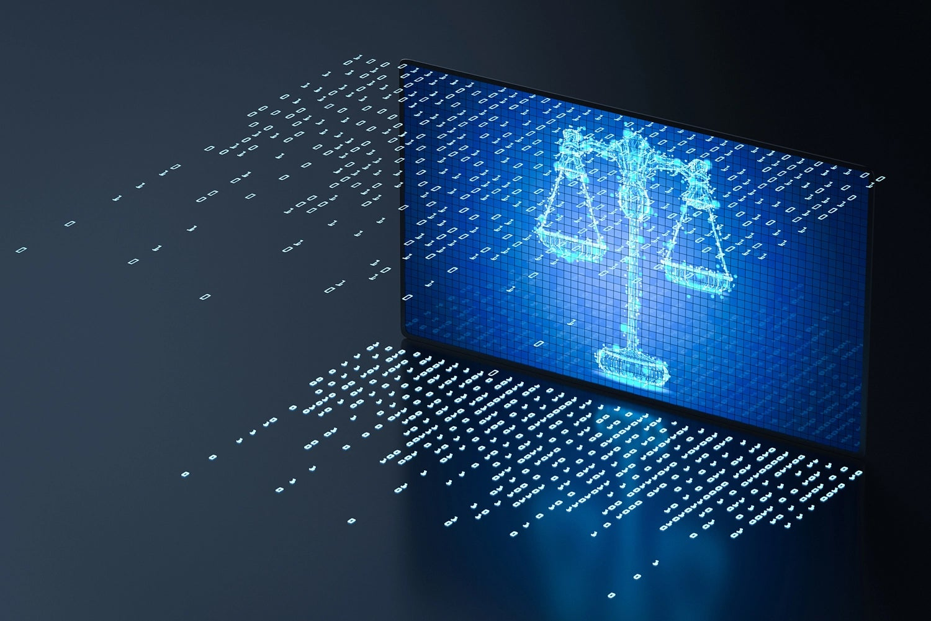
Ethics

Slide 2
ALERT
Assignment 9 is due Friday.
Assignment 10 will be available on Brightspace on Wednesday and due Wednesday, April 22.

Slide 3
Introduction
Social and ethical issues related to information technology are unavoidable
  Just because we can, doesn’t mean we should
Today, we will
  Develop skills to reason about such issues
  Learn about morality and ethics in the digital space
  Examine case studies with important ethical issues
  Describe arguments for and against certain positions
  Evaluate arguments in terms of ethics

Slide 4
Case Studies Case 1: Is Sharing Good?
Napster file-sharing system was developed (1999)
Peer-to-peer file sharing
  Software introduces users to each other
  Sharing happens directly between users
Recording companies filed suit against Napster
Lawsuit claimed Napster was a conspiracy to encourage mass infringement of copyright

Slide 5
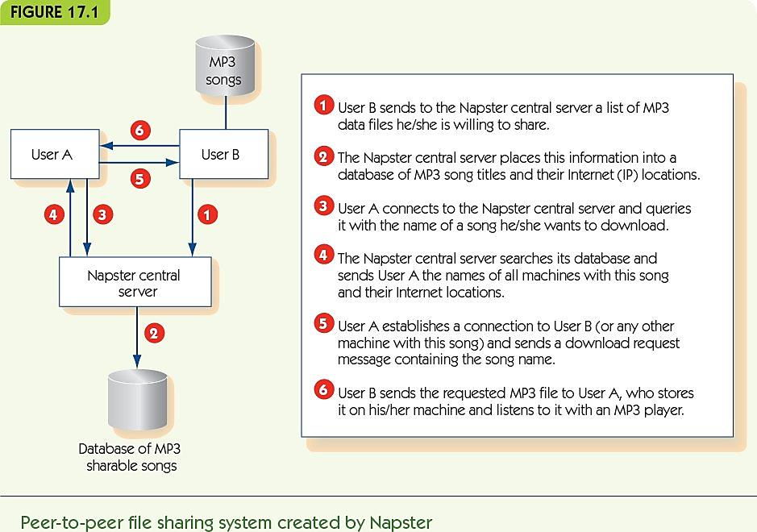
Case Studies Case 1: Is Sharing Good?

Slide 6
Case Studies Case 1: Is Sharing Good?
Facts
  Most shared music was copyrighted
  Many artists opposed sharing—no revenue for them
  Some artists supported sharing
Napster claims
  Napster reported song locations, not involved in actual sharing
  They were not responsible for users’ behaviors
  Swapping files this way should be “fair use” under copyright law

Slide 7
Case Studies Case 1: Is Sharing Good?
Napster lost the case and appeals, and closed in 2001
Sharing movies, legally or not, is a growing issue
Downloading images from the web for personal use
Ethical (not legal) questions
  Is it right to swap copyrighted music files?
  Is it right to provide a search engine to enable users to search each other’s databases for copyrighted materials?

Slide 8
Case Studies Case 1: Is Sharing Good?
Ethics: the study of how to decide if something is morally right or wrong
How do we judge right or wrong?
Consequentialism focuses on the consequences of an act—on the whole good or bad outcomes
Utilitarianism: look at overall good for everyone

Slide 9
Case Studies Case 1: Is Sharing Good?
Utilitarian argument #1: copying is OK
  There are many more music users than publishers
  Music users are happy to get free access
  Publishers get publicity for their products
  File sharing is akin to hearing a song on the radio
  Many users buy a song after listening to it
  Drop in sales may relate more to purchasing
  song-by-song rather than by album

Slide 10
Case Studies Case 1: Is Sharing Good?
Utilitarian argument #2: copying is not OK
  Early on MP3 sharing encouraged CD sales, but long-term trend is reduction in sales
  iTunes and Amazon sell one song at a time to compete with illegal file sharing
  If publishers cannot profit, then less music will be made
  Copyright protection is the law, and music file sharing is clearly illegal; encouraging illegal behavior is wrong

Slide 11
Case Studies Case 1: Is Sharing Good?
Dialectic: a dialogue that explores an issue from both sides to lead to greater understanding
An example:
  Facts are that music sales have dropped continuously
  Long-term, argument that less music would be published is a strong one
  Lesser-known artists may use file sharing to become better known, depend on income from performances
  Rethink the music industry from a new viewpoint

Slide 12
Case 2: The Athens Affair—Privacy vs. Security
Law enforcement needs to wiretap phones belonging to suspects
  Prior to cellular technology, a wiretap was a literal split off the main phone wire into the building
Modern use of cell phones and VoIP complicates phone taps
However, most/all phone calls go through computer systems
Laws require all telecommunications to support “lawful intercept” (LI) systems for wiretaps

Slide 13
Case 2: The Athens Affair—Privacy vs. Security
Built-in LI systems are a target for hackers
In Greece, hackers wiretapped 100 major business and political leaders
No trace of who did it or why
Ethical question
  How does the decision to require LI software impact privacy and security?

Slide 14
Case 2: The Athens Affair—Privacy vs. Security
Ethical reasoning by analogy
  Analogy-making is familiar to everyone
  Analogies are never perfect: what aspects are important?
  Apply decisions from one problem to another
  Identify what doesn’t fit; often an important aspect of the problem

Slide 15
Case 2: The Athens Affair—Privacy vs. Security
Analogy #1: LI is like requiring everyone to record their face-to-face conversations
  Focused on VoIP (e.g., Skype)
  Similarities between VoIP and face-to-face
    Forms of communication
    Meant to include a limited number
    Possible for others to listen in
    Easy access for others; required recordings allow abuses by government or hackers

Slide 16
Case 2: The Athens Affair—Privacy vs. Security
  Decisions about face-to-face conversations
    Private conversations are not monitored routinely
    Monitoring only with court order and probable cause
    We do NOT record all conversations all the time
  Implications by analogy for VoIP
    LI systems go beyond rules for private conversations
    Without LI, law enforcement can still monitor as with face-to-face conversations

Slide 17
Case 2: The Athens Affair—Privacy vs. Security
  Problems with the analogy
    This argument would apply to normal phone tapping
    Society accepts the need for some phone taps
    What features of the analogy don’t work?
    Fourth party involvement: telecommunications provider
  An analogy that includes a middleman is needed

Slide 18
Case 2: The Athens Affair—Privacy vs. Security
Analogy #2: LI is like suspicious activity reporting (SAR) in banking
  U.S. banks must notify government when they see suspicious transactions
  Similarities between LI and SAR
    Both are critical resources for criminals and require the help of external (law-abiding) entity
    Information helps to connect suspects with each other and discover networks of suspects

Slide 19
Case 2: The Athens Affair—Privacy vs. Security
  Problems with the analogy
    Who initiates the sending of information differs (banks initiate, not government)
    The information provided is very different
      Banks provide times, dates, and participants
      Full conversation recording supplies much more detail

Slide 20
Case 2: The Athens Affair—Privacy vs. Security
  Decision about suspicious activity reporting
    Banks should be required to report suspicious activity
  Implications by analogy
    Telecom companies should be required to report suspicious activity
  Supports storage of detailed call records
  Does not support storage of whole conversations

Slide 21
Case 2: The Athens Affair—Privacy vs. Security
After analyzing the analogies, consider three possible options/solutions:
  Require all VoIP systems to implement LI
  Do not require LI; use physical eavesdropping
  Require VoIP providers to report suspicious activities, but do not record conversations

Slide 22
Case 2: The Athens Affair—Privacy vs. Security
Interested parties
  Law enforcement
    Monitoring saves time and money; can do job better
  Hackers and non-hacker criminals
  The public
    Monitoring helps law enforcement, but decreases privacy and perhaps safety

Slide 23
Case 2: The Athens Affair—Privacy vs. Security
Utilitarian analysis
  Law enforcement
    Option 1 is best
  The public
    Option 2 reduces police effectiveness
    Option 1 allows for abuses
    Option 3 may also reduce police effectiveness

Slide 24
Case 3: Hackers—Public Enemies or Gadflies?
Hackers: people who break into computer systems, launch Internet worms and viruses, vandalize web sites, etc.
Some hackers are clearly criminals
  Purposeless vandalism
  Identity theft
  Outright theft
Some hackers engage in “hacktivism”
Can hacking a computer be a social good?

Slide 25
Case 3: Hackers—Public Enemies or Gadflies?
WikiLeaks
  Protects government and corporate whistle-blowers
  Provides a secure way to share sensitive documents anonymously
  Video of U.S. firing on Reuters employees
  U.S. diplomatic cables
  One million confidential/secret U.S. government documents
  WikiLeaks is a public corporation with known leadership

Slide 26
Case 3: Hackers—Public Enemies or Gadflies?
Anonymous
Primarily interested in freedom of speech
No official leader or organizing body
Amorphous, secret membership
DOS attack in retribution for sanctions against WikiLeaks
Attacks on government sites in Tunisia, Egypt, Libya
Publication of emails from corporations

Slide 27
Case 3: Hackers—Public Enemies or Gadflies?
Analogy: breaking into a computer is like breaking into someone’s house
  Similarities
    Intruders are there without permission
    Owners take precautions to discourage intrusion
    Both are against the law
  Differences
    Burglars take physical objects, depriving owner
    Hackers, in this case, copy intellectual property
    No threat of violence with hacking

Slide 28
Case 3: Hackers—Public Enemies or Gadflies?
Utilitarian arguments
  Owner of information loses control over it
  Hacker gains access to information
  Owner must increase security
    Increased awareness of vulnerability may be good
    Increased security only required because of hackers
  Hard to see consequences
  Must we distinguish between “good hackers” and “bad hackers”?

Slide 29
Case 3: Hackers—Public Enemies or Gadflies?
Deontological arguments
  Deontology: the study of duty and obligation
  Focus on duties of actor and effect on other’s rights
  Categorical imperative (Kant):
    Never treat a fellow human merely as a means to an end
  Focus on intent of an action, not consequences
  Hackers for personal gain are unethical; ignore them
  Focus on hackers who claim benign intent

Slide 30
Case 3: Hackers—Public Enemies or Gadflies?
Parts of the hacker ethic (Steven Levy):
  “All information should be free”
    To make decisions, people need good information
    Hackers should always spread information
  “Mistrust authority—promote decentralization”
    Bureaucracies and rules prevent things from getting done
    Each hacker should act individually as he or she sees best

Slide 31
Case 3: Hackers—Public Enemies or Gadflies?
Ethical critique of hacker ethic
  The information being shared does not belong to the hacker
  Does not respect other people’s wishes or safety
  Rules exist because we, as a society, expect electronic privacy
  Why should their ethic override other people’s wishes?
  Does hacking treat other people as a means to an end?

Slide 32
Thinking Straight about Technology and Ethics
“Paramedic ethics:” know a little and know when to ask
Ask these questions when facing an ethical problem:
  Who are the stakeholders in this situation?
  What does each stakeholder have to gain or lose?
  What duties and responsibilities are important?
  Can you think of an analogous situation? Does it clarify the situation?
  Make a decision or repeat in dialectic form

Slide 33
Summary
Computer technology intrinsically involves new social and ethical issues
Ethical reasoning provides a framework for analyzing ethical issues
Utilitarianism evaluates an act based on its consequences
A dialectic is a comparative discussion of opposing sides intended to clarify and improve understanding
Reasoning by analogy can clarify issues of an ethical problem

Slide 34
Summary
Deontological reasoning focuses on intent rather than outcomes
Ethical issues with information technology include:
  Copyright protections in an era of file sharing
  Personal privacy and lawful intercept laws
  Hackers who claim to be a social good
  Privacy and the protection of personal information
  Cyberbullying, sexting and distribution of online postings

Slide 35
The ACM Code of Ethics
The Association for Computing Machinery (ACM) is the primary professional society for computer science
  IEEE also has some relevance to computer scientists
  (Institute of Electrical and Electronics Engineers)
The ACM has adopted a code of ethics for computing professionals
  ACM Code of Ethics

