Slide 1
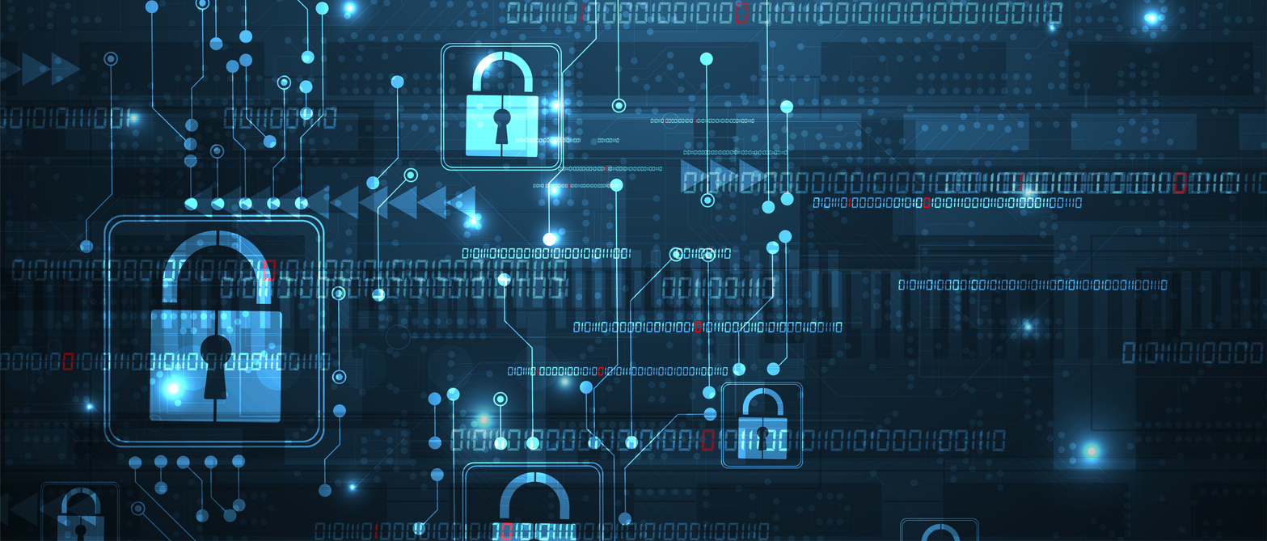
Computer Security: Cryptology

Slide 2
ALERT
Assignment 9 will be available on Brightspace on Friday.

Slide 3
Why Security?
When computers were single-user mainframes, security was in the form of locked doors and human guards.
Once computers could talk to each other then they suddenly became vulnerable
  not to physical, in-person attacks
  but to digital, electronic intrusions
Also, since the only reason for networks to exist is for communication, networks suffered from security vulnerabilities in that respect as well
  Communications could be intercepted
  Identities could be spoofed

Slide 4
Communication Security
Cryptology = Cryptography + Cryptanalysis
  Codes vs. Ciphers
  Cryptography: An ancient discipline of creating ciphers
    Greek: κρυπτος + γραφη = kryptos + graphe
      hidden writing
  Cryptanalysis: The art & science of breaking ciphers

Slide 5
Caesar Cipher
https://rot13.com/
In ancient Roman times when Julius Caesar was commanding remote generals in the field he needed a secure form of communication
  Most of his enemies were illiterate anyway, so a sophisticated system wasn’t required
The Caesar cipher is a scheme where each letter is replaced with the letter that comes 3 positions earlier in the alphabet:
plain text: a b c d e f g h i j k l m n o p q r s t u v w x y z
cipher text: x y z a b c d e f g h i j k l m n o p q r s t u v w
    “attack at dawn” becomes “xqqxzh xq axtk”
The number 3 in this cipher is known as the key, and in general when the key can be any value, this is known as a shift cipher

Slide 6
Encryption
Foundational Principle:
  The security of a cipher should lie entirely in the key and not in the algorithm itself
  In other words, the algorithm can be publicly known but the encryption keys should remain secret
Modern encryption operates on bits rather than characters
Symmetric vs. Asymmetric
  Symmetric encryption uses the same key to both encrypt and decrypt the messages (like shift cipher)
  This requires the key to be known to both parties, and no one else!
  How can this be accomplished?

Slide 7
The Diffie-Hellman Algorithm
Riley Lochridge
April 11, 2003
Adapted October 29, 2012 by David J. Stucki

Slide 8
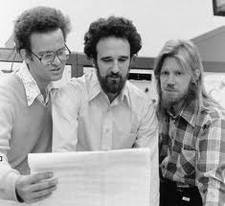
Introduction
Discovered by Whitfield Diffie and Martin Hellman
  “New Directions in Cryptography”
Ralph Merkle, Martin Hellman, Whitfield Diffie

Slide 9
Introduction
Discovered by Whitfield Diffie and Martin Hellman
  “New Directions in Cryptography”
Diffie-Hellman key agreement protocol
  Exponential key agreement
  Allows two users to exchange a secret key
  Requires no prior secrets
  Real-time over an untrusted network

Slide 10
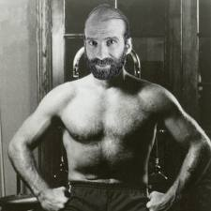
Introduction
Security of transmission is critical for many network and Internet applications
Requires users to share information in a way that others can’t decipher the flow of information
  “It is insufficient to protect ourselves with laws; we need to protect ourselves with mathematics.”
  -Bruce Schneier

Slide 11

Chuck Norris Facts
When Alexander Graham Bell invented the telephone he had three missed calls from Chuck Norris.
Chuck Norris went skydiving and his parachute failed to open, so he took it back the next day for a refund.
Chuck Norris has a grizzly bear carpet in his room — the bear isn’t dead it is just afraid to move.
Chuck Norris counted to infinity. Twice.
Chuck Norris is Darth Vader’s father.
Chuck Norris tells Simon what to do.
When Chuck Norris does a pushup he’s not pushing himself up — he’s pushing the Earth down.
Death once had a near-Chuck-Norris experience.
Chuck Norris knows Victoria’s secret.
Chuck Norris can unscramble eggs.
Chuck Norris and Superman once fought each other on a bet. The loser had to start wearing his underwear on the outside of his pants.

Slide 12

bRUCE sCHNEIER Facts
When Bruce Schneier observes a quantum particle, it remains in the same state until he has finished observing it.
Bruce Schneier once decrypted a box of AlphaBits.
Bruce Schneier knows the state of schroedinger's cat.
The sum of the ASCII values of the characters in Bruce Schneier’s passwords is always a prime number. Their product is too.
Bruce Schneier once factored a prime.
Bruce Schneier assembled assembly...with his bare hands!
A mystery wrapped in an Enigma is no more puzzling to Bruce Schneier than a mystery wrapped in ROT-13.
Bruce Schneier knows your private key.
The nuclear launch codes held by the President of the United States are secured by an unbreakable system: a plain brown envelope with a picture of Bruce Schneier on the flap.

Slide 13
Introduction
The approach is based on the difficulty of computing discrete logarithms of large numbers.
Requires two large numbers: p, a prime & g, a primitive root of p
p and g are both publicly available numbers (p is at least 512 bits)
Users pick private values a and b
Compute public values
  A = gª mod p
  B = g^{b} mod p

Slide 14
Implementation
Public values A and B are exchanged
Compute shared, private key
  K_{a} = Bª mod p
  K_{b} = A^{b} mod p
Algebraically it can be shown that K = K_{a} = K_{b}
  K = A^{b} mod p = (gª mod p)^{b} mod p = g^{ab} mod p = (g^{b} mod p)ª mod p = Bª mod p
  Users now have a symmetric secret key to encrypt

Slide 15
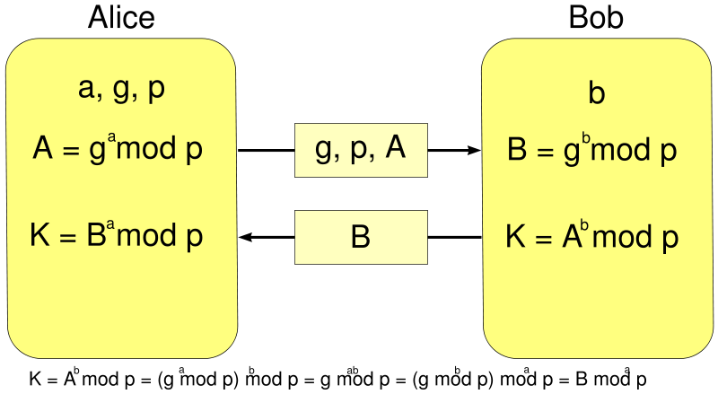
Implementation

Slide 16
Example
Alice and Bob get public numbers
  p = 23, g = 9
They then each pick a secret key
  Alice: 4
  Bob: 3
Alice and Bob compute public values
  A = 9⁴ mod 23 = 6561 mod 23 = 6
  B = 9³ mod 23 = 729 mod 23 = 16

Slide 17
Example
Alice and Bob exchange public numbers
Alice and Bob compute symmetric keys
  K_{a} = Bª mod p = 16⁴ mod 23 = 9
  K_{b} = A^{b} mod p = 6³ mod 23 = 9
Alice and Bob now can talk securely!

Slide 18
Applications
Diffie-Hellman is currently used in many protocols, namely:
  Secure Sockets Layer (SSL)/Transport Layer Security (TLS)
  Secure Shell (SSH)
  Internet Protocol Security (IPSec)
  Public Key Infrastructure (PKI)

Slide 19
Conclusion
Authenticated Diffie-Hellman Key Agreement (1992)
  Defeats middleperson attack
Diffie-Hellman POP Algorithm
  Enhances IPSec layer
Diffie-Hellman continues to play large role in secure protocol creation

Slide 20
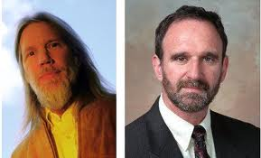

Slide 21
Next Time
More encryption

