Slide 1
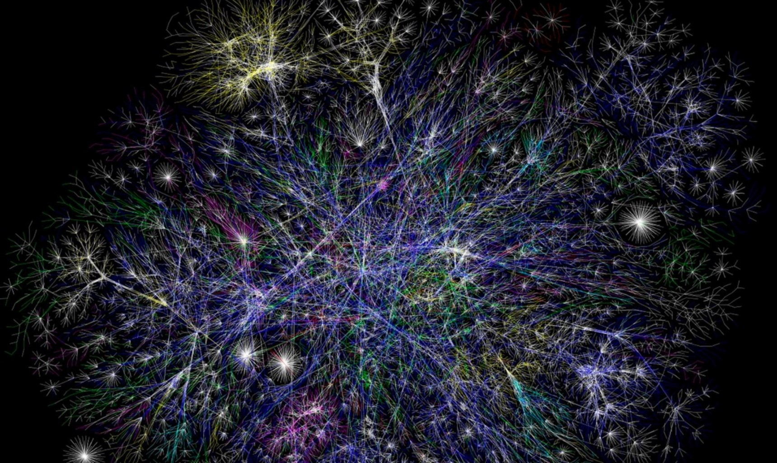
World
Wide
Web

Slide 2
ALERT
Assignment 8 is available on Brightspace and due next Wednesday.
Midterm II is next Wednesday
  Review is Monday

Slide 3
Ted Talks on Internet trends
Andrew Blum
Eli Pariser
Kevin Slavin

