Slide 1
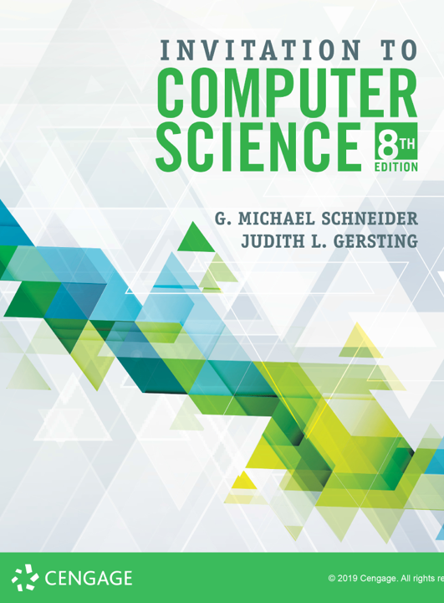
Artificial Intelligence

Slide 2
ALERTS
Lab 17 due Monday
Assignment #8 due today
Final Exam
Thursday, 12/12 at 8am
Final Exam Review next Friday

Slide 3
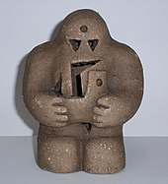
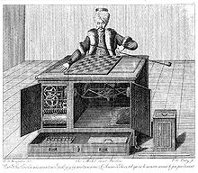
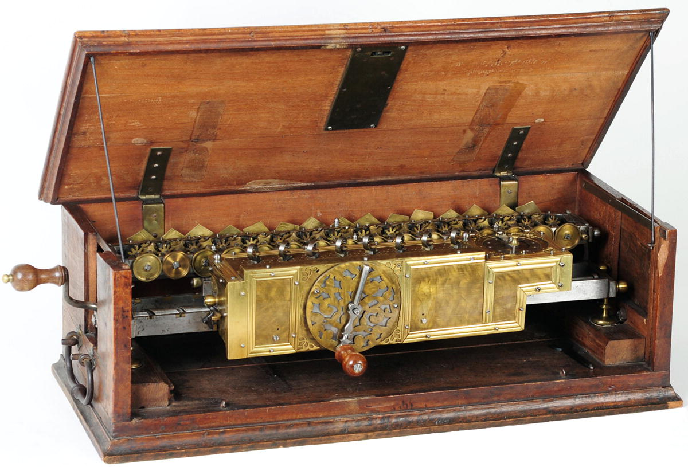
Machine Intelligence
AI can trace its roots back to medieval Jewish mysticism and the Rennaisance
The mythology of the ‘golem’
Kempelen’s Chess Automaton
Da Vinci’s Robot
Leibniz’ Calculus of Thought

Slide 4
Alan Turing
1950: “Computing Machinery & Intelligence”
The Turing Test
Loebner Prize
The Arguments (objections)
Theological
“Heads in the sand”
Mathematical
Consciousness
Various Disabilities
Lady Lovelace (learning)
Continuity (in the nervous system)
Informality of behavior
Extra-sensory perception (ESP)
Bottom Line: The TT is the best flawed measure available
Read: A Coffeehouse Conversation on the Turing Test, by Douglas Hofstadter (see website)

Slide 5
Origins
Dartmouth College, 1956, Hanover, New Hampshire
Two month, ten participant conference
“The study is to proceed on the basis of the conjecture that every aspect of learning or any other feature of intelligence can in principle be so precisely described that a machine can be made to simulate it. An attempt will be made to find how to make machines use language, form abstractions and concepts, solve kinds of problems now reserved for humans, and improve themselves.”
John McCarthy, Dartmouth (coined AI, invented LISP, Stanford AI Lab)
Marvin Minsky, Harvard (co-founded MIT AI Lab w/McCarthy)
Claude Shannon, MIT (father of Information Theory)
Herbert Simon, CMU (Economics Nobel; also won Turing)
Allen Newell, CMU (The Logic Theorist; General Problem Solver)
Arthur Samuel, IBM (1st Checkers AI, machine learning, Stanford)

Slide 6
Approaches
Symbolic AI: knowledge represented explicitly as statements of predicate logic (or equiv) along with semantic structural relationships
Facts, rules, inference engines
Expert systems
LISP, Prolog
Neural Networks
‘Bottom-up’ approach alternative to ‘top-down’ symbolic
Inspired by neuro-science (loose abstraction)
Some similarities with Turing Machines as a computational model
Bayesian Reasoning
Google, Big Data, Data Science
Uses probabilities observed at large scales to find patterns

Slide 7
Ambiguity
Acoustic/Phonetic:
It’ll cost you a nominal egg.
Morphological/Syntactic
I saw the Golden Gate Bridge flying into San Francisco.
Can companies litter the environment (. or ?)
The chickens are ready to eat.
Time flies like an arrow.
Semantic/Pragmatic
The grounds are excellent.
Stay away from the bank.
Jack went to the store. He found milk in aisle 3. He paid for it and left.
I ate pasta with a friend.
I ate pasta with a fork.
I ate pasta with marinara.

Slide 8
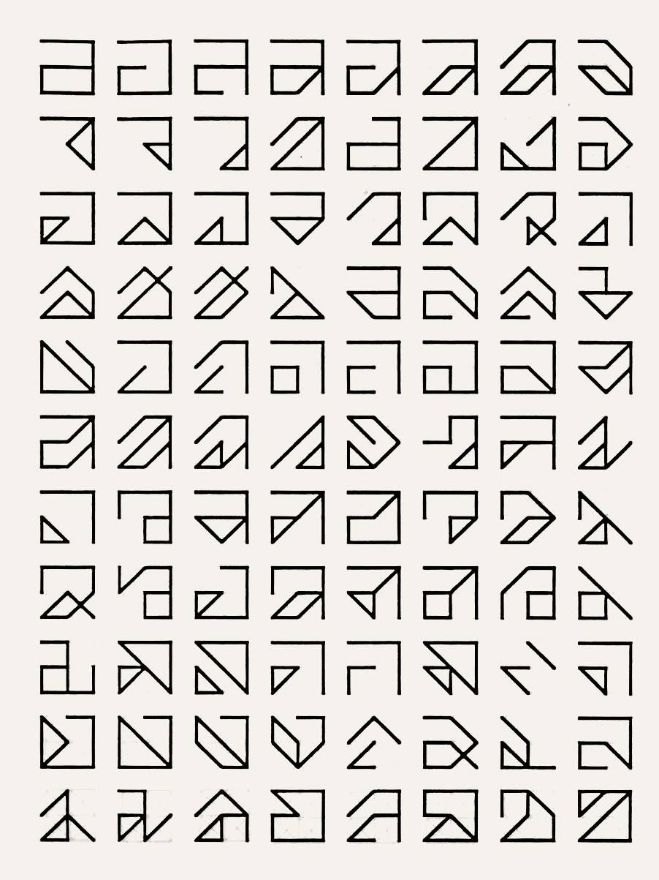
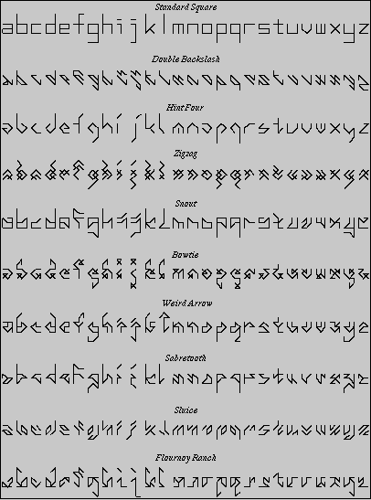
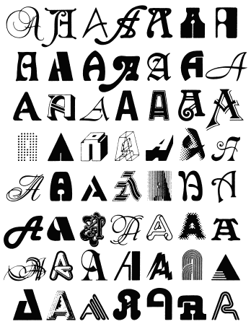
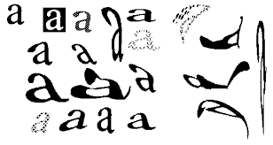
Letter Spirit (Dougles Hofstadter)

Slide 9
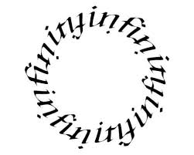
Letter Spirit Ambigrams

Slide 10
Objections
Hubert Dreyfus
What Computers Can’t Do
John Searle
The Chinese Room
Computers lack understanding even if they pass the TT
Roger Penrose
Based on Gödel’s Incompleteness, argues that human thought is inherently non-algorithmic
Thoughts are quantum phenomena that emerge via micro-tubules in the structure of neurons

Slide 11
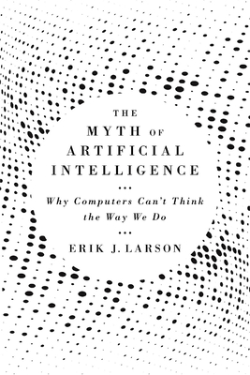
Objections
Erik J. Larson
The Myth of Artificial Intelligence: Why Computers Can't Think the Way We Do
Computer approaches to AI are based on deductive and inductive inference, but human intelligence also heavily relies on abductive inference

