Slide 1
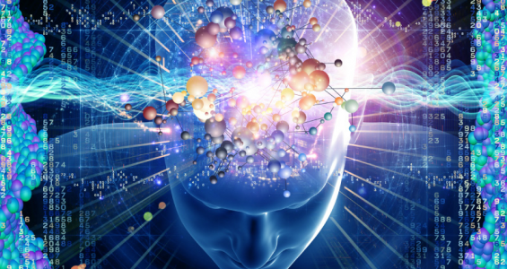
Thinking & Computation
COMP1500
David J Stucki

Slide 2
ALERTS
Assignment #8 due next Monday
Lab 16 due Friday
Lab 17 due a week from Monday
Final Exam
  December 12 @ 8am
Final Exam Review Friday, 12/6

Slide 3
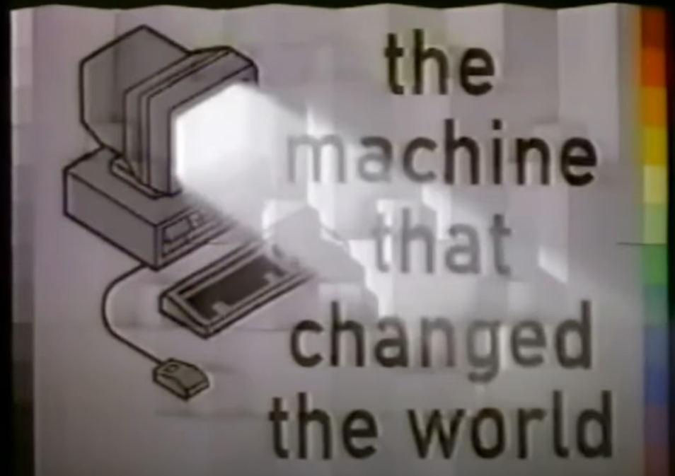
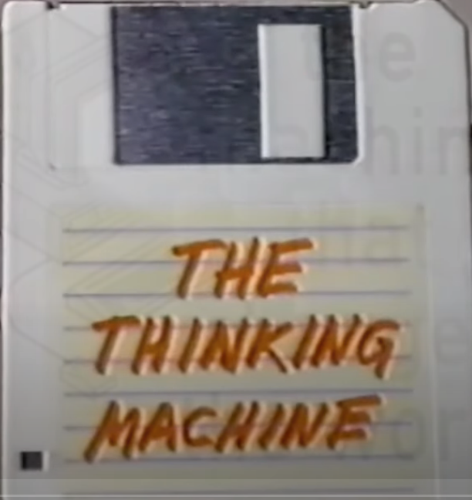
TMTCTW “The Thinking Machine”
https://youtu.be/enWWlx7-t0k
Discussion?

Slide 4
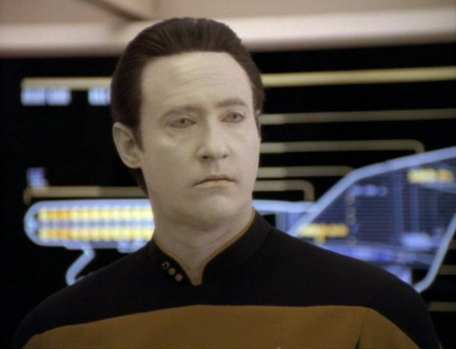
ST:TNG “Sentient Being”
https://www.youtube.com/watch?v=vjuQRCG_sUw
Discussion?

Slide 5
SyMBoLIc
REPRESENTaTIoN
“When some thing is allowed to stand for another”
  What does this mean?
Examples
  Corporate Logos Flags Mathematics
  Road Signs Music Facial Expressions
  Language Mascots Art
    Others?
Every aspect of human culture relies on the power of symbolic representation:
  Communication Education Business/Commerce
  History Government Technology
    Others?

Slide 6
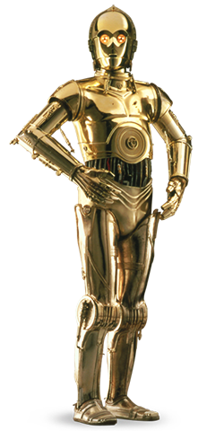

ABSTRacTIoN
A process of simplification that proceeds by
ignoring irrelevant detail while focusing on
what is important
One of the fundamental concepts in
computer science
It is itself a by-product of symbolic representation,
since symbols allow abstraction to take place
A road sign serves only as a compact
abstraction of the law

Slide 7
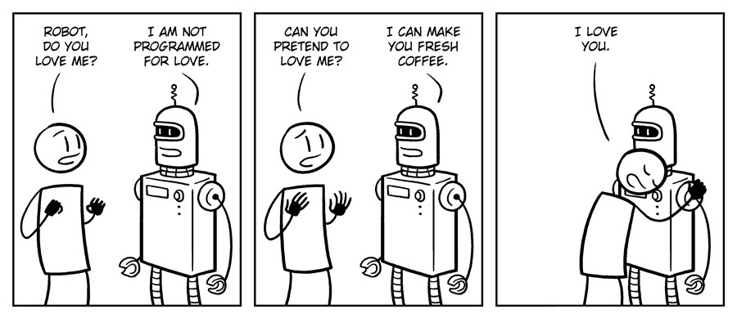
THoUgHT
Without symbolic representation would these be possible?
  Imagination
  Creativity
  Love
  Faith
  Thought
In other words, symbolic representation appears to be central to what it means to be human…

Slide 8
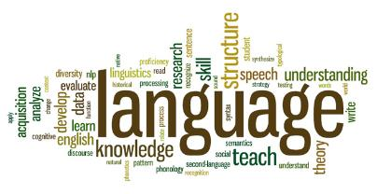
Perhaps the most important, and certainly one of the most sophisticated forms of symbolic representation
  Phonology : Sound, Stress, & Intonation
  Syntax : Structure or Form
  Semantics : Meaning
  Pragmatics : Use or Intention
Since the dawn of recorded history, until the middle of the 20th century, symbolic representation & language have been artifacts of living creatures, most notably humans.
Only recently has this monopoly been broken….

Slide 9
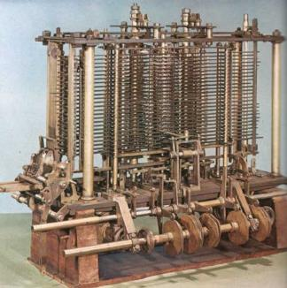
CoMPUTaTIoN
Machines historically have been designed with a specific purpose, which they are then dedicated to for as long as they function.
It wasn’t until Charles Babbage and Ada Lovelace worked on the Analytic Engine in the 1830s that this changed.
The Analytical Engine represents the simultaneous birth of general purpose computing and programming!
Unfortunately, it would be another 100 years
before Alan Turing would resurrect this idea
Today there are almost as many artificial
computer languages as there are natural
human languages.

Slide 10
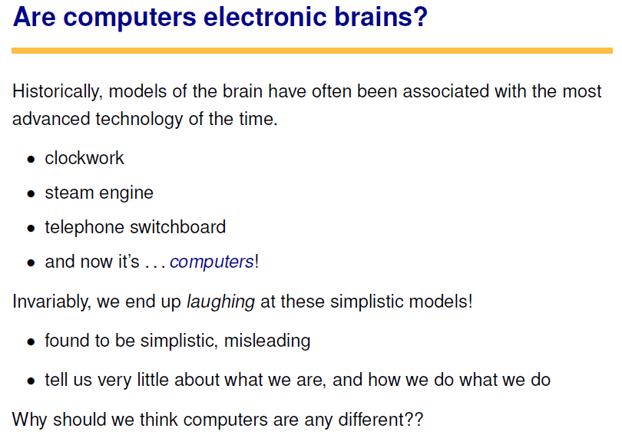

Slide 11
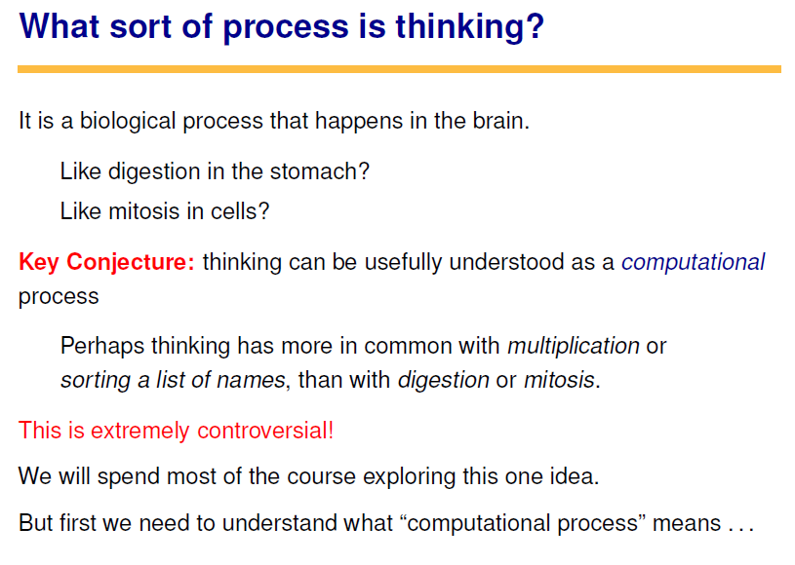

Slide 12
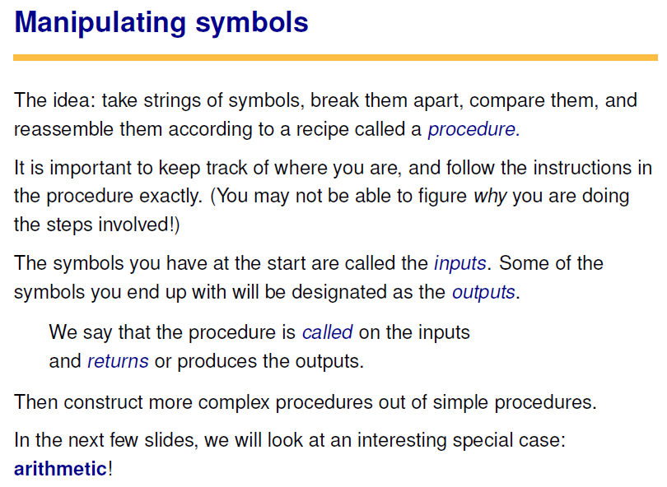


Slide 13
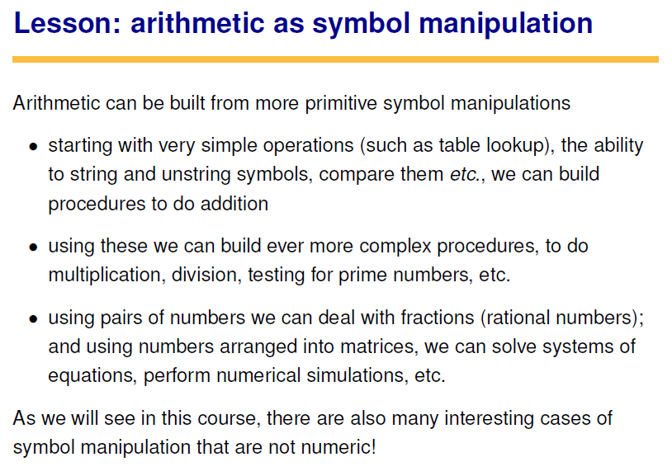

Slide 14
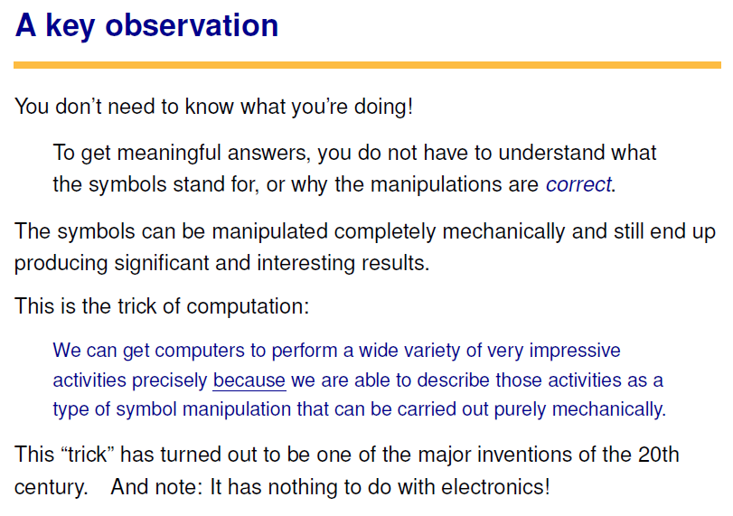

Slide 15
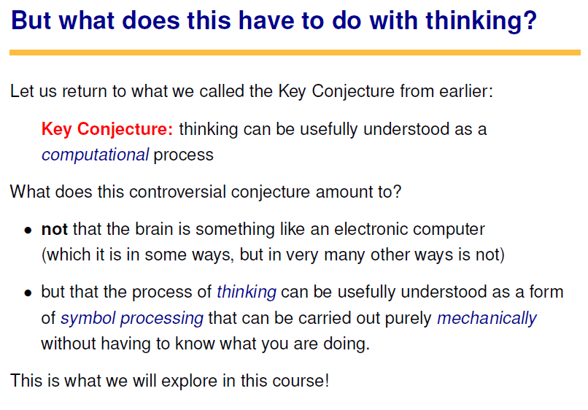

Slide 16
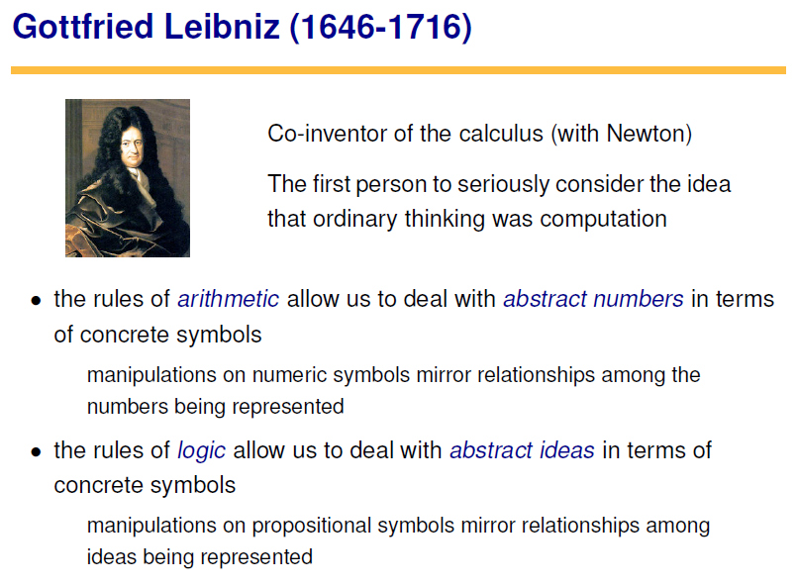

Slide 17
Artificial Intelligence
Synthetic
Artificial
“The exciting new effort to make computers think…machines with minds, in the full and literal sense” (Haugeland, 1985)
“The study of mental faculties through the use of computational models”
(Charniak and McDermott, 1985)
Cognitive
“[The automation of] activities that we associate with human thinking, activities such as decision-making, problem solving, learning...” (Bellman, 1978)
“The study of the computations that make it possible to perceive, reason, and act” (Winston, 1992)
“The art of creating machines that perform functions that require intelligence when performed by people”
(Kurzweil, 1990)
“A field of study that seeks to explain and emulate intelligent behavior in terms of computational processes.”
(Schalkoff, 1990)
Behavioral
“The study of how to make computers do things at which, at the moment, people are better” (Rich and Knight, 1991)
“The branch of computer science that is concerned with the automation of intelligent behavior”
(Luger and Stubblefield, 1993)
Engineering
Science

Slide 18
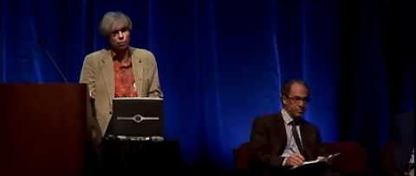
HOFSTADTER & KURZWEIL
“If you read Ray Kurzweil’s books … what I find is that it’s a very bizarre mixture of ideas that are solid and good with ideas that are crazy. It’s as if you took a lot of very good food and some dog excrement and blended it all up so that you can’t possibly figure out what’s good or bad.” –Douglas Hofstader

Slide 19
The Human Mind is Never Blank
If it were,
how would you know?

