Slide 1
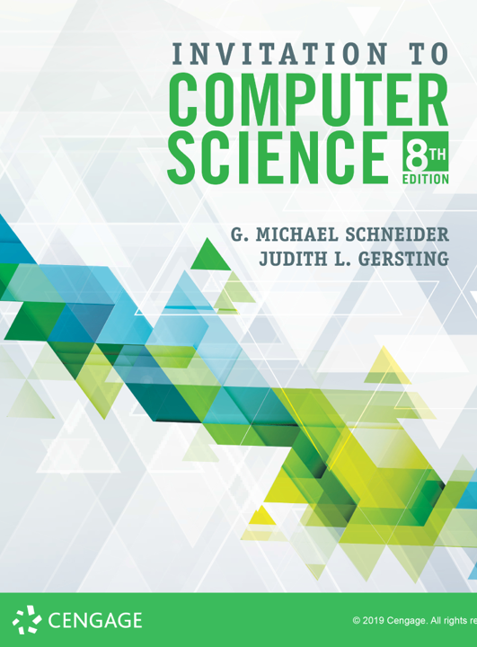
The Limits of Computation

Slide 2
ALERTS
Homework 8 available on Brightspace and the course website
Due November 25
Lab 16 available on Brightspace.
Due November 22
Lab 17 available on Brightspace
Due December 2

Slide 3
The Nature of Computation
Last week with compilers and language translation we finally came full circle in our study of computers
We can now express algorithms as virtual machines, also known as programs.
Computer science from here is built up as a complex infrastructure of virtual machines running on virtual machines
How can we continue to higher levels of abstraction?
Last time we saw Turing machines as one option
Consider this schematic of a hierarchy of abstractions...

Slide 4
Abstraction Hierarchy
Ideal Realm (à la Plato)
:
Mathematical Notation
Algorithms
Programming Languages
Assembly Languages
Machine Languages
Microcode
“The GAP”
Von Neumann Machine
Functional Components
Digital Circuits
Electronic Devices
:
Physical Reality

Slide 5
The Limits of Computation
Why did Alan Turing write his paper in the 1st place?
What are the limits of computation?
Claim: Any algorithm can be written as a Java program.
True? False?
But what if there were problems for which no algorithm could exist?
Are there unsolvable problems?
How could we know?
This is what Turing was after in the 1930s
Let’s understand historically why this was important...

Slide 6
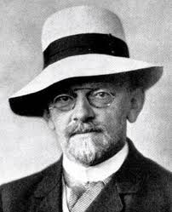
David Hilbert
At the 2nd International Congress of Mathematicians in Paris in 1900, he enumerated 23 open problems in mathematics that he claimed should be the focus of research in the 20th century
Who among us would not be happy to lift the veil behind which is hidden the future; to gaze at the coming developments of our science and at the secrets of its development in the centuries to come? What will be the ends toward which the spirit of future generations of mathematicians will tend? What methods, what new facts will the new century reveal in the vast and rich field of mathematical thought?
These questions did in fact become the roadmap

Slide 7
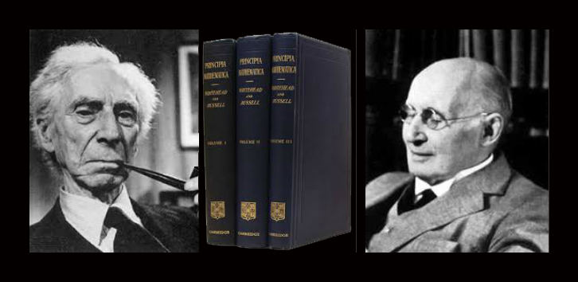
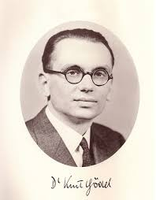
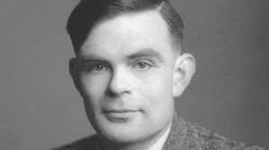
The Foundations of Computing
Russell & Whitehead (1910-1913)
Can mathematics be grounded in logic?
Kurt Gödel (1931)
Incompleteness Theorems
Alan Turing (1936)
Computable Numbers

Slide 8
The Church-Turing Thesis
In the 1930s & 1940s there were several others working simultaneously on models of computation
Emil Post: Production Systems
John von Neumann: RAM Machines
Andrey Markov: Markov Chains
Alonzo Church: Lambda Calculus
Stanislaw Ulam: Cellular Automata
McCulloch & Pitts: Neural Networks
and others...
Church-Turing Thesis: if there is an algorithm that performs a symbol manipulation task, then there is a Turing Machine that also performs the task

Slide 9
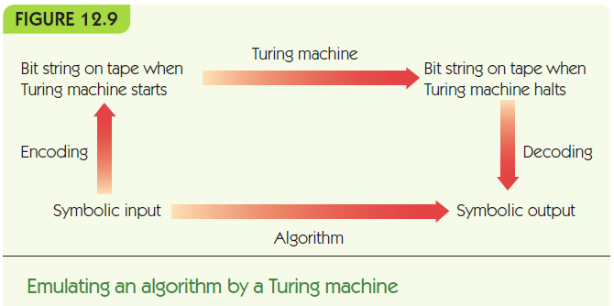
The Church-Turing Thesis

Slide 10
The Church-Turing Thesis
Turing machines define the limits of what can be computed: computability
If a problem cannot be solved by a Turing machine, then it cannot be solved algorithmically
It is incomputable or unsolvable

Slide 11
The Church-Turing Thesis
Some Turing machines may not halt when given inappropriate input
Example: If input is consists of a single 1, what happens?
(1, 1, 0, 2, R)
(1, 0, 1, 2, R)
(2, b, b, 2, L)
(2, 0, 0, 2, R)
… | b | 1 (1) | b | b | …
… | b | 0 | b (2) | b | …
… | b | 0 (2) | b | b | …
… | b | 0 | b (2) | b | …
… | b | 0 (2) | b | b | …
… | b | 0 | b (2) | b | …

Slide 12
The Halting Problem
Given a Turing machine program and an input tape is it possible to tell whether the machine will halt on that tape?
Surprisingly, the answer is NO, the halting problem is unsolvable.
It can be proven mathematically; in fact Turing did exactly that in his 1936 paper.
It is a proof by contradiction, similar in structure to the Incompleteness proofs of Gödel five years earlier.

Slide 13
The Halting Problem
The textbook has an overview of the proof, but I find this to be easier to understand:
Java version of the Halting Problem

