Slide 1
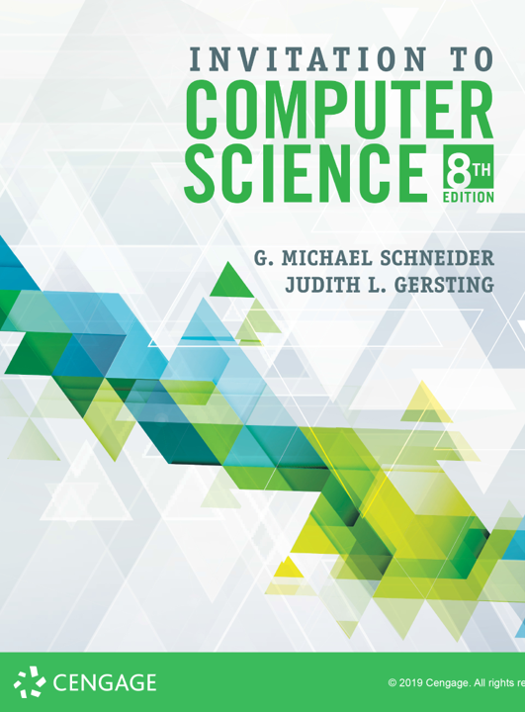
Turing Machines

Slide 2
ALERTS
Lab 16 available on Brightspace.
Due Friday, November 22
Homework 8 is available on Brightspace and the course website
Due Monday, November 25

Slide 3
Where have we been?
What is computer science?
What is an algorithm?
Transistors, Gates, Circuits, Binary Representations
Adders, Multiplexors, Decoders
Von Neumann architecture: CPU, RAM, I/O
Machine Language
Assembly Language (and assemblers)
Operating Systems & Networks
High Level Languages (and compilers)
Algorithms: we’ve come full circle...

Slide 4
A Model of a Computing Agent
What are key features of a computing agent?
Read input data
Store and retrieve information in memory
Perform instructions based on current input and current state
Output results

Slide 5
A Model of a Computing Agent
Turing machine: a model of a computing agent
Has a tape, infinite in both directions
Each cell of the tape holds one symbol
Tape alphabet: finite set of symbols for tape
Tape holds input and memory
Has finite number of internal states, 1 to k
Instructions for machine:
Examine current tape symbol and current state
Write new tape symbol, change state, and move left or right one cell

Slide 6
A Model of a Computing Agent

Slide 7
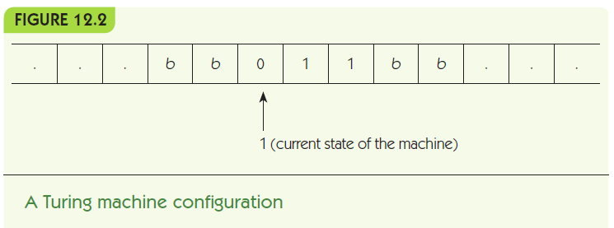
A Model of a Computing Agent

Slide 8
A Model of a Computing Agent
Turing machine instructions
if (in state S) and (reading symbol X) then
write symbol Y onto tape
change to state T
move in direction D
Encode this in concise terms:
(S, X, Y, T, D)

Slide 9
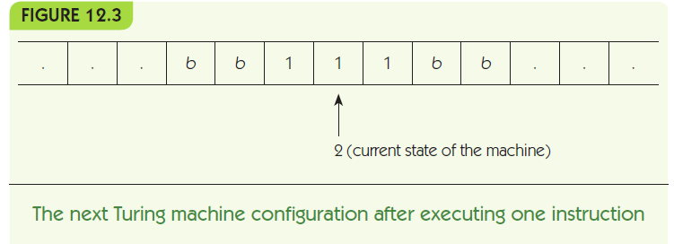
A Model of a Computing Agent
Example:
(1, 0, 1, 2, right)
if (state=1) and (input=0)
write 1
change into state 2
move right

Slide 10
A Model of a Computing Agent
Turing machine program: a set of rules
First state is always 1
Machine always starts reading leftmost symbol in the input
Avoid ambiguity
No two rules with same state and input
If no rule applies, machine halts

Slide 11
A Model of a Computing Agent
A Turing machine is a good model of a computing agent:
It reads input from its tape
It uses its tape as a memory and can read and write it
It takes actions based on its state and its input
It can produce output, on its tape

Slide 12
A Model of an Algorithm
A model of an algorithm must
Be a well-ordered collection
Consist of unambiguous and effectively computable operations
Halt in a finite amount of time
Produce a result
Is a Turing machine program a model of an algorithm?

Slide 13
A Model of an Algorithm
Be a well-ordered collection
The starting state and position on the tape are well-defined
At most one rule can match a given state and position
It is well defined what happens if no rule matches
A Turing machine knows where to start, and what step to do next

Slide 14
A Model of an Algorithm
Consist of unambiguous and effectively computable operations
Turing machine instructions completely specify what the machine must do
Turing machine instructions cannot be ambiguous
Halt in a finite amount of time
Turing machines can go into infinite loops, like poor attempts at algorithms
We can ensure halting for inputs within the scope of the problem

Slide 15
A Model of an Algorithm
Produce a result
The contents of the tape when the Turing machine halts are the output
Thus a Turing machine program is a good model of an algorithm!

Slide 16
Turing Machine Examples
Examples to show what Turing machines can do:
Bit inverter
Parity Bit
Unary Increment
Unary Addition
Note: a state diagram is a visual representation of a Turing machine algorithm

Slide 17
Turing Machine Examples
Bit inverter:
Given a string of 0s and 1s, change every 0 to a 1 and every 1 to a 0
Algorithm idea: move right, flipping each bit as it goes, and stop when you reach a blank
Include no rule that responds to a blank symbol, and the machine must stop when input ends

Slide 18
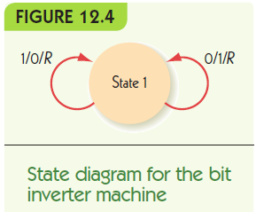
Turing Machine Examples
Rules:
(1, 1, 0, 1, R)
(1, 0, 1, 1, R)

Slide 19
Turing Machine Examples
Bit inverter example:
Each row shows contents of tape after a move
Head position is in shaded cell, always in state 1
… | b | 1 | 0 | 0 | 1 | b | …
… | b | 0 | 0 | 0 | 1 | b | …
… | b | 0 | 1 | 0 | 1 | b | …
… | b | 0 | 1 | 1 | 1 | b | …
… | b | 0 | 1 | 1 | 0 | b | …

Slide 20
Turing Machine Examples
Parity Bit Problem:
Given a string of 0s and 1s,
Count whether the number of 1s is even or odd
If it is even, add a 1 to the end of the string
Else add a 0 to the end of the string
Algorithm idea:
State 1 represents even parity so far
State 2 represents odd parity so far
Reading 0 doesn’t change the state
Reading 1 changes from state 1 to 2 and vice versa

Slide 21
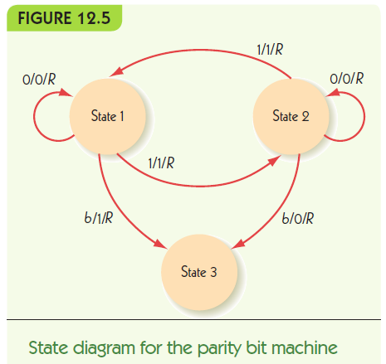
Turing Machine Examples
Rules:
(1, 0, 0, 1, R)
(1, 1, 1, 2, R)
(2, 0, 0, 2, R)
(2, 1, 1, 1, R)
(1, b, 1, 3, R)
(2, b, 0, 3, R)

Slide 22
Turing Machine Examples
Parity Bit example:
Each row shows contents of tape after a move
Head position is in shaded cell, state in parentheses
… | b | 1 (1) | 0 | 0 | 1 | b | b | …
… | b | 1 | 0 (2) | 0 | 1 | b | b | …
… | b | 1 | 0 | 0 (2) | 1 | b | b | …
… | b | 1 | 0 | 0 | 1 (2) | b | b | …
… | b | 1 | 0 | 0 | 1 | b (1) | b | …
… | b | 1 | 0 | 0 | 1 | 1 | b (3) | …

Slide 23
Turing Machine Examples
Unary Incrementing
Given a unary representation of a number n,
Change the tape to represent n+1
Unary representation: uses one symbol
0 = 1
1 = 11
2 = 111
3 = 1111
Algorithm idea: move to the right end and add a 1

Slide 24
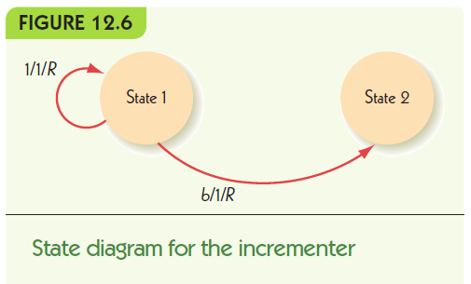
Turing Machine Examples
Rules:
(1, 1, 1, 1, R)
(1, b, 1, 2, R)

Slide 25
Turing Machine Examples
Unary Increment example:
Each row shows contents of tape after a move
Head position is in shaded cells, state in parentheses
… | b | 1 (1) | 1 | 1 | 1 | b | b | …
… | b | 1 | 1 (1) | 1 | 1 | b | b | …
… | b | 1 | 1 | 1 (1) | 1 | b | b | …
… | b | 1 | 1 | 1 | 1 (1) | b | b | …
… | b | 1 | 1 | 1 | 1 | b (1) | b | …
… | b | 1 | 1 | 1 | 1 | 1 | b (2) | …

Slide 26
Turing Machine Examples
Alternative algorithm:
Move left to a blank and add a 1 there
Rules:
(1, 1, 1, 1, L)
(1, b, 1, 2, L)
… | b | b | 1 (1) | 1 | 1 | 1 | b | …
… | b | b (1) | 1 | 1 | 1 | 1 | b | …
… | b (2) | 1 | 1 | 1 | 1 | 1 | b | …

Slide 27
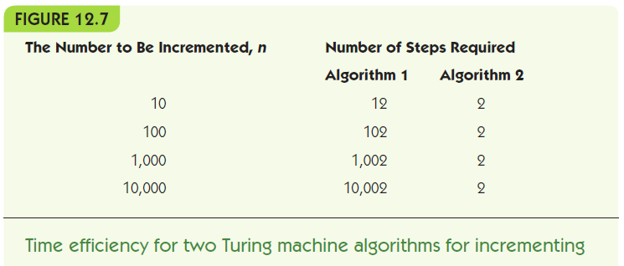
Turing Machine Examples
Algorithm 1 efficiency: length of input plus 2
Algorithm 2 efficiency: exactly 2 steps

Slide 28
Turing Machine Examples
Unary Addition
Given a unary representation of two numbers n and m, separated by one blank on the tape,
Change the tape to represent n+m
Algorithm idea:
Erase leftmost 1
Erase second-to-left 1
Find blank in the middle
Change it to a one

Slide 29
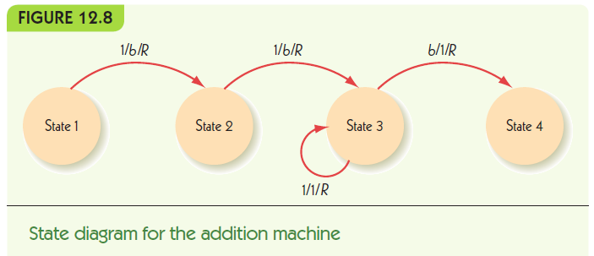
Turing Machine Examples
Rules:
(1, 1, b, 2, R) (3, 1, 1, 3, R)
(2, 1, b, 3, R) (3, g, 1, 4, R)

