Slide 1
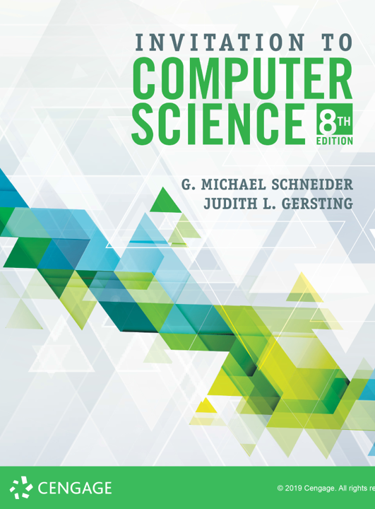
Language Translation

Slide 2
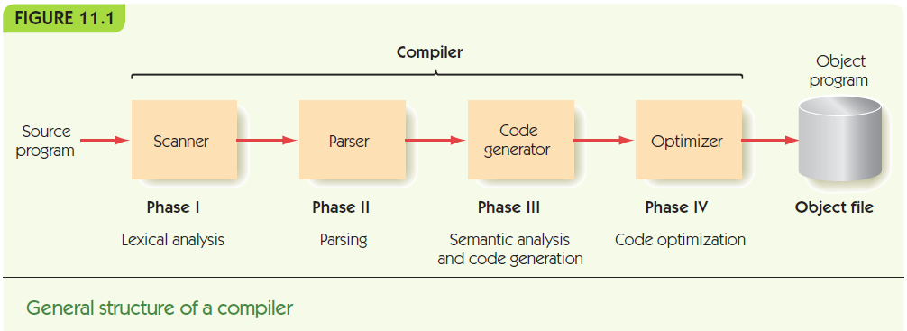
The Compilation Process (continued)

Slide 3
Approach
Lexical analysis: transform the sequence of characters into a sequence of tokens
Syntactic analysis: transform the sequence of tokens into a parse tree
Semantic analysis: transform the parse tree into an abstract representation of the computation
Code generation: transform the abstract representation into a machine language equivalent
Optimization: reorganize the machine language code to run faster and leaner

Slide 4
Phase III: Semantics and Code Generation
Syntax is structure. Semantics is meaning.
Correct syntax, correct semantics
She lit a candle.
<pronoun> <verb> <article> <noun>
Correct syntax, incorrect semantics
She ate a skyscraper.
<pronoun> <verb> <article> <noun>

Slide 5
Phase III: Semantics and Code Generation
Semantic analysis
Verify that the program is not just grammatically correct (it parses properly into a parse tree) but that it is also sensible!
Grammatical statements can be meaningless
A kiwi embarrassed the asparagus.
Colorless green ideas sleep furiously.
Java example:
boolean b = false;
int i = 15;
char c = 'f';
double d = b + i * c;

Slide 6
Phase III: Semantics and Code Generation
Semantic records
Store information about actual values associated with nonterminals
In other words, the symbol table must include more information than the assembler had to:
variable types
variable scope
variable token string
etc.
Ensures program is type safe & modular

Slide 7
Phase III: Semantics and Code Generation
Examples of semantic errors in programs
Using a variable that has not been defined
Mismatch of operand types a = 15 / "hello"
Mismatch of parameter types b = squareroot("hello")

Slide 8
Phase III: Semantics and Code Generation
There are many other syntactical elements of a language that can’t be captured by BNF
“define before use” rules
finitary constraints (numeric upper bounds, string length, etc.)
type checking
logical dependencies

Slide 9
Phase III: Semantics and Code Generation
What a program does is more abstract than the code:
if (height > 72) {
ideal = 2 * height + 30;
} else {
ideal = 3 * height + 12;
}
if height > 72 then begin
ideal := 2 * height + 30
end else begin
ideal := 3 * height + 12
end;

Slide 10
Phase III: Semantics and Code Generation
Code generation
Translate abstract representation to assembly code
Code is produced by traversing the parse tree, applying standard translations along the way
Can build semantic records as it goes
In some languages, such as Java, the machine code is for a virtual machine
The Java compiler produces bytecode defined by the Java Virtual Machine (JVM)
The JVM is required at runtime to make the final translation as the program is running

Slide 11
Phase III: Semantics and Code Generation
x = y + z
Transition from: <variable> = <variable> + <variable>
to: <variable> = <expression>
produces the code: load y
add z
Transition from: <variable> = <expression>
to: <assignment statement>
produces the code: store x

Slide 12
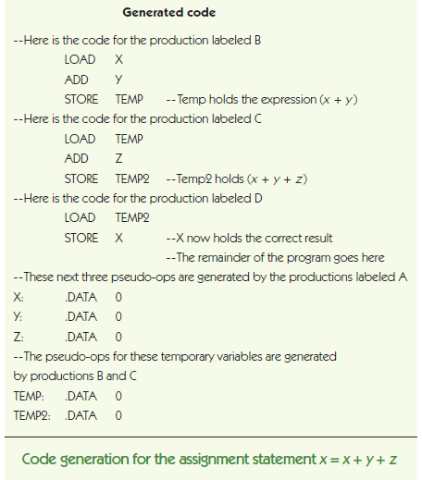
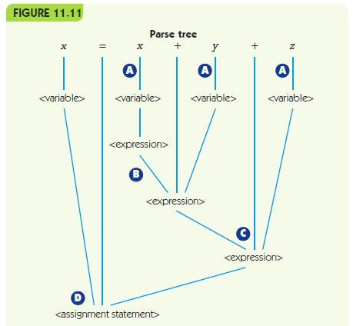

Slide 13
Phase IV: Code Optimization
Code optimization
Improving the time or space efficiency of code produced by a compiler
Early days:
“Hardware is expensive, programmers are cheap”
Humans could write more optimal code than a compiler
These days:
“Hardware is cheap, programmers are expensive”

Slide 14
Phase IV: Code Optimization
Modern compilers optimize, but focus on other issues:
Visual development environments help programmers see what is happening
Online debuggers help find and correct bugs
Reusable code libraries and toolkits

Slide 15
Phase IV: Code Optimization
Local optimization
Examine small chunks of assembly code (< 5 instructions)
Constant evaluation, compute arithmetic expressions at compile-time if possible
Strength reduction, use faster arithmetic alternatives (e.g., 2 * x is equivalent to x + x)
Eliminating unnecessary operations, remove operations that are unneeded, like a LOAD of a value already in memory

Slide 16
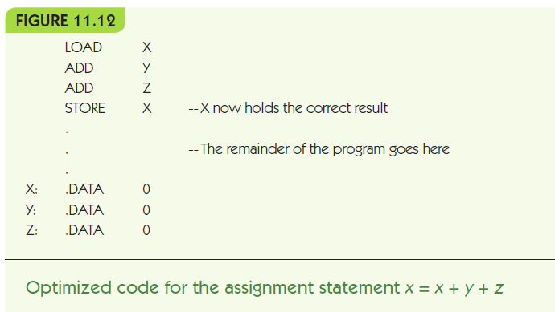
The Compilation Process Phase IV: Code Optimization (continued)

Slide 17
Phase IV: Code Optimization
Global optimization
Looks at large segments of the program
Blocks like while loops, if statements, and procedures
Much more difficult, much bigger effect!
Optimization cannot overcome an inefficient algorithm

