Slide 1
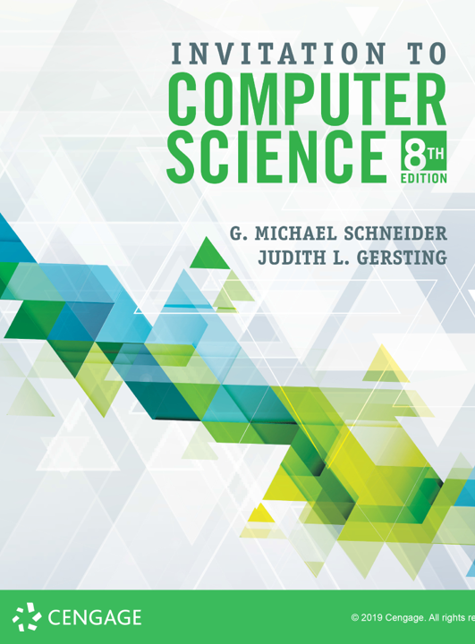
Programming Language Translation

Slide 2
Program
What is a program?
We’ve had several competing definitions over the last week... Can you reiterate any of them?
But today we are interested in answering the question from the perspective of language translation:
A program is a sequence of characters
How can we translate Java or Python into machine language?
The outline on the next few slides gives a general overview, although (once again) the actual story is more complex than the version we will consider

Slide 3
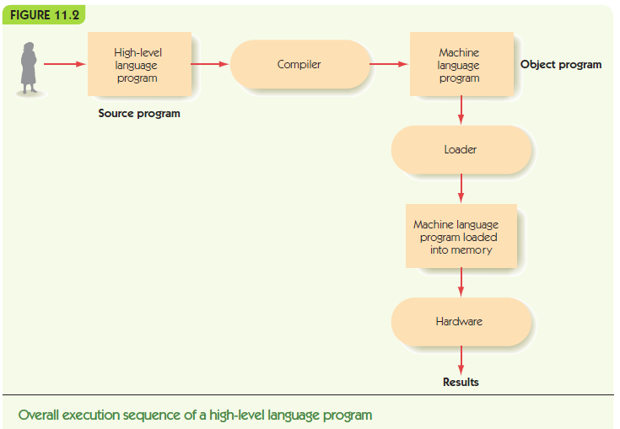

Slide 4
Compilers & Interpreters
A compiler translates source code all at once into machine language, saving the object code as an executable file
An interpreter translates the source code “on the fly” while simultaneously executing it, discarding the translation after it is executed
Many languages use a hybrid approach
Java: JVM—Java Virtual Machine
.NET: CLR—Common Language Runtime

Slide 5
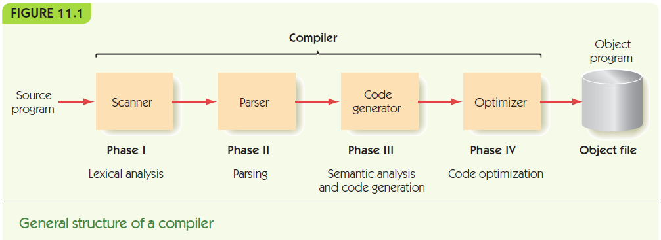
The Compilation Process

Slide 6
Approach
Lexical analysis: transform the sequence of characters into a sequence of tokens
Syntactic analysis: transform the sequence of tokens into a parse tree
Semantic analysis: transform the parse tree into an abstract representation of the computation
Code generation: transform the abstract representation into a machine language equivalent
Optimization: reorganize the machine language code to run faster and leaner

Slide 7
Phase I: Lexical Analysis
A Lexical analyzer or scanner
Groups input characters into tokens
Discards unneeded characters
E.g., blanks, tabs, comment text
Determines the type of each token
E.g., symbol, number, left parenthesis
Tokens are the smallest syntactic units that carry meaning within the language

Slide 8
Phase I: Lexical Analysis
There are 5 categories of tokens
Identifiers: names, variables, symbols, functions, classes
Keywords/reserved words
Literals
Operators
Separators
During tokenization the lexical analyzer also builds a symbol table & generates syntax error messages (similar to the 1st pass of the assembler)

Slide 9
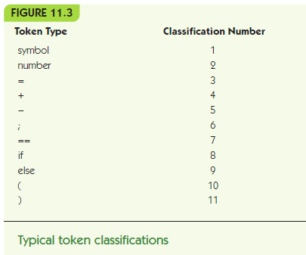
Phase I: Lexical Analysis

Slide 10
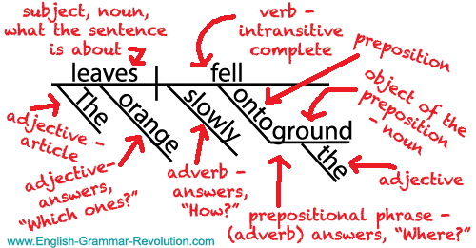
Phase II: Parsing
Just identifying words doesn’t mean you understand a language: you also have to know its grammar!!
Bicycle the rode brother sister past fast my my.
A grammar defines the language’s structure
A valid program can be generated from the grammar
Recall diagramming sentences?

Slide 11
Phase II: Parsing
A parser takes a list of tokens and
Determines grammatical structure
Diagrams the program, building a parse tree
Syntax = grammatical structure
Syntax is defined by rules (productions)
BNF (Backus-Naur Form) is notation for describing rules
A grammar is the set of rules that define a language

Slide 12
Phase II: Parsing
BNF
Rules:
left-hand side ::= right-hand side
<sentence> ::= <subject> <verb> <object>
Left-hand side: grammatical category
Right-hand side:
pattern that captures the structure of category

Slide 13
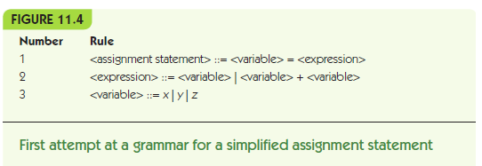
Phase II: Parsing

Slide 14
Phase II: Parsing
BNF
Patterns made from terminals and nonterminals
Terminals = tokens from lexical analyzer
Nonterminals = grammatical categories
Written in <angle brackets> or italics
Start symbol (or goal symbol)
Nonterminal that begins process (generation)
Signals grammatical program is found (recognition)
Metasymbols: <, >, ::=, |, Λ
Λ (lambda) is null string = emptiness [also ε]

Slide 15
Phase II: Parsing
BNF Grammar for a subset of English
<sentence> ::= <subject> <verb> <object> <period>
<subject> ::= <noun phrase>
<object> ::= <noun phrase>
<noun phrase> ::= <article> <noun>
<article> ::= a | an | the
<noun> ::= kiwi | asparagus | bib | child
<verb> ::= squashes | embarrassed | burned
<period> ::= .

Slide 16
Phase II: Parsing
“If, by repeated applications of the rules of the grammar, a parser can convert the sequence of input tokens into the goal symbol, then that sequence of tokens is a syntactically valid statement of the language. If it cannot convert the input tokens into the goal symbol, then this is not a syntactically valid statement of the language.”

Slide 17
Phase II: Parsing
<sentence> ::= <subject> <verb> <object> <period>
<subject> ::= <noun phrase>
<object> ::= <noun phrase>
<noun phrase> ::= <article> <noun>
<article> ::= a | an | the
<noun> ::= kiwi | asparagus | bib | child
<verb> ::= squashes | embarrassed | burned
<period> ::= .
The bib embarrassed the child .
| | | | | |
<A> <N> <V> <A> <N> <P>
\ / | \ / |
<NP> | <NP> |
| | | |
<S> | <O> |
\ | | /
<sentence>

Slide 18
Phase II: Parsing
<sentence> ::= <subject> <verb> <object> <period>
<subject> ::= <noun phrase>
<object> ::= <noun phrase>
<noun phrase> ::= <article> <noun>
<article> ::= a | an | the
<noun> ::= kiwi | asparagus | bib | child
<verb> ::= squashes | embarrassed | burned
<period> ::= .
Kiwi a squashed burned an .
| | | | | |
<N> <A> <V> <V> <A> <P>
OOPS!

Slide 19
Phase II: Parsing
Look-ahead parsing algorithms
Look at future tokens to choose the right rule to apply
Allowing for arbitrary-length patterns
x = x + y + z + q + p
Recursive definition: definition includes left-hand term on the right-hand side:
<expression> ::= <expression> + <expression>

Slide 20
Phase II: Parsing
BNF Grammar for a subset of LISP
<start> ::= <s_exp>
<s_exp> ::= <atom> | <list>
<atom> ::= NUMBER | SYMBOL | STRING
<list> ::= ( ) |
( <s_exp_list> ) |
( <s_exp_list> . <s_exp> ) |
\' <s_exp> |
SHARP_QUOTE <s_exp>
<s_exp_list> ::= <s_exp> | <s_exp_list> <s_exp>

Slide 21
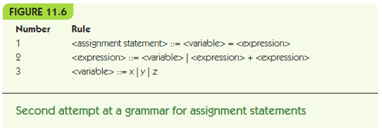
Phase II: Parsing

Slide 22
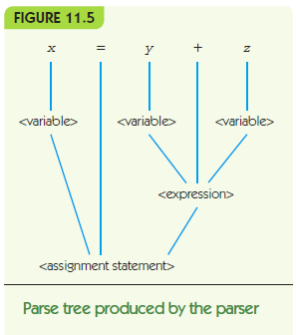
Phase II: Parsing

Slide 23
Phase II: Parsing
Ambiguous: a grammar where the same string can be parsed multiple ways
x = x – y – z means x = (x – y) – z
OR
x = x – y – z means x = x – (y – z)
Grammars must be unambiguous!

Slide 24
Phase II: Parsing
Ambiguous BNF Grammar for a subset of Arithmetic
<expression> ::= <expression> + <expression>
<expression> ::= <expression> * <expression>
<expression> ::= NUMBER | VARIABLE
BNF Grammar for a subset of Arithmetic
<expression> ::= <term> | <expression> + <term>
<term> ::= <factor> | <term> * <factor>
<factor> ::= NUMBER | VARIABLE | (<expression>)

Slide 25
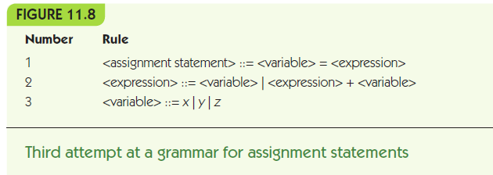
Phase II: Parsing

Slide 26
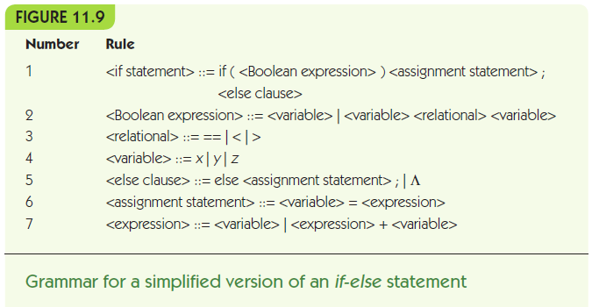
Phase II: Parsing

Slide 27
