Slide 1
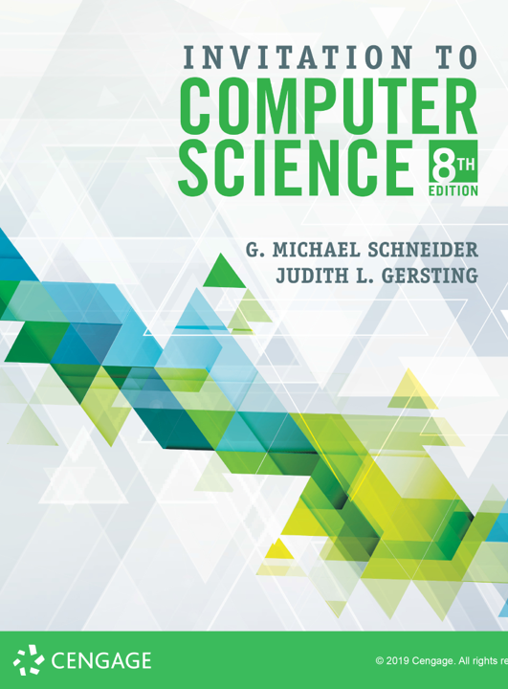
High Level Programming Language: SCHEME

Slide 2
Scheme
One of the oldest high level programming languages, LISP (LISt Processor) was developed in 1958 by John McCarthy as a direct response to the formation of the research area now known as Artificial Intelligence
Scheme is a direct descendent of LISP, created at the MIT AI Media Lab in the 1970s
Today we will look at the simplest elements of Scheme that are directly derived from its LISP ancestry

Slide 3
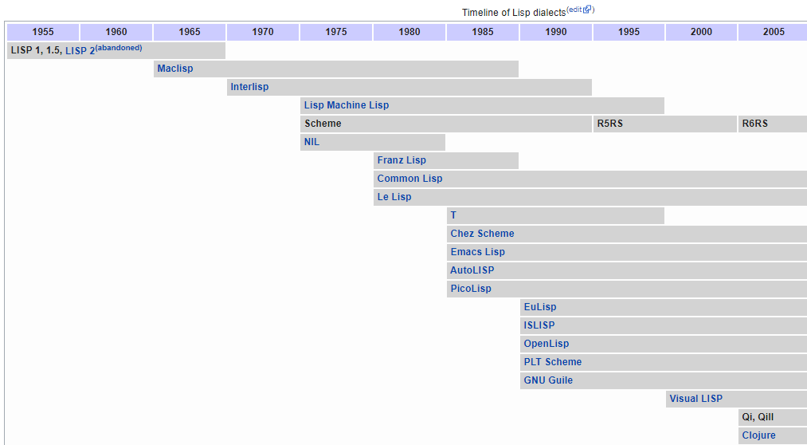
Scheme Timeline

Slide 4
Scheme
Definitions
In Scheme, everything is either a list or an atom
An atom is a literal value or a symbol
literals: 5 3.14 "hello" #t #f null
symbols: x mydata items p315 z_key
A list is a sequence of elements, consisting of either atoms or lists, separated by spaces and delimited by parentheses
lists: (5 12 415) (a b c) (+ 3 4) ((a b) (c d))
Demo: BiwaScheme

