Slide 1
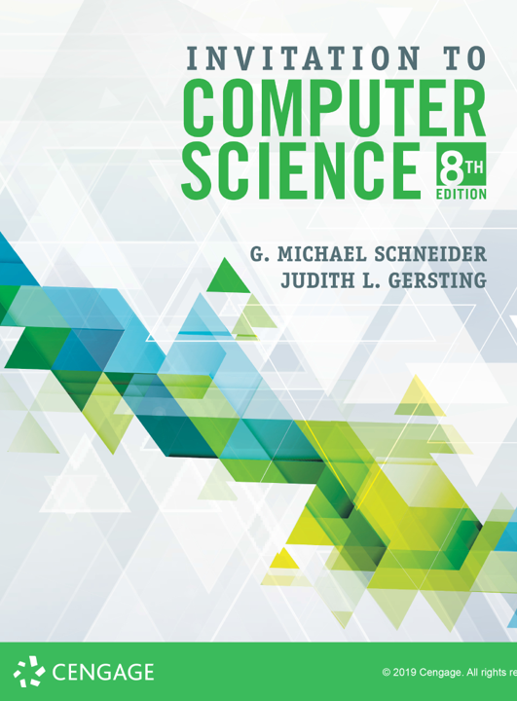
More High Level Programming Languages

Slide 2
Programming paradigms
Historically, languages were developed within programming paradigms
Imperative: programs are sequences of commands that change the state of the machine
Structured: programs are organized by control constructs and subroutines; algorithm-centric
Object-oriented: programs are collections of communicating objects that have state and behavior
Functional: programs are mathematical computations
Logic: programs are collections of facts and if-then statements
A paradigm is a standard, perspective, or set of ideas. A paradigm is a way of looking at something. The word paradigm comes up a lot in the academic, scientific, and business worlds. When you change paradigms, you're changing how you think about something. —Vocabulary.com

Slide 3
Programming paradigms
More recently, modern languages don’t fit neatly into specific paradigms, but tend to be multi-paradigmatic—that is they borrow features from a variety of traditional paradigms
Things continue to get more complicated and messy
Comparison chart

Slide 4
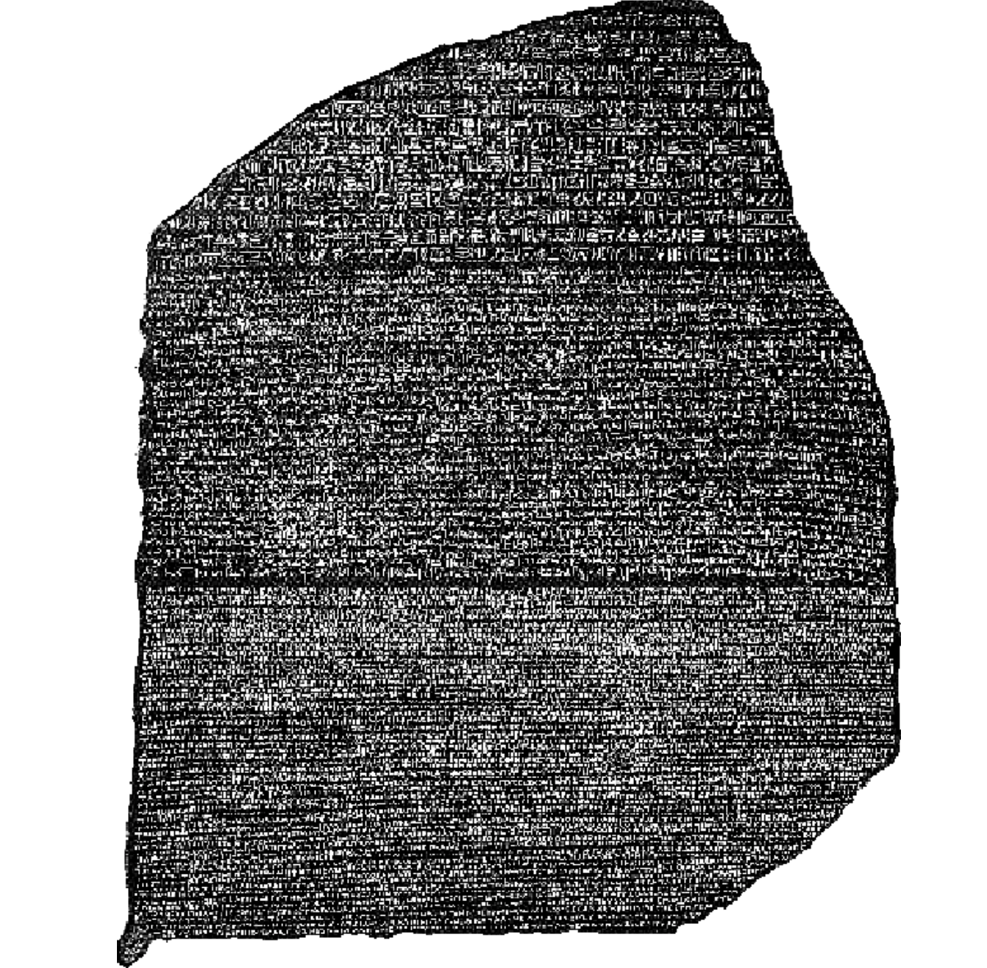
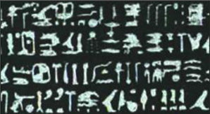
Rosetta Code
Rosetta Stone
Proclamation from the time of Ptolemy
Written in Hieroglyphics, Demotic script, and Greek
Instrumental in decoding Hieroglyphics
Rosetta Code
A website that showcases side by side implementations of common algorithms in multiple languages
rosettacode.org

Slide 5
Euclid’s Algorithm
Greatest Common Divisor (gcd)
In his book The Elements the ancient Greek mathematician Euclid (he was actually from Alexandria, Egypt) described what is now thought to be the oldest algorithm:
$48=2×2×2×2×3=2^{4}×3$
$84=2×2×3×7=2^{2}×3×7$
$\gcd\left(48,84\right)=2×2×3=12$
Euclid solved this problem using the following process of repeated subtraction

Slide 6
Euclid’s Algorithm
gcd(a, b):
while a ≠ b:
if a > b then
a ← a – b
else
b ← b – a
gcd = a
gcd(a, b):
while b ≠ 0:
t ← b
b ← a mod b
a ← t
gcd = a
gcd(a, b):
if b = 0:
gcd = a
else
gcd = gcd(b, a mod b)

Slide 7
Euclid’s Algorithm: FORTRAN
subroutine gcd(value, u, v)
integer, intent(out) :: value
integer, intent(inout) :: u, v
integer :: t
do while( v /= 0 )
t = u
u = v
v = mod(t, v)
enddo
value = abs(u)
end subroutine gcd

Slide 8
Euclid’s Algorithm: COBOL
IDENTIFICATION DIVISION.
PROGRAM-ID. GCD.
DATA DIVISION.
WORKING-STORAGE SECTION.
01 A PIC 9(10) VALUE ZEROES.
01 B PIC 9(10) VALUE ZEROES.
01 TEMP PIC 9(10) VALUE ZEROES.
PROCEDURE DIVISION.
Begin.
DISPLAY "Enter first number, max 10 digits."
ACCEPT A
DISPLAY "Enter second number, max 10 digits."
ACCEPT B
IF A < B
MOVE B TO TEMP
MOVE A TO B
MOVE TEMP TO B
END-IF
PERFORM UNTIL B = 0
MOVE A TO TEMP
MOVE B TO A
DIVIDE TEMP BY B GIVING TEMP REMAINDER B
END-PERFORM
DISPLAY "The gcd is " A
STOP RUN.

Slide 9
Euclid’s Algorithm: C
int gcd(int u, int v) {
if (u < 0) u = -u;
if (v < 0) v = -v;
if (v) while ((u %= v) && (v %= u));
return (u + v);
}
int gcd(int u, int v) {
return (v != 0)?gcd(v, u%v):u;
}

Slide 10
Euclid’s Algorithm: Pascal
function gcd(u, v: longint): longint;
var
t: longint;
begin
while v <> 0 do
begin
t := u;
u := v;
v := t mod v;
end;
gcd := abs(u);
end;

Slide 11
Euclid’s Algorithm: Perl, Python, & APL
sub gcd($$) {
my ($u, $v) = @_;
while ($v) {
($u, $v) = ($v, $u % $v);
}
return abs($u);
}
def gcd_iter(a, b):
a ˅ b
def gcd(u, v):
while v:
u, v = v, u % v
return abs(u)

Slide 12
Euclid’s Algorithm: LISP, Scala & Forth
(define (gcd a b)
(if (= b 0)
a
(gcd b (modulo a b))))
def gcd(a: Int, b: Int):
Int = if (b == 0) a.abs else gcd(b, a % b)
: gcd ( a b -- n )
begin dup while tuck mod repeat drop ;

Slide 13
Palindrome Detection: Java
public boolean pali(String s){
if(s.length()<=1){
return true;
}
int last = s.length() – 1;
if(s.charAt(0) != s.charAt(last)){
return false;
}
return pali(s.substring(1, last));
}

Slide 14
Palindrome Detection: Python & C
def is_palindrome(s):
return s == s[::-1]
#include <string.h>
int palindrome(const char *s)
{
int i,len;
len = strlen(s);
for(i=0; i<len/2; i++)
{
if ( s[i] != s[len-i-1] ) return 0;
}
return 1;
}

Slide 15
Palindrome: Factor, OCaml, & PHP
USING: kernel sequences ;
: palindrome? ( str -- ? ) dup reverse = ;
let is_palindrome s =
let l = String.length s in
let rec comp n =
n = 0 || (s.[l-n] = s.[n-1] && comp (n-1)) in
comp (l / 2)
<?php
function is_palindrome($string) {
return preg_match('/^(?:(.)(?=.*(\1(?(2)\2|))$))*.?\2?$/', $string);
}
?>

