Slide 1
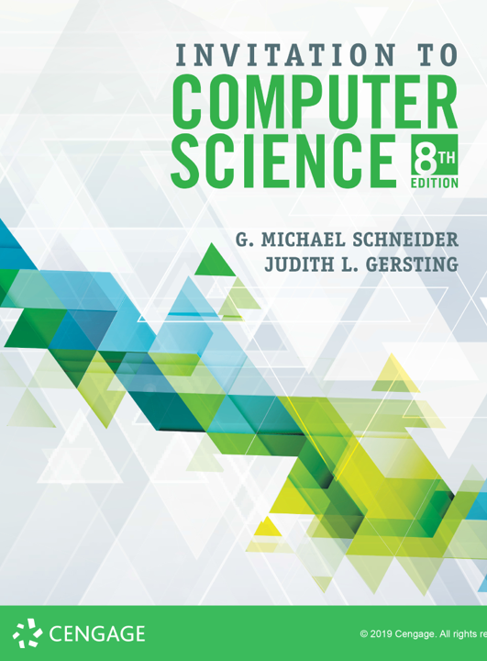
Computer Security:
More Cryptology

Slide 2
ALERT
Lab 10.5 is due 10/30
Midterm review on 10/30
Assignment 7 is due 11/1
Midterm II on 11/1

Slide 3
Encryption
Foundational Principle:
The security of a cipher should lie entirely in the key and not in the algorithm itself
Symmetric vs. Asymmetric
Asymmetric encryption uses one key to encrypt and a different key to decrypt the messages
If the encryption key is made public, this is called Public Key Encryption (most web security relies on this)
If the decryption key is made public, this enables a technology called digital signatures
The most popular Public Key Encryption algorithm is RSA

Slide 4
Public-Key Cryptography
Notes:
Stallings Fig 9-1.

Slide 5
RSA
by Rivest, Shamir & Adleman of MIT in 1977
They won the Turing Award for this in 2002!
based on exponentiation in a finite (Galois) field over integers modulo a prime
exponentiation takes O((log n)³) operations (easy)
uses large integers (eg. 1024 bits)
security due to cost of factoring large numbers
factorization takes O(e ^{log n log log n}) operations (hard)
Notes:
RSA is the best known, and by far the most widely used general public key encryption algorithm.

Slide 6
RSA
RSA key creation:
Pick 2 large prime numbers: p and q
Compute $n = p×q$, and $m = (p−1)×(q−1)$
Choose large number e at random, so that e and m are relatively prime (no common factors except 1)
Find unique value $d$, between 0 and $m$, such that $(e×d) modulo m = 1$
Public key = (n, e), Private key = d

Slide 7
rsa
RSA key creation, example:
p = 7, q = 13
n = 7×13 = 91, and m = 6×12 = 72
Let e = 77 (72 = 2 * 2 * 2 * 3 * 3, 77 = 7 * 11)
d = 29
Public key = (91, 77), Private key = 29

Slide 8
rsa
RSA encryption:
Given public key (n, e)
Convert message to integer P
Calculate C = P^{e} modulo n
RSA decryption:
Given private key d
Calculate C^{d} modulo n

Slide 9
rsa
RSA encryption, example:
Given public key (91, 25)
Convert message to integer P = 37
Calculate C = 37⁷⁷ modulo 91 = 46
RSA decryption:
Given private key 29
Calculate 46²⁹ modulo 91 = 37

Slide 10
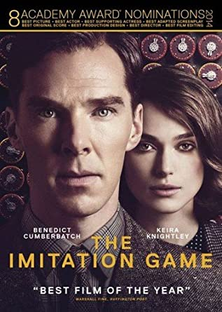
History: Enigma
One of the most interesting cryptographic battles in history took place during World War II
This was not publicly known until the 1990s, 50 years after the fact
Alan Turing played a pivotal role
The story was told in the motion picture The Imitation Game
Enigma History
Paper Enigma (video)

