Slide 1
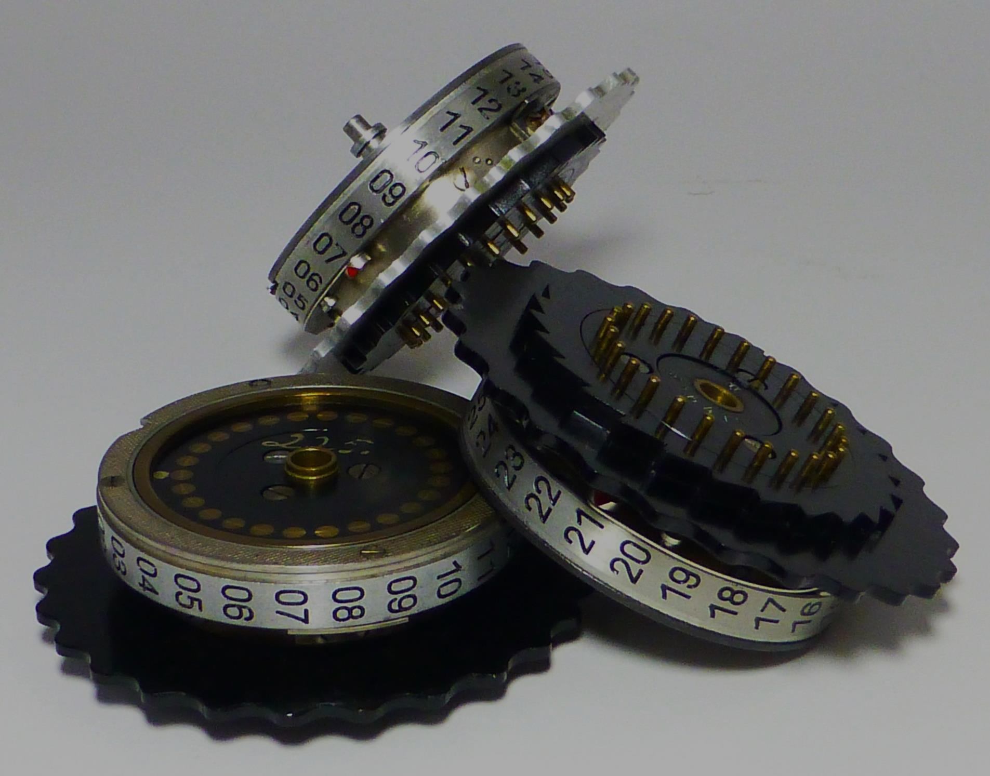
The Race to Crack the Enigma Machine
San Francisco Navy League
June 12, 2018
Ralph Simpson
Ralph@CipherHistory.com
Copyright © 2018 CipherHistory.com

Slide 2
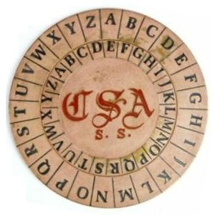
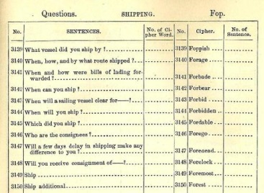
WW1 - All Ciphers were Broken!
Proliferation of radios in WW1 highlighted the need for a new cipher technology
100’s of messages used the same key, so all ciphers were broken
Cipher technology was manual, error-prone, and 500 years old!
Confederate Vigenère Wheel
1888 Code Book

Slide 3
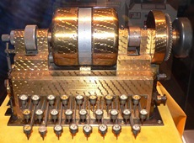
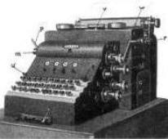
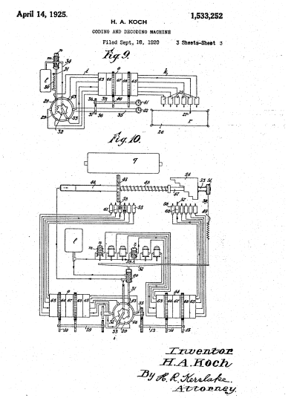
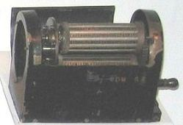
Invention of Electro-Mechanical Rotor
Enigma was one of four cipher machines with electro-mechanical rotors invented in 4 different countries between 1917-1919
Edward Hebern
USA
1917
Arthur Scherbius
Germany
1918
Hugo Koch
Holland
1919
Arvid Damm
Sweden
1919

Slide 4
Quiz
What do the following ciphers have in common?
Enigma
Jefferson wheel cypher
One-time pad
Public key encryption
Vigenère cipher
Wheatstone cryptograph
Playfair cipher
They were all originally credited to the wrong inventor!
Notes:
Cylinder – Thomas Jefferson in 1795, not Bazeries in 1891
One-time pad – Frank Miller in 1872, not Gilbert Vernam and Joseph Mauborgne in 1917
Enigma – Dutch sailors Rudolf Spengler and Theo van Hengel in 1915, not Arthur Scherbius in 1918
Public Key Encryption - James Ellis, Malcolm Williamson and Clifford Cocks of the UK GCHG in 1973, not Whitfield Diffie and Martin Hellman in 1976 and Ron Rivest, Adi Shamir, and Leonard Adleman in 1978
Vigenere – Leon Batista Alberti in 1467, not Blaise de Vigenere who was born 56 years later
Wheatstone – Decius Wadsworth in 1817, not Charles Wheatstone in 1850s
Playfair – Charles Wheatstone in 1854, not Lord Playfair, a friend of Wheatstone who advocated its use

Slide 5
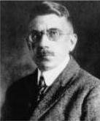
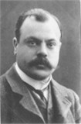
Enigma Invention – the Legend
Arthur Scherbius
Germany
Hugo Koch
Holland
German Navy bought Enigma in 1926, Army in 1928
In 1927, Enigma inventor Scherbius curiously bought the rights to Koch’s patent, paid 600 Dutch guilders (~$350)
Scherbius had the earlier and almost identical patent
Koch died in 1928
Scherbius died in 1929 in a horse carriage accident, not knowing the role his invention would have in history

Slide 6
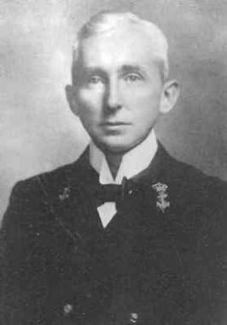
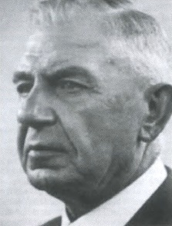
History Rewritten in 2003
2003 discovery: electro-mechanical rotor was invented in 1915 by two Dutch naval officers
Dutch Navy suppressed this patent until a month after Koch’s patent was granted
Patent attorney for the Dutch naval officers was the brother-in-law of Hugo Koch!
Theo van Hengel
(1875-1939)
Rudolf Spengler
(1875-1955)
Koch collaborated with Scherbius, their patent drawings were identical to the Dutch naval officers’ drawings
Now van Hengel and Spengler are recognized as the true inventors of the electro-mechanical rotor and the Enigma machine

Slide 7
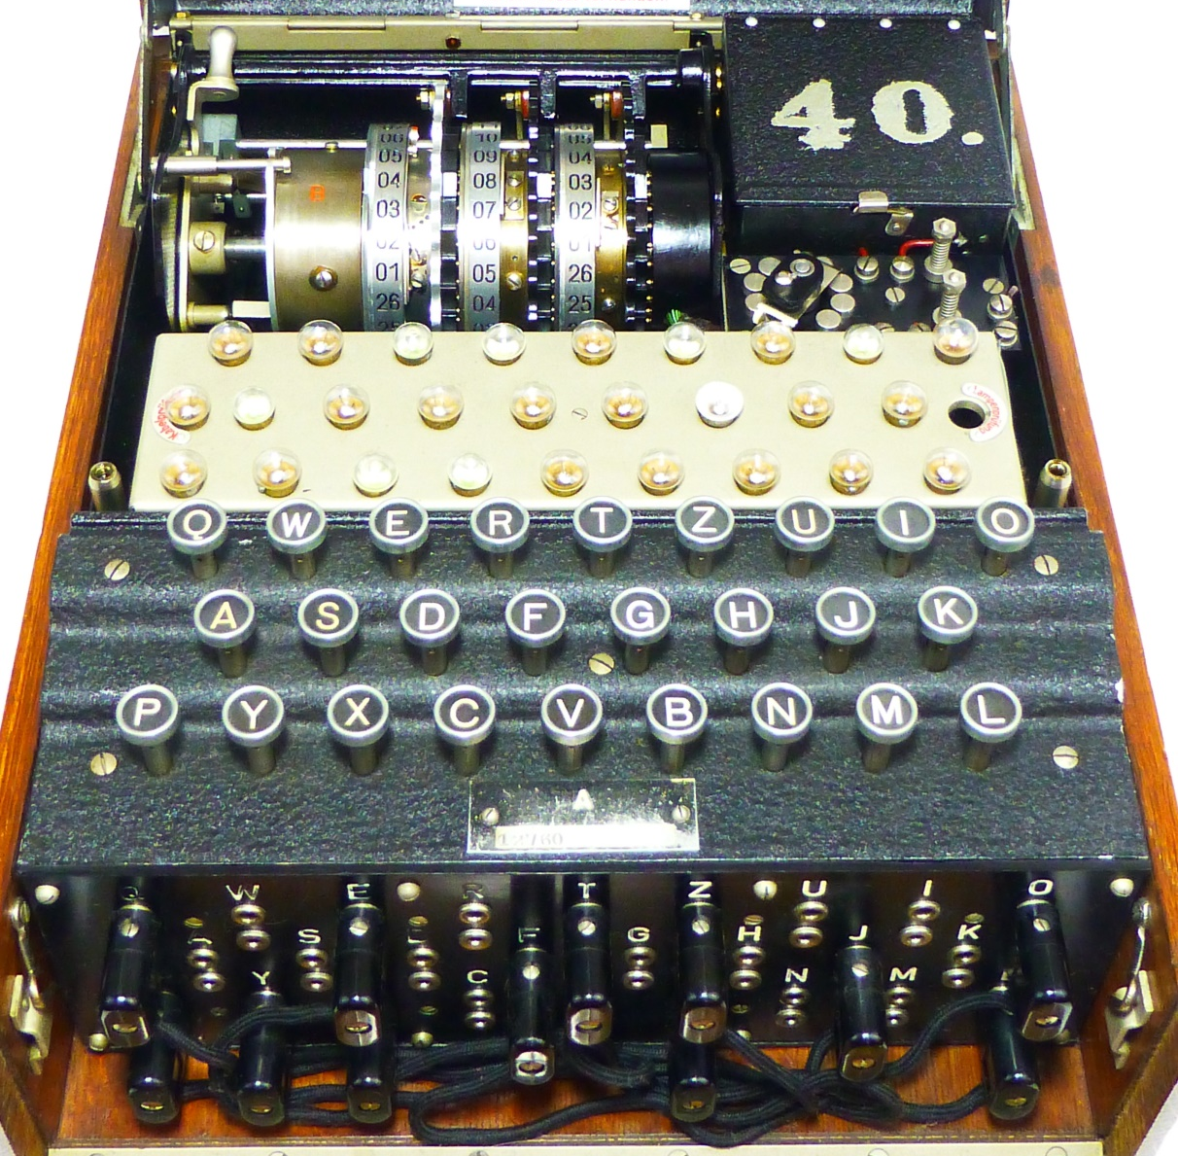
Enigma Technology
Typewriter style cipher machine
Major advance in ease of use and cryptologic strength
Innovation of electro-mechanical rotors
Rotors turn odometer style, giving a new cipher algorithm for each letter in a message
German military added plugboard
No printing capability

Slide 8
Wiring Diagram ( example of A encoding to H )
Left
Rotor
Middle
Rotor
Right
Rotor
Entry
Drum
2
Reflector
Rotors rotate
B
F
B
F
J
J
M
M
X
X
O
P
O
P
N
N
-
Q
W
E
R
T
Z
U
I
O
-
BATTERY
Light Panel
H
A
S
D
F
G
H
J
K
+
P
Y
X
C
V
B
N
M
L
+
1
“A” key is pressed
3
Q
W
Electrical circuit closed
4
E
R
T
Z
U
I
O
Keyboard
A
S
D
F
G
J
K
Electricity flows
A
H
P
Y
X
C
V
B
N
M
L
Q
W
E
R
T
Z
U
I
O
O
A
S
D
F
G
H
J
K
O
Plugboard
P
Y
X
C
V
B
N
M
L
M
M
Copyright © 2017 CipherMachines.com and EnigmaMuseum.com

Slide 9
Key Space of the Enigma
Enigma has theoretical maximum number of settings of 3 X 10¹¹⁴ - far more than the number of atoms in the universe (10⁸⁰)
If you capture an Enigma and know the German operational procedures, it still has astronomical key space of 10²³
A key space of 10²³ is equivalent to a 76 bit key, better than the 56 bit DES standard of 1976-2002
A key space of 10²³ means 100,000 operators, each checking one key setting every second, 24X7, would take twice the age of the universe to break the code!

Slide 10
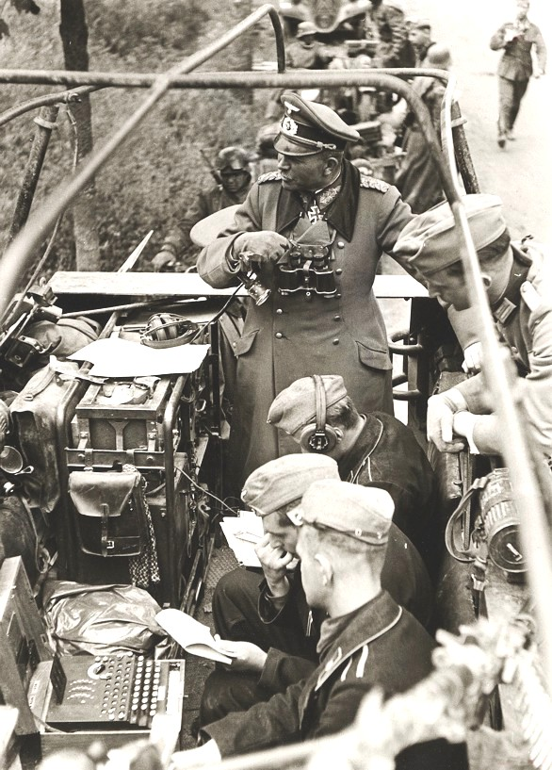
Shortcomings of the Enigma
Greatest shortcomings were lax operator procedures
Reflector designed so no letter encoded to itself
Rotors had regular “odometer” movement
Multiple notches used to make odometer stepping more complex was used on naval Enigma only
Ironically, the strength of Enigma design gave Germans too much confidence in its security, even when faced with evidence of compromise
“Panzer General” Heinz Guderian on communications truck with Enigma machine

Slide 11
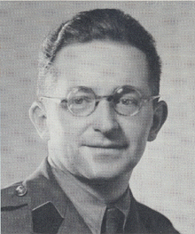
Polish Success in Decoding Enigma
In 1932, French bribed a German official to get Enigma keys
German official, Hans-Thilo Schmidt, was later caught and executed
Polish code-breakers could now exploit the double sending of the key – breaking the code in Dec. 1932
Poles made the Bomba – 6 Enigma machines in series to check codes for the 6 combinations of 3 rotors
Marian Rejewski
Polish cryptographer
Poles successfully decoded Enigma messages until 1939, when the Germans quit sending the key twice and added 2 new rotors
Poles finally disclosed their code-breaking success to Britain and France just before Germany invaded Poland on Sept. 1, 1939
Breakthrough was breaking of rotors and plugboard separately

Slide 12
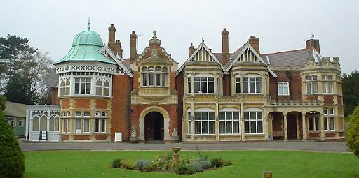
British Effort in Breaking the Code
In 1939, UK began a major decoding effort in Bletchley Park, employing 11,000 people
Effort led by Alan Turing, who built the Bombe - 36 Enigmas in series to check settings
Bletchley Park Mansion
Many settings were manually eliminated and only the remaining settings checked by the Bombe – brute force wouldn’t work
Army and Luftwaffe messages were routinely decoded, the Naval Enigma was the greatest challenge
British only acted on intelligence that could be uncovered from traditional sources (spies, direction finding, radar, traffic analysis)

Slide 13
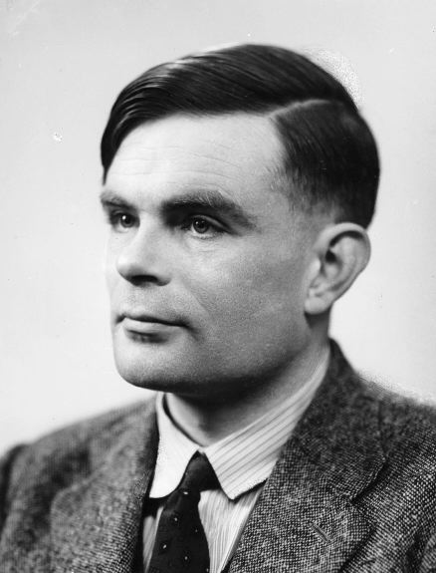
Bombe – the Beginning of Computing
Alan Turing:
Father of
Computing
US Bombe
Polish called their electro-mechanical codebreaker the Bomba for an ice cream treat, British called it a Bombe
210 Bombes were built in the UK, all were destroyed after WW2
US employed NCR to build a faster version of the Bombe to decode the 4 rotor naval Enigma – 121 were built
By the end of the war, the naval code was deciphered within 12 hours and the rest of the day’s messages were read in real time
Notes:
The British bombe operated at a speed of 50 rpm, later improved to 120 rpm.
The US bombe operated at 1725 rpm.
It took about 20 min. to test all the combinations of a 3 rotor setting for the British Bombe.
It took about 20 min. to test all the combinations of a 4 rotor setting for the US Bombe.
The US Bombe could test a 3 rotor setting in 50 seconds.

Slide 14
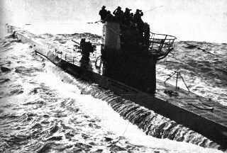
U-Boat Peril
Before the US entered the war, U-boats decimated Allied shipping, sinking about 60 ships per month
U-boats roamed freely, forming “wolfpacks” to efficiently destroy convoys of supply ships
Nazis expected a quick surrender by blockading the UK
Naval Enigma was initially the same as the Army, but later more complex versions were used with more rigorous procedures
Naval Enigma messages were secure until May 1941
“The only thing that ever really frightened me during the war was the U-boat peril.”
- Winston Churchill
U-Boat

Slide 15
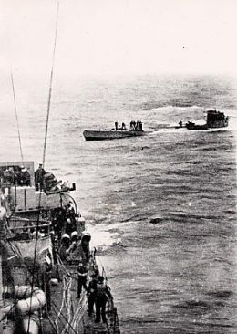
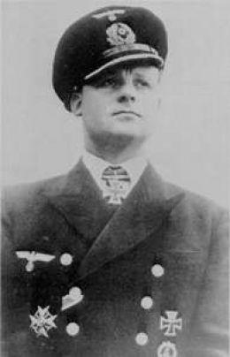
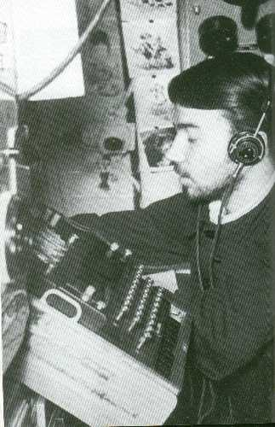
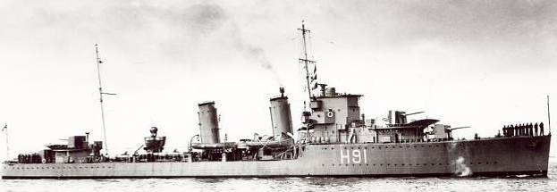
U-110
The first U-boat boarded and code books recovered was from U-110 in May 1941
Captain died scuttling U-boat
U-110 later sunk by British so Germans didn’t realize their codes were compromised
This single act was the turning point in the Battle of the Atlantic
Sinking of U-110
Captain of U-110 Fritz Julius Lemp
Enigma
operator
in U-110
HMS Bulldog – British destroyer captured U-110

Slide 16
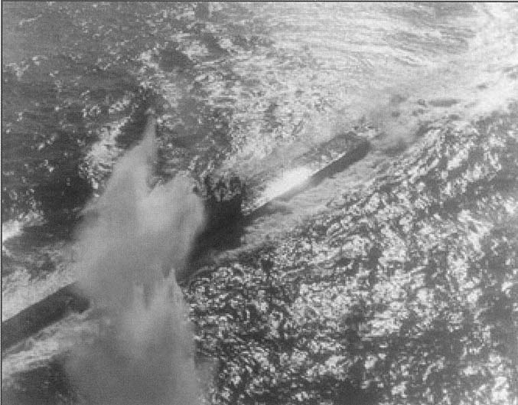
Battle of the Atlantic
After breaking the Naval Enigma, the British continuously re-routed convoys to avoid U-boats
British targeted the supply ships and mother U-boats
It was discovered that unarmed weather trawlers carried the Enigma and codes, an easy target for additional code books
US bombing of U-117 – Aug. 1943
Early U-boat success turned to failure, 725 of 1155 U-boats and 82% of 35,000 sailors never returned from sea
Some estimate breaking the Enigma shortened WW2 by 2 years

Slide 17
Enigma After WW2
Code-breaking success was not revealed until 1974, despite thousands of people who knew the secret in the US and UK
US and UK encouraged use of Enigmas by other countries, including Allies, reading their secrets for 3 decades
About 35-40,000 Enigmas were manufactured, most were destroyed during or just after the war
Today, about 350 Enigma machines are known to exist, half in private collections, half in museums
NSA Historian verifies story of Enigmas used as ballast in a US Navy missile test after WW2, sinking thousands of Enigmas
Record prices at auction:
$269K for a 3-rotor Enigma at Bonhams on 4/13/15
$547K for a 4-rotor Enigma at Christies on 6/15/17

Slide 18
Did Germans Know Enigma was Broken?
Enigma key space gave Germans confidence in its security
Japanese and Italian warnings of codebreaking ignored
Allies only used Enigma messages after deception of traditional sources (spotter planes, spies, etc.)
Naval 4 rotor Enigma not designed because of Allied code breaking
Likely purpose – security from other German military, spies
Confirmed in interview with Admiral Dönitz in 1974
Examples of Allied codebreaking that should have been suspect:
5 U-Boats, identified in one Enigma message, sunk in one day!
Supply ships for Gen. Rommel in Africa found and sunk, despite cloud cover

Slide 19
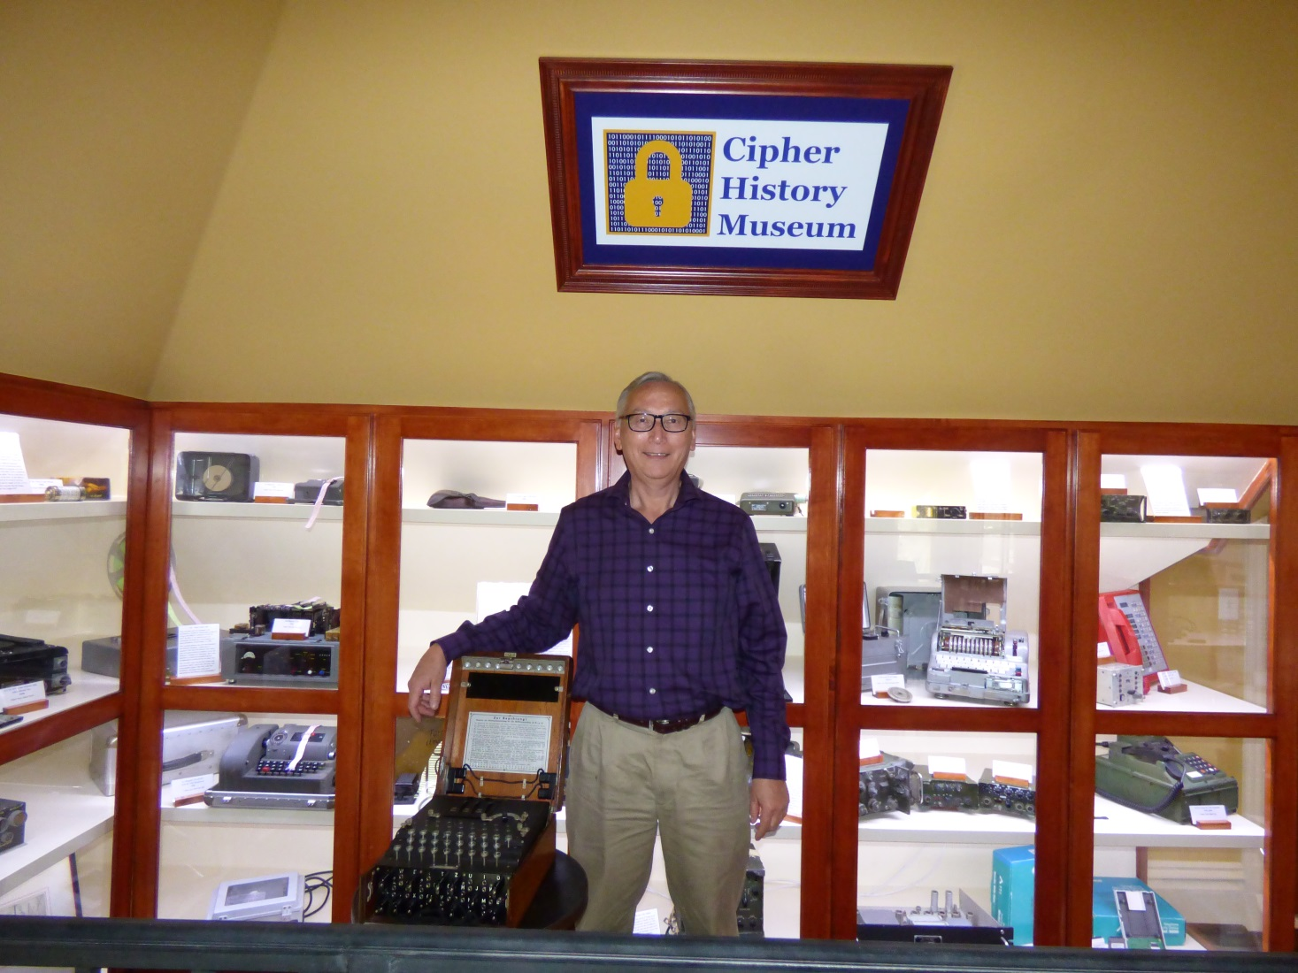
Download this Presentation
CipherHistory.com/enigma.ppt

Slide 20
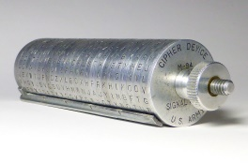
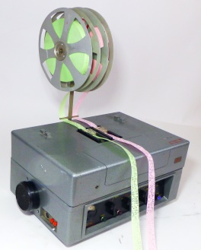
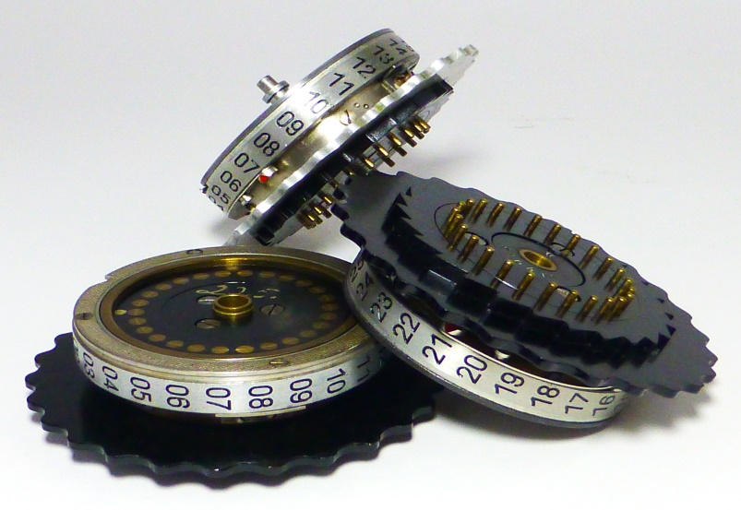
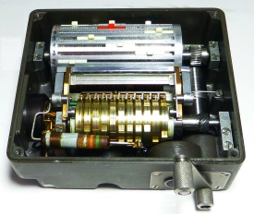
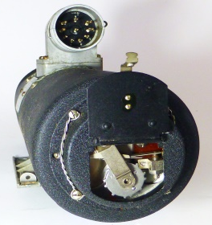
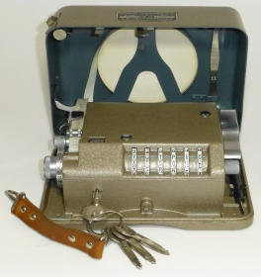
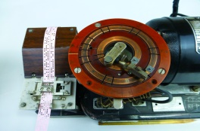
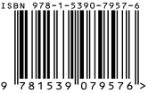
Crypto Wars
Available on Amazon
Crypto Wars
2000 Years of Cipher Evolution
Ralph Simpson

Slide 21
Addendum
Calculations showing the maximum number of settings both theoretically and as practiced by the Nazis

Slide 22
Plugboard Settings
The # of possible plugboard settings is a function of 3 variables:
1. # plugboard cables, p, can be from 0 to 13
2. # of groupings of possible letters (2p letters out of 26)
3. # interconnections of p cables within the group of letters chosen
1. # plugboard | 2. # groupings of letters | 3. # interconnections | Total # possible settings
cables | 26! / ((2p!) X (26-2p)!) | (2p-1) X (2p-3) X (2p-5) X …X 1 | (column 2) X (column 3)
0 | 1 | 1 | 1
1 | 325 | 1 | 325
2 | 14,950 | 3 | 44,850
3 | 230,230 | 15 | 3,453,450
4 | 1,562,275 | 105 | 164,038,875
5 | 5,311,735 | 945 | 5,019,589,575
6 | 9,657,700 | 10,395 | 100,391,791,500
7 | 9,657,700 | 135,135 | 1,305,093,289,500
8 | 5,311,735 | 2,027,025 | 10,767,019,638,375
9 | 1,562,275 | 34,459,425 | 53,835,098,191,875
10 | 230,230 | 654,729,075 | 150,738,274,937,250
11 | 14,950 | 13,749,310,575 | 205,552,193,096,250
12 | 325 | 316,234,143,225 | 102,776,096,548,125
13 | 1 | 7,905,853,580,625 | 7,905,853,580,625
Total |  |  | 532,985,208,200,576

Slide 23
Rotor Settings
The internal wiring of each rotor could be constructed in 26! different combinations. Since 3 rotors are used, the number of combinations when selecting 3 rotors out of 26! are:
26! X (26!-1) X (26!-2) = 65,592,937,459,144,
468,297,405,473,480,371,753,615,896,841,298,
988,710,328,553,805,190,043,271,168,000,000
Each of the 3 rotors could initially be set to any letter:
26 X 26 X 26 = 17,576
The right-most rotor advances one letter after each key is pressed, the second and third rotors advance one letter after a full revolution of the rotor to its right. The setting for the notch to enable this was also changeable to any letter of the alphabet:
26 X 26 = 676 (Note: notch on left-most rotor has no effect)

Slide 24
Reflector Settings
The reflector scrambled the letters in pairs so it could encrypt and decrypt
The letter “A” could be switched to any of the 25 remaining letters, the next letter could be switched to any of the 23 remaining letters, and so on.
Notice this result is the same as using 13 plugboard cables, since all letters are paired (see chart on page 22)
25 X 23 X 21 X … X 1 = 7,905,853,580,625

Slide 25
Total Theoretical Number of Settings
The total theoretical number of Enigma settings is thus the product of the 5 items on the previous 3 slides, or…
3,283,883,513,796,974,198,700,882,069,882,752,878, 379,955,261,095,623,685,444,055,315,226,006,433,615, 627,409,666,933,182,371,154,802,769,920,000,000,000
Or 3.28 X 10¹¹⁴
This number is far greater than the total number of atoms in the observable universe (10⁸⁰)

Slide 26
Theory vs. Practice
The theoretical number of Enigma settings was not achieved in practice by the Germans, the number of settings the Allied Forces encountered for the standard 3 rotor enigma:
10 plugboard cables were always used, reducing errors and the possible combinations to 150,738,274,937,250
Only 5 of 26! possible rotors were issued and known by Allies, so selecting 3 out of 5 is 5 X 4 X 3 = 60
The initial settings of the rotors and the positions of the notches remain the same at 17,576 and 676
Reflector setting was known and remained unchanged = 1
The product of the above numbers is: 107,458,687,327,250,619,360,000 or 1.07 X 10²³
To test 10²³ key settings, 100,000 operators each checking one setting every second would take twice the age of the universe to break the code

