Slide 1
Internet History

Slide 2
ALERT
Lab 9 due today
Lab 10.5 due 10/30
Assignment #7 is due 11/1
Midterm II is 11/1

Slide 3
How Old Is the Internet?
Do you know when the internet began?
It was NOT invented by Vice-President Al Gore in the 70s ☺
We’ll get to the answer in a minute, but first some historical context
1957: The USSR launches Sputnik, the 1st artificial earth satellite.
1958: In response, the USA forms the Advanced Research Projects Agency (ARPA) within the Department of Defense (DoD)
1966-7: Larry Roberts (ARPA) designs ARPANET and recruits the RAND Corporation and National Physical Laboratory (NPL) to help
1969: Bolt Beranek and Newman, Inc. (BBN) is awarded a contract to build packet switching Interface Message Processors (IMPs)
DoD commissions ARPANET for networking research

Slide 4
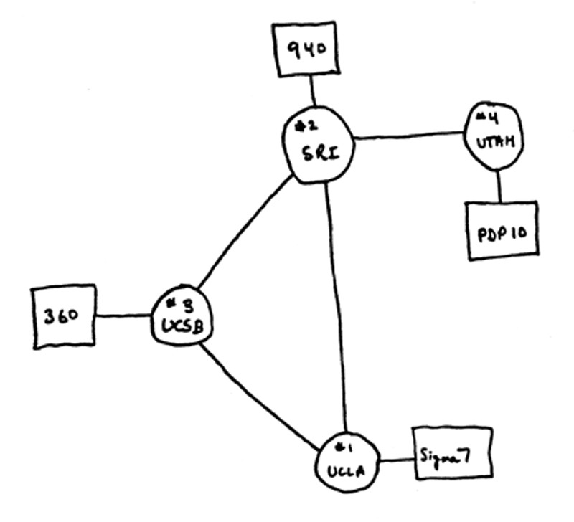
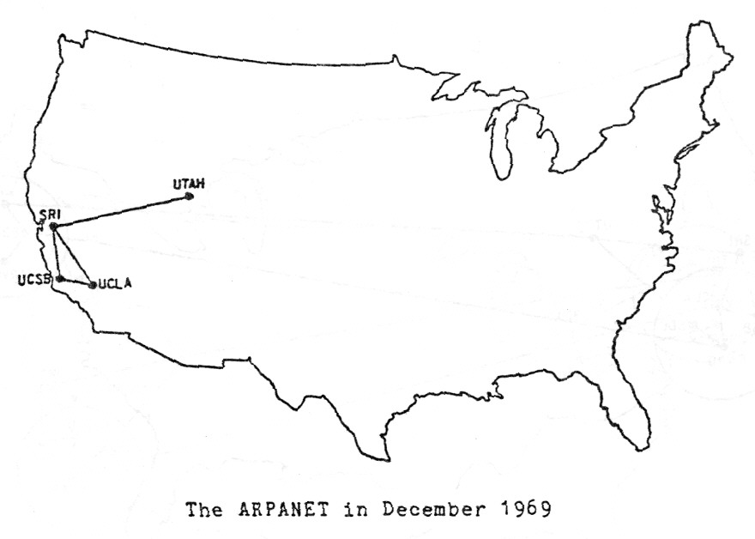
Arpanet The Autumn of ‘69
Node 1: UCLA
30 August, hooked up 2 September
SDS SIGMA 7
Node 2: Stanford Research Institute (SRI)
1 October
SDS940/Genie
Node 3: Univ. of California Santa Barbara (UCSB)
1 November
IBM 360/75
Node 4: University of Utah
December
DEC PDP-10

Slide 5
http://mercury.lcs.mit.edu/~jnc/tech/arpageo.html

Slide 6
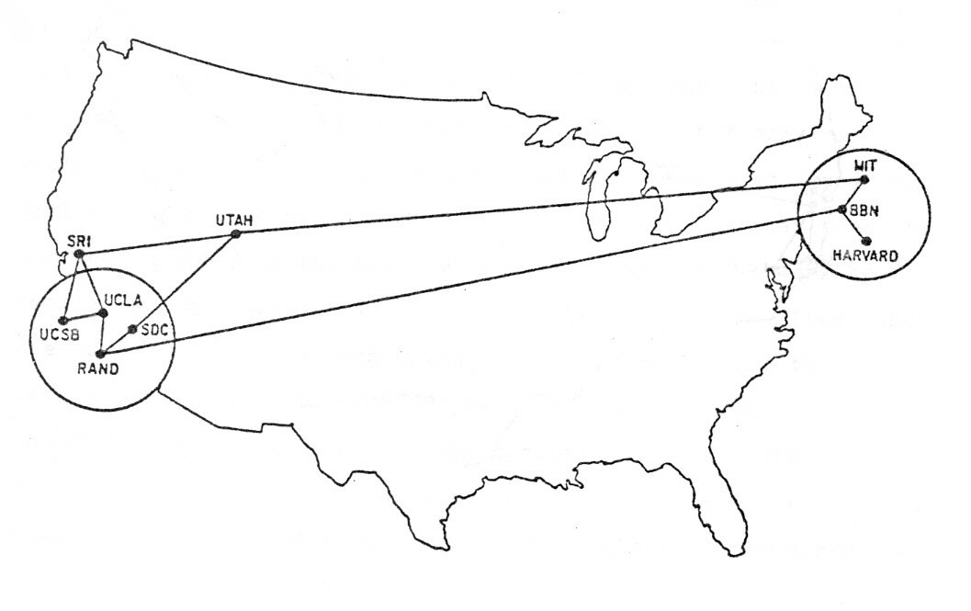
June 1970

Slide 7
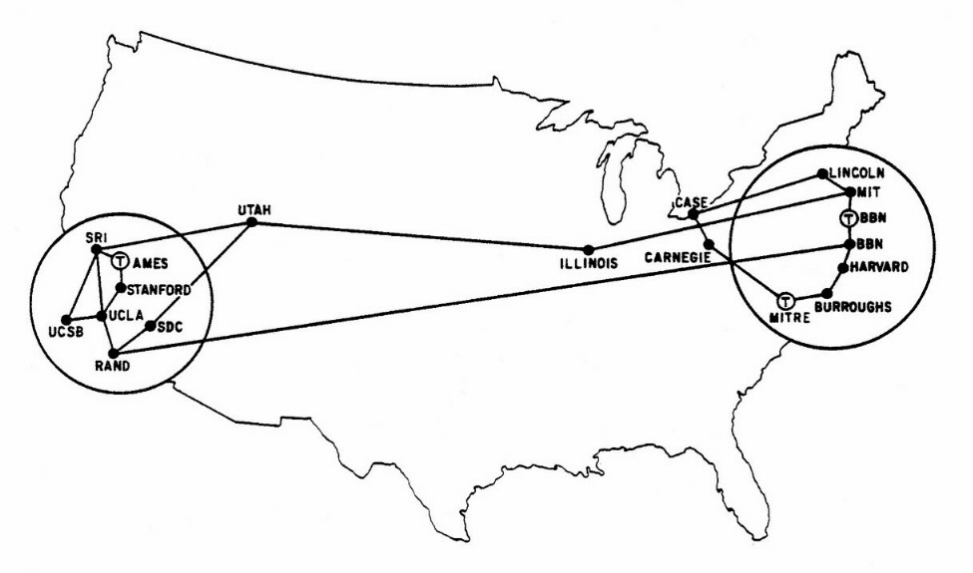
September 1971

Slide 8
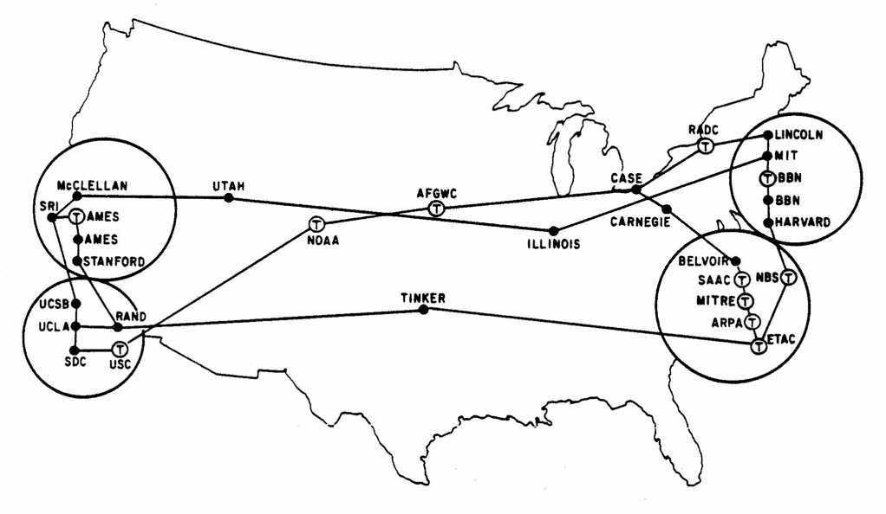
August 1972

Slide 9
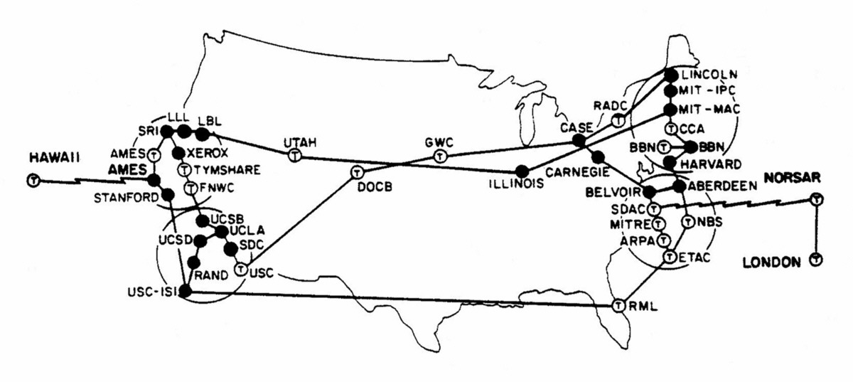
September 1973

Slide 10
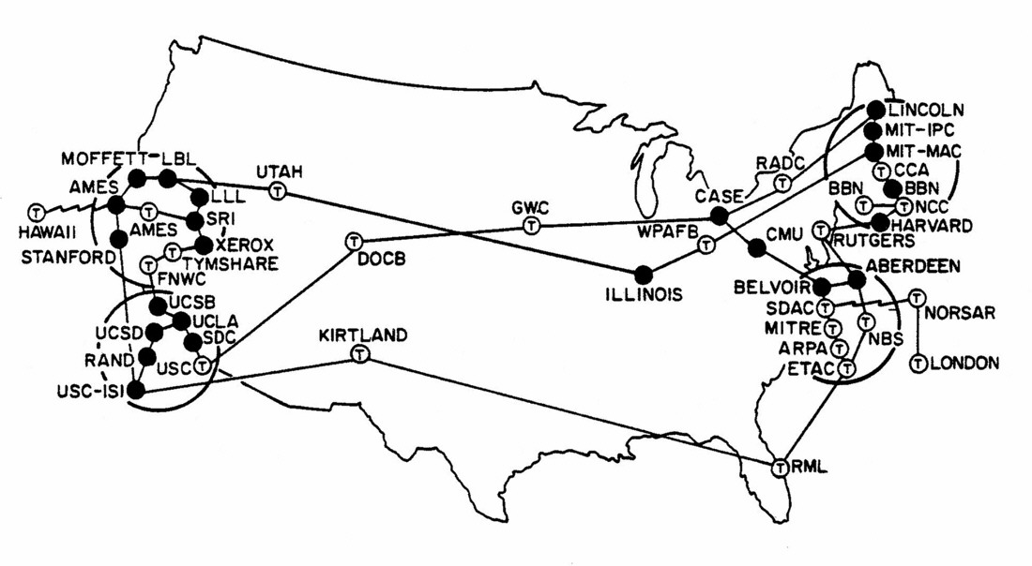
June 1974

Slide 11
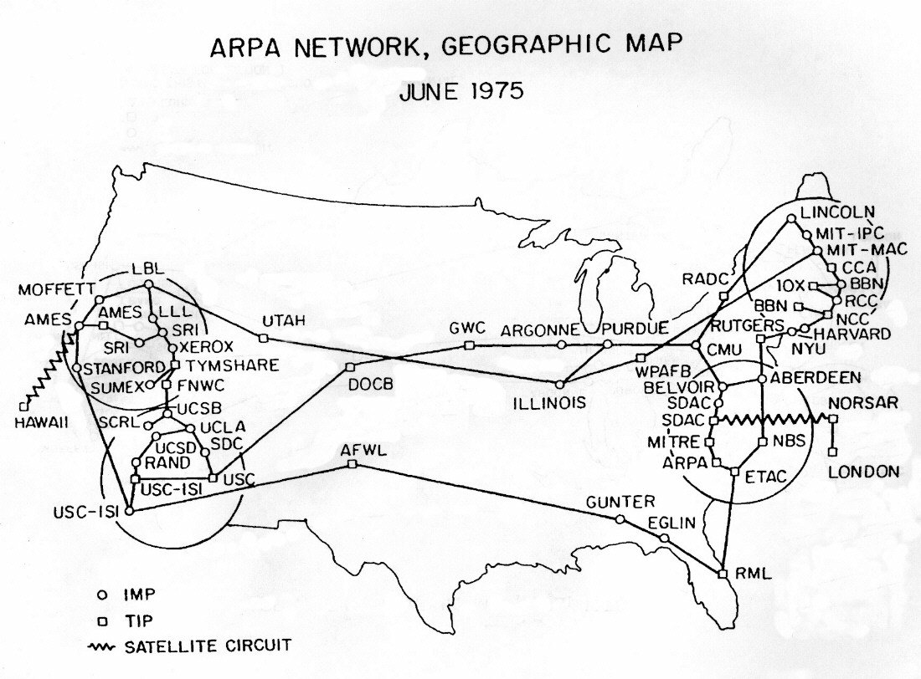

Slide 12
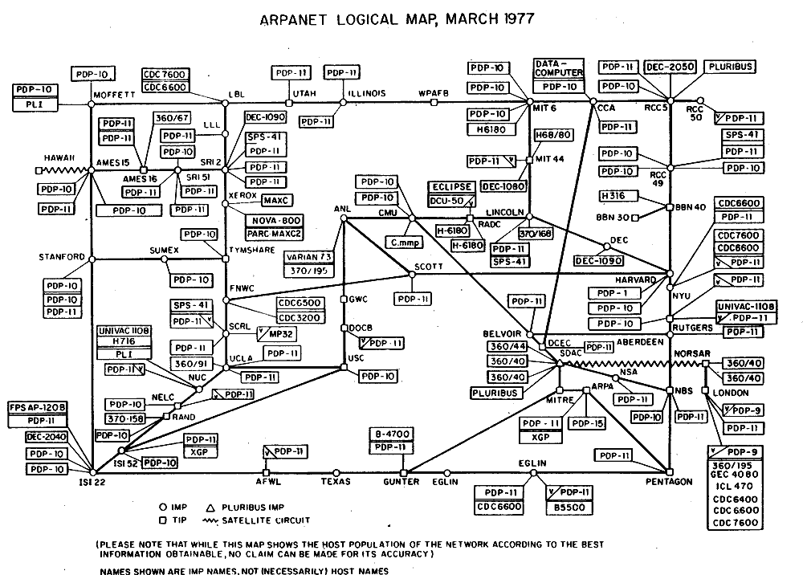

Slide 13
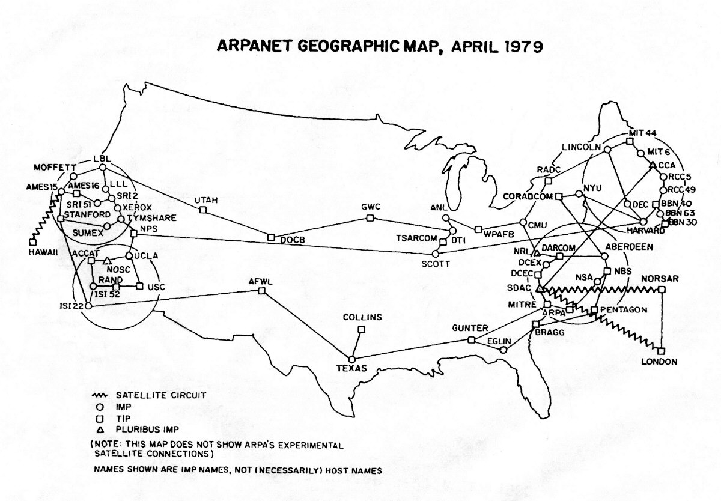

Slide 14
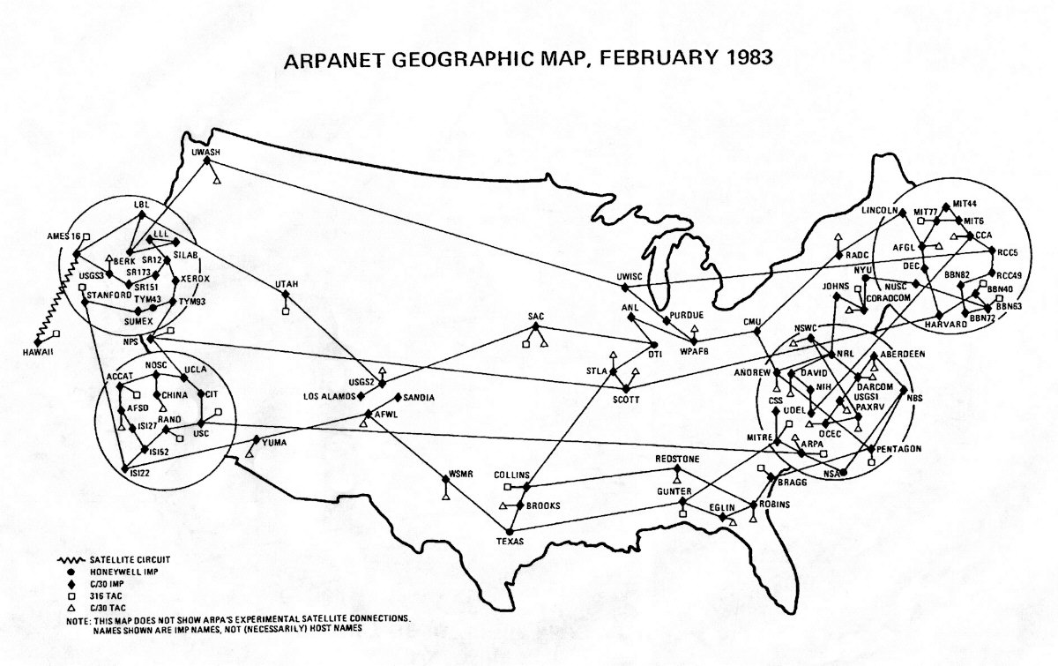

Slide 15
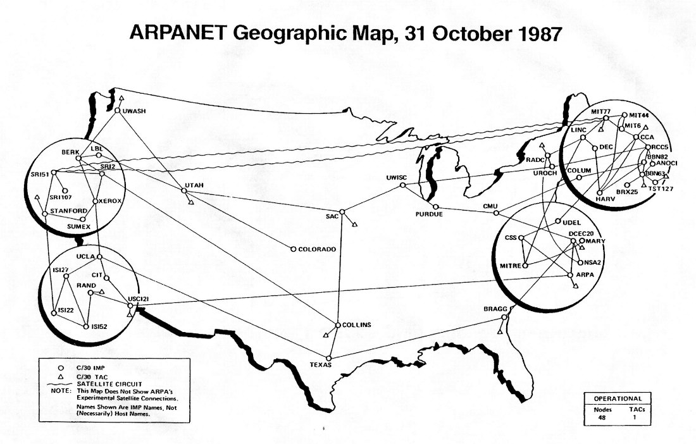

Slide 16
1970s: Inventing
Cerf and Kahn’s internetworking principles:
minimalism, autonomy - no internal changes required to interconnect networks
best effort service model
stateless routers
decentralized control
define today’s Internet architecture
1972: first e-mail, 15 computers on ARPANET
1st computer to computer chat
1974: Cerf and Kahn - interconnecting networks (Internet)
TCP introduced by Kahn & Cerf
1976: Ethernet at Xerox PARC
Queen Elizabeth II sends an email
1978: TCP split into TCP and IP
1st commercial spam message sent by DEC marketing
1979: ARPANET has 200 hosts
Many small proprietary networks emerge in the late 70s

Slide 17
1980s: Innovation & Growth
1981: BITNET (because it’s time network)—CUNY & Yale
1982: smtp e-mail protocol defined
1983: DNS defined for name-to-IP-address translation
1984: the number of hosts breaks 1,000
1985: ftp protocol defined
1987: the number of hosts breaks 10,000
1988: Internet worm released November 2
1989: the number of hosts breaks 100,000
More national networks are formed: BITnet, NSFnet, USENET, CSnet, Minitel, FidoNet, FreeNet, UUNET, etc.

Slide 18
1990s: Explosion & WWW
1990: ARPNET ceases to exist; Electronic Frontier Foundation (EFF) founded by Mitch Kapor
1991: WWW released by CERN
1992: the number of hosts breaks 1,000,000
1994: Mosaic, the 1st web browser
Just like the introduction of the Apple Macintosh in 1984...
The introduction of a Graphical User Interface to the internet changed everything!

Slide 19
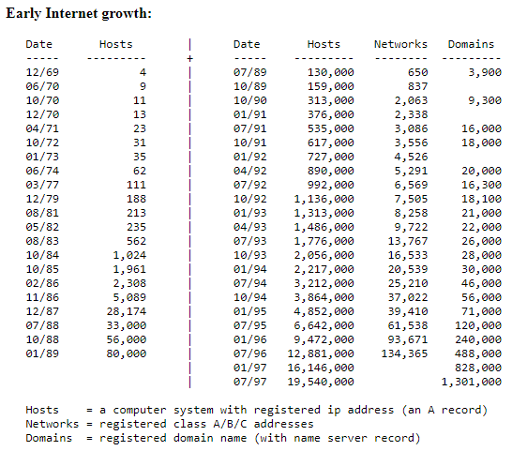
Hobbes' Internet Timeline 25 https://www.zakon.org/robert/internet/timeline/

Slide 20
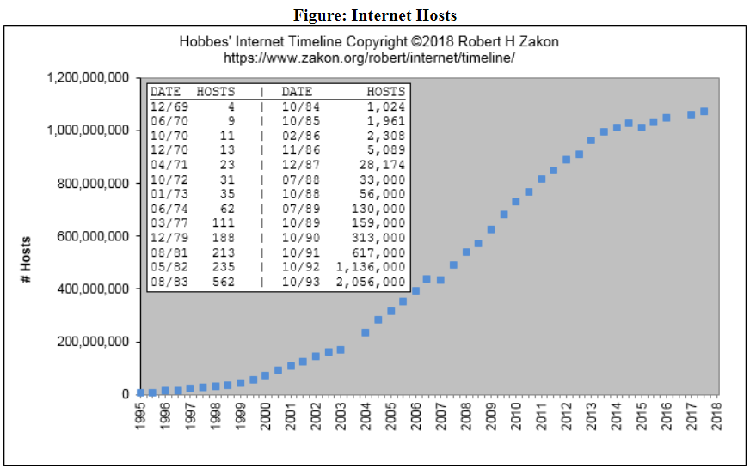
Hobbes' Internet Timeline

Slide 21
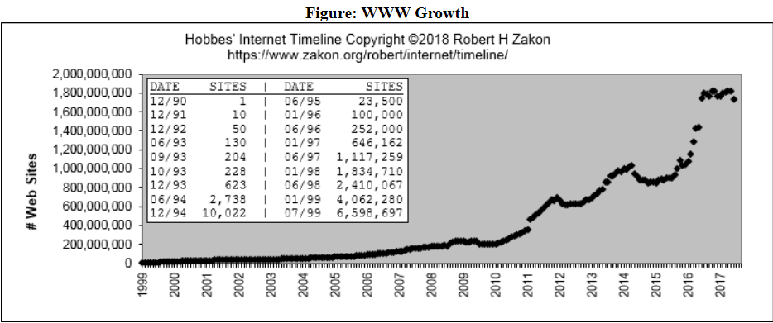
Hobbes' Internet Timeline

