Slide 1
Network Layers
Based on Dr. Pete’s adaptation of Chapters 2-5 of Computer Networking: A Top Down Approach, 6th edition
Jim Kurose, Keith Ross
Addison-Wesley

Slide 2
Internet structure: network of networks
Tier 1 ISP
Tier 1 ISP
Google
IXP
IXP
IXP
Regional ISP
Regional ISP
access
ISP
access
ISP
access
ISP
access
ISP
access
ISP
access
ISP
access
ISP
access
ISP
at center: small # of well-connected large networks
tier-1 commercial ISPs (e.g., Sprint, AT&T), national & int’l coverage
content provider network (e.g, Google): private network that connects its data centers to Internet, often bypassing tier-1, regional ISPs

Slide 3
Protocol Layers to deal with complexity
Networks are complex, with many “pieces” !
hosts
routers
links of various media
applications
protocols
hardware, software
What is a protocol?
How do layers help us deal with the complexity?

Slide 4
What is a protocol?
a human protocol and a computer network protocol:
Hi
TCP connection
request
Hi
TCP connection
response
Got the
time?
Get http://www.awl.com/kurose-ross
2:00
<file>
time
Q: other human protocols?

Slide 5
Layers analogy
It is your Colorado grandmother’s birthday. Send her a card.
Write a nice message on the card
Put it in envelope, with her address
Envelope goes into a postal truck to post office
Post office puts it into another truck to airport
Goes into shipping module, which is put into a jet
Jet flies to Denver
Module contents go into truck to post office
Sorted and put into another truck for delivery
Grandma opens the envelope, loves the card!

Slide 6
Layers analogy
After 2. Put it in envelope with her address, ...
message is in a container (envelope) with destination address (her house)
After 3. Envelope goes into postal truck to post office, ...
message is in container (envelope) which is in a container (truck) with destination (post office)

Slide 7
Layers analogy
After 5. Goes into a shipping module, which is put into a jet, . .
message is in container( envelope), which is in a container(shipping module), which is in a container (jet) with destination (Denver)
Get it? Containers nested inside containers, like Russian nesting dolls.

Slide 8
Network Protocol layers stack
application: supporting network applications (HTTP, FTP, SMTP)
transport: process-to-process data transfer (TCP, UDP)
network: routing of data from source to destination (IP)
link: data transfer between neighbor nodes (WiFi, Ethernet)
physical: bits “on the wire”
application
transport
network
link
physical

Slide 9
Encapsulation
source
message
M
application
transport
network
link
physical
segment
H_{t}
M
H_{t}
datagram
H_{n}
H_{n}
H_{t}
M
frame
H_{l}
H_{n}
H_{t}
M
link
physical
switch
destination
H_{n}
H_{t}
M
network
link
physical
M
application
transport
network
link
physical
H_{l}
H_{n}
H_{t}
M
H_{n}
H_{t}
M
H_{t}
M
H_{n}
H_{t}
M
H_{l}
H_{n}
H_{t}
M
router

Slide 10
Application Layer
Network Services used by applications
Process-to-process communication through ports called sockets
Some examples:
HTTP (HyperText Transfer Protocol): Communication to and from web servers (e.g. http://www.otterbein.edu)
FTP (File Transfer Protocol): Communication to and from file servers
SMTP (Simple Mail Transfer Protocol): Communication to and from email servers.

Slide 11
Client-server architecture
server:
always-on host
permanent address
clients:
communicate with server
may be intermittently connected
do not communicate directly with each other
Examples include web browsers and email readers
client/server

Slide 12
HTTP overview
HTTP: hypertext transfer protocol
Web’s application layer protocol
client/server model
client: browser that requests, receives, (using HTTP protocol) and “displays” Web objects
server: Web server sends (using HTTP protocol) objects in response to requests
HTTP request
PC running
Firefox browser
HTTP response
HTTP request
server
running
Apache Web
server
HTTP response
iphone running
Safari browser

Slide 13
HTTP request message
two types of HTTP messages: request, response
HTTP request message:
ASCII (human-readable format)
carriage return character
request line
(GET, POST,
HEAD commands)
line-feed character
GET /index.html HTTP/1.1\r\n
Host: www-net.cs.umass.edu\r\n
User-Agent: Firefox/3.6.10\r\n
Accept: text/html,application/xhtml+xml\r\n
Accept-Language: en-us,en;q=0.5\r\n
Accept-Encoding: gzip,deflate\r\n
Accept-Charset: ISO-8859-1,utf-8;q=0.7\r\n
Keep-Alive: 115\r\n
Connection: keep-alive\r\n
\r\n
header
lines
carriage return,
line feed at start
of line indicates
end of header lines

Slide 14
HTTP response message
status line
(protocol
status code
status phrase)
HTTP/1.1 200 OK\r\n
Date: Sun, 26 Sep 2010 20:09:20 GMT\r\n
Server: Apache/2.0.52 (CentOS)\r\n
Last-Modified: Tue, 30 Oct 2007 17:00:02 GMT\r\n
ETag: "17dc6-a5c-bf716880"\r\n
Accept-Ranges: bytes\r\n
Content-Length: 2652\r\n
Keep-Alive: timeout=10, max=100\r\n
Connection: Keep-Alive\r\n
Content-Type: text/html; charset=ISO-8859-1\r\n
\r\n
data data data data data ...
header
lines
data, e.g.,
requested
HTML file

Slide 15
Transport Layer
provide logical communication between applications running on different hosts
protocols run in end systems
send side: breaks messages into segments, passes to network layer
receive side: reassembles segments into messages, passes to application layer
application
transport
network
data link
physical
logical end-end transport
application
transport
network
data link
physical

Slide 16
Transport Layer protocols
reliable, in-order delivery (TCP)
congestion control
flow control
connection setup
unreliable, unordered delivery: UDP
no-frills “best-effort”
services not available:
delay guarantees
bandwidth guarantees
application
transport
network
data link
physical
network
data link
physical
network
data link
physical
network
data link
physical
logical end-end transport
network
data link
physical
network
data link
physical
network
data link
physical
network
data link
physical
application
transport
network
data link
physical

Slide 17
TcP segment structure
32 bits
URG: urgent data
(generally not used)
counting
by bytes
of data
(not segments!)
source port #
dest port #
sequence number
ACK: ACK #
valid
acknowledgement number
head
len
not
used
U
receive window
A
P
R
S
PSH: push data now
(generally not used)
F
# bytes
rcvr willing
to accept
checksum
Urg data pointer
RST, SYN, FIN:
connection estab
(setup, teardown
commands)
options (variable length)
application
data
(variable length)
Internet
checksum
(as in UDP)

Slide 18
Network layer
application
transport
network
data link
physical
Transports segment from sending to receiving host
Sender packages segment into datagram; receiver unpackages
Makes routing decisions at each router in between
Protocol is called IP (Internet Protocol)
network
data link
physical
network
data link
physical
network
data link
physical
network
data link
physical
network
data link
physical
network
data link
physical
network
data link
physical
network
data link
physical
network
data link
physical
application
transport
network
data link
physical
network
data link
physical
network
data link
physical

Slide 19
IP datagram format
IP protocol version
number
32 bits
total datagram
length (bytes)
header length
(bytes)
head.
len
type of
service
ver
length
for
fragmentation/
reassembly
“type” of data
flgs
fragment
offset
16-bit identifier
max number
remaining hops
(decremented at
each router)
time to
live
upper
layer
header
checksum
32 bit source IP address
upper layer protocol
to deliver payload to
32 bit destination IP address
options (if any)
e.g. timestamp,
record route
taken, specify
list of routers
to visit.
data
(variable length,
typically a TCP
or UDP segment)
how much overhead?
20 bytes of TCP
20 bytes of IP
= 40 bytes + app layer overhead

Slide 20
IP addressing
223.1.1.1
IP address: 32-bit or 128-bit identifier for host, router interface
Every “device” attached to the Internet communicates using a unique IP address
Example, the 32-bit IP address of www.otterbein.edu is 23.251.152.199
(in Windows, enter cmd in search box to open command window, then nslookup www.otterbein.edu)
223.1.2.1
223.1.1.2
223.1.1.4
223.1.2.9
223.1.1.3
223.1.3.27
223.1.2.2
223.1.3.1
223.1.3.2
223.1.1.1 = 11011111 00000001 00000001 00000001
223
1
1
1

Slide 21
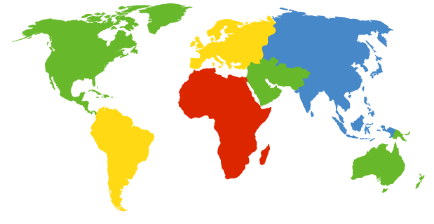
DNS: Domain Name System
Service to translate server name into IP address for Internet routing
Root DNS Servers
com DNS servers
org DNS servers
edu DNS servers
yahoo.com
DNS servers
pbs.org
DNS servers
poly.edu
DNS servers
umass.edu
DNS servers
amazon.com
DNS servers
13 root name “servers” worldwide
US DoD Columbus, OH (5 other sites)

Slide 22
Link Layer
Link layer transfers datagram from one node to physically adjacent node over a link
global ISP
Sender and receiver directly connected, within or on edge of LAN (Local Area Network)
Sender packages datagram into a frame; receiver unpacks

Slide 23
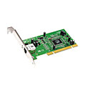
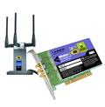
Where is the link layer implemented?
in each and every host
implemented in NIC ( Network Interface Card) or on a chip
Ethernet card
implements link, physical layer
attaches into host’s system bus
combination of hardware, software, firmware
application
transport
network
link
cpu
memory
link
physical
host
bus
(e.g., PCI)
controller
physical
transmission
network adapter
card

Slide 24
MAC addresses
MAC (aka LAN, physical, Ethernet) address
used ‘locally” to get frame from one interface to another physically-connected interface
48 bit MAC address burned in NIC ROM
e.g.: 1A-2F-BB-76-09-AD
hexadecimal (base 16) notation
(each “number” represents 4 bits)

Slide 25
Ethernet frame structure
sender encapsulates IP datagram in Ethernet frame
preamble: 8 byte 0101… pattern to synchronize receiver, sender clock rates
addresses: 6 byte source, destination MAC addresses
type: indicates higher layer protocol (usually IP)
CRC: cyclic redundancy check -- like a parity check
type
preamble
dest.
address
source
address
data (payload)
CRC

Slide 26
Ethernet protocol CSMA
Carrier Sense Multiple Access
Multiple devices on one data channel
When ready to transmit, check the channel
if channel sensed idle: transmit entire frame
if channel sensed busy, defer transmission
Collisions can still occur: two nodes may not hear each other’s transmission
entire frame transmission time wasted
each sender waits random time, then tries again

Slide 27
Physical Layer
Transmit bits through the wired or wireless carrier
Much of this introduced in the previous lecture
DSL, Cable, WiFi, Cell, Ethernet access
Twisted Pair, Coax, Fiber wire
Most media carry analog signals (sine waves) so how to encode digital data?

Slide 28
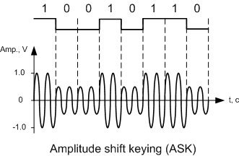
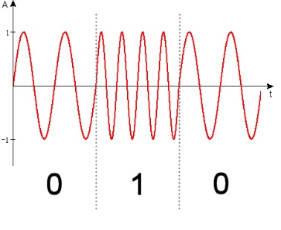
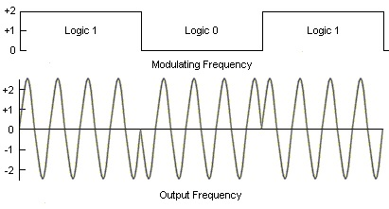
Physical Layer
Signal modulation to encode digital data
amplitude shift keying (soft/loud)
frequency shift keying (low/high)
phase shift keying
4 levels to encode 2 bits per level, 8 to encode 3, etc
To get the full effect, !

