Slide 1


Network Structures
Based on Dr. Pete’s adaptation of Chapter 1 of Computer Networking: A Top Down Approach, 6th edition
Jim Kurose, Keith Ross
Addison-Wesley

Slide 2




















What’s the Internet?
PC
connected devices:
  hosts = end systems
  running network apps
mobile network
server
wireless
laptop
global ISP
smartphone
home
network
communication links
  fiber, copper, radio, satellite
  transmission rate: bandwidth
regional ISP
wireless
links
wired
links
Packet switches: forward packets (chunks of data)
  routers and switches
router
institutional
network

Slide 3


A closer look at network structure
network edge:
  hosts: clients and servers
  servers in data centers
mobile network
global ISP
network access media:
  wired & wireless
  communication links
home
network
regional ISP
network core:
  interconnected routers
  network of networks
institutional
network

Slide 4


Access networks and physical media
Question: How to connect end systems to edge router?
mobile access networks
residential access nets
institutional access networks (school, company)

Slide 5

Access net: digital subscriber line (DSL)
central office
telephone
network
DSL
modem
splitter
ISP
voice, data transmitted
at different frequencies over
dedicated line to central office
  use existing telephone line to central office
    data over DSL phone line goes to Internet
    voice over DSL phone line goes to telephone net
  ~ 1 Mbps upload transmission rate
  ~ 10 Mbps download transmission rate

Slide 6



Access net: cable network
Cable headend
…
cable
modem
splitter
data, TV transmitted at different
frequencies over shared cable
distribution network
ISP
hybrid fiber-coaxial cable
  ~10 Mbps upstream transmission rate
  ~ 50Mbps download transmission rate
homes share access network to cable headend

Slide 7
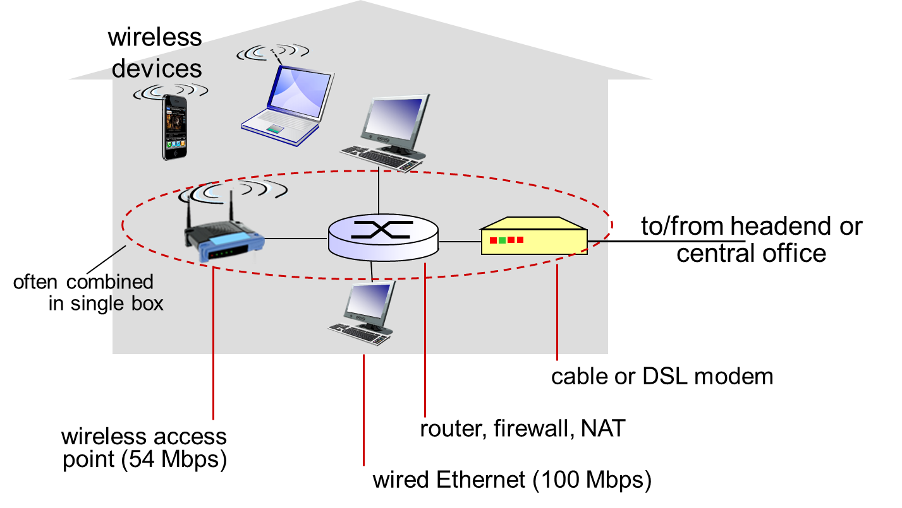
Access net: home network

Slide 8










Institutional Networks
institutional link to
ISP (Internet)
institutional router
Ethernet
switch
institutional mail,
web servers
typically used in companies, universities, etc
  10 Mbps, 100Mbps, 1Gbps, 10Gbps transmission rates
  end systems typically connect into Ethernet switch

Slide 9








Wireless access networks
shared wireless access network connects end system to router
wide-area wireless access
  provided by cell network, (20 mi)
  3G, 4G, 5G: 3 to 30 to 100 Mbps
local-area wireless access:
  within building (100 ft)
  WiFi: 54 Mbps transmit rate
to Internet
to Internet

Slide 10
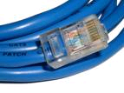


Wired physical media
twisted pair:
two insulated copper wires
coaxial cable:
two concentric copper conductors
fiber optic cable:
glass fiber carrying light pulses, each pulse a bit

Slide 11
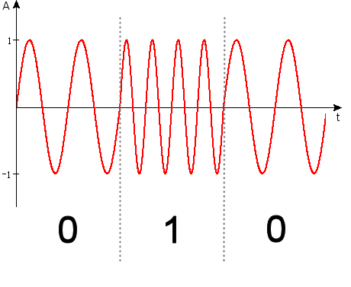
Wireless physical media
Microwave
  up to 45 Mbps
WiFi
  11Mbps, 54 Mbps
Cellular
  3G: ~3 Mbps
  4G: ~30 Mbps
  5G: ~100 Mbps
Satellite
  Kbps to 45Mbps channel
  270 msec end-end delay
  geosynchronous versus low altitude

Slide 12









The network core
mesh of interconnected routers
packet-switching: hosts break messages into packets
  forward packets from one router to the next on path from source to destination

Slide 13
Internet structure: network of networks
End systems connect to Internet via access ISPs (Internet Service Providers)
Access ISPs in turn must be interconnected.
  So any two hosts can send packets to each other
Resulting network of networks is very complex
  Evolution was driven by economics and national policies
Let’s take a stepwise approach to describe current Internet structure

Slide 14
Internet structure: network of networks
Question: given millions of access ISPs, how to connect them together?
…
…
access
net
access
net
access
net
access
net
access
net
access
net
access
net
…
…
access
net
access
net
access
net
access
net
access
net
access
net
…
access
net
access
net
…
access
net

Slide 15
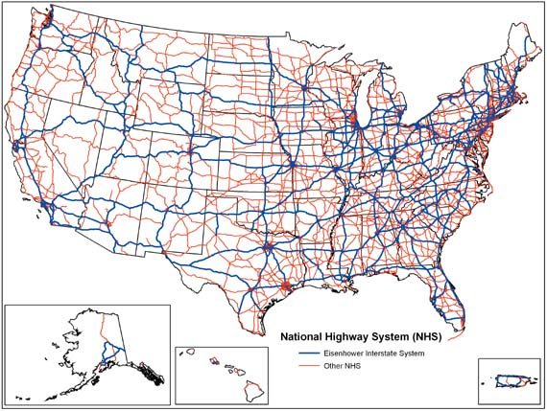
Analogy: National Highway System

Slide 16
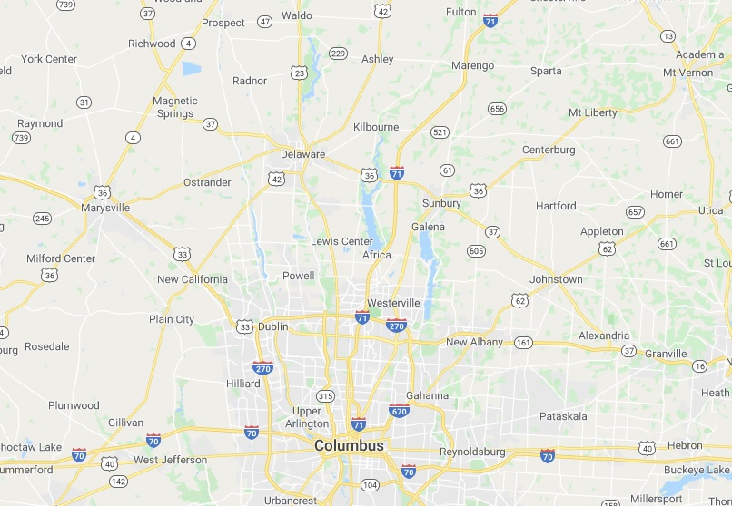
Central Ohio Highways and Roads

Slide 17
Internet structure: network of networks
Tiers of Internet Service Providers (ISPs), exchange points (IXP)
…
…
access
net
access
net
access
net
access
net
access
net
IXP
access
net
access
net
ISP A
…
…
IXP
access
net
access
net
ISP B
ISP C
access
net
access
net
access
net
regional net
access
net
…
access
net
access
net
…
access
net

Slide 18
Internet structure: network of networks
Tier 1 ISP
Tier 1 ISP
Google
IXP
IXP
IXP
Regional ISP
Regional ISP
access
ISP
access
ISP
access
ISP
access
ISP
access
ISP
access
ISP
access
ISP
access
ISP
at center: small # of well-connected large networks
  tier-1 commercial ISPs (e.g., Sprint, AT&T), national & int’l coverage
  content provider network (e.g, Google): private network that connects its data centers to Internet, often bypassing tier-1, regional ISPs

