Slide 1
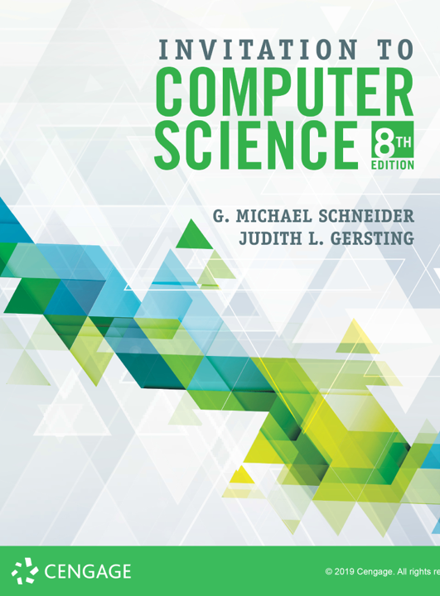
Operating Systems
Based on A (not-so-) Quick and Dirty production by Dr. Pete

Slide 2
ALERT
Syllabus reminder
We’re finishing Chapter 6 today
We start Chapter 7 on Wednesday
Assignment #6 is due next Friday
Problems from chapters 6 & 7

Slide 3
What is an Operating System?
Interesting question!
“If you can answer that to the satisfaction of both the Department of Justice and Microsoft, you should be nominated for a Nobel prize.” – Dr. Sanderson (2004)
Here are a few definitions
The one program running at all times on the computer
Program that acts as the intermediary between a user of a computer and the computer hardware
System software that supports a computer's basic functions, such as scheduling tasks, executing applications, and controlling peripherals

Slide 4
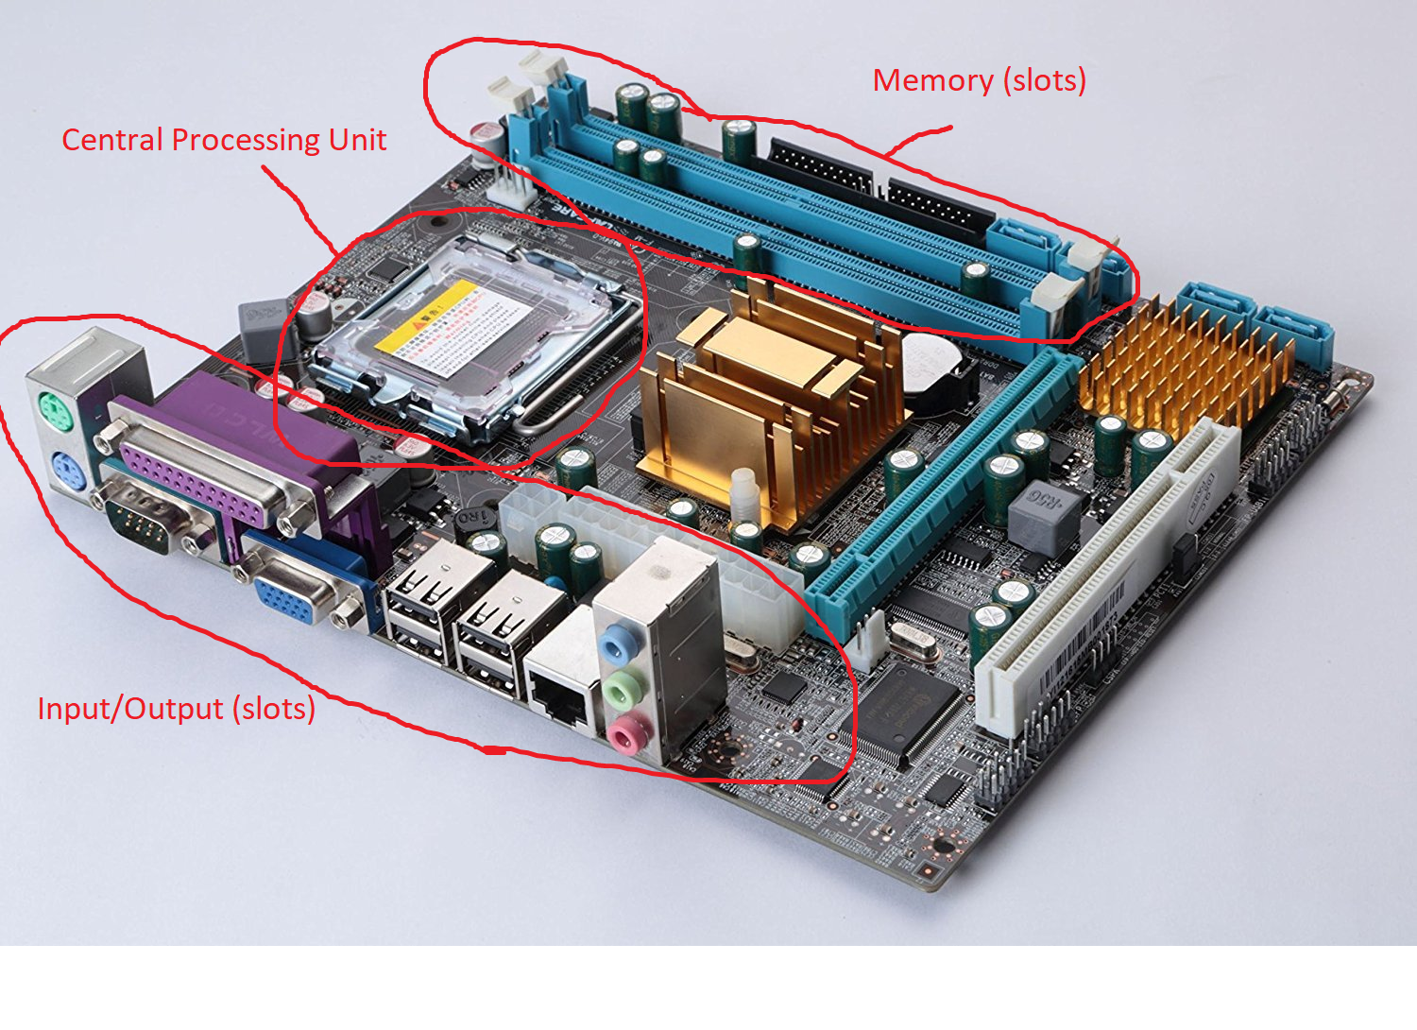
Here is a PC motherboard illustrating the von Neumann architecture
The operating system controls these critical resources

Slide 5
Brief history of OS via user interface
1940s: No OS: nearly “naked computer”
Programmer hand-loaded programs (PDP-11)
1950s-1960s: batch (one at a time), punched cards
Programmers gave programs to operator to schedule
1970s-1980s: Command Line Interface (typed)
Programmer can launch loader at will
1980s-1990s: Graphical User Interface (moused)
A new metaphor for interaction
2000s-2010s: GUI (mouse & touch; mobile devices)
What will be next...?

Slide 6
Operating Systems “under the hood”
Overarching concept: policy vs. mechanism
Efficient resource allocation:
CPU, RAM, mass storage
Safe use of system resources:
deadlock, synchronization
Security and Protection
Note: coverage of some topics goes further than the textbook

Slide 7
Policy vs. Mechanism
Most of the complexity of an Operating System is in its decision-making
Policy is decisions made by software
If 4 programs want a CPU at once, which one gets it?
If the system needs to write something new to memory and it is full, what will be replaced?
Mechanism is the hardware that carries out the decisions

Slide 8
Process Management (CPU)
A process is defined as a program either in execution or wanting to be
A process is always in one of 3 states:
running (currently executing)
ready (can run but not assigned to processor)
waiting (waiting for an external event)
Many processes compete for the CPU
Windows Task manager, Ctrl-Alt-Del
My PC currently has 167 processes, almost all in wait state

Slide 9
Process Management (CPU)
What resource does the CPU offer? Time!
Just like you! You have a fixed amount of time and many demands. How do you allocate your time?
We will explore these topics in the following slides:
Time slicing
Dispatcher – mechanism
Scheduler – policy
What causes process to change state

Slide 10
Time Slicing
CPU time is allocated in fixed-size slices.
Typical slice is 100 milliseconds (1/10 second)
If a process terminates during its slice, another process replaces it
If a process requests input or output during its slice, another process replaces it. WHY?
If a process uses up its slice, another process replaces it

Slide 11
Dispatcher
Mechanism to replace one process with another: process switch
Each process is represented by a data structure called a Process Control Block (PCB)
Program Counter and Register values
Other data for process, memory, I/O management
Upon process switch:
CPU register values written to outgoing PCB
Incoming PCB values written to CPU registers
Just like you have to adjust your brain when you switch from one task to another!

Slide 12
Scheduler
Scheduler determines order in the queue (line) of Ready processes
It makes decisions based on scheduling policy
Some well-known policies:
First-come First-served
Priority
Shortest Job First
Shortest Job First keeps track of past time-slice usage. Processes with lots of I/O are preferred. Why?

Slide 14
What causes a process to change state?
Dispatcher assigns to CPU
Running
Ready
Time Slice Expires
Requests I/O
I/O completes
Waiting

Slide 15
Memory Management
What resource does RAM memory offer? Space!
We will explore the following issues:
Virtual vs. physical memory
Pages (“space slicing”)
Memory allocation

Slide 16
Physical Memory
The “running” process and all “ready” processes must be in memory, so they have to share!
What if their total size is > physical memory size??
Oh and this…all have been assembled into machine code and all have first instruction at address 0.
Only one process can occupy physical address 0!!

Slide 17
Virtual Memory
Every process starts at virtual address 0!
Process can be loaded anywhere in physical memory!
Store physical starting address in Process Control Block
When process dispatched to run, copy physical starting address into CPU Relocation Register
For each memory reference while executing, add Relocation Register value to it to get physical address!
Ex: process starting physical address is 100. When LOAD 12 executed, read from address 112 (100+12)

Slide 18
Memory Pages
There are many processes loaded in memory
There may be empty gaps between them (e.g. space vacated by a terminated process)
Suppose there are 3 gaps of size 10, 12, 15.
New process size 20 needs loaded. Where to put it?
One solution is to shift the others to make bigger gaps. No fun!
Another solution is “space slices”, like “time slices”

Slide 19
Memory Pages
Partition memory into fixed-size chunks called pages
Process is split up into page-size pieces
PCB includes a Page Table to track where each piece is physically located.
Use Page Table to translate each memory reference while running.
Process’ Page Table
Virtual Page | Physical Page
0 | 18
1 | 19
2 | 24
3 | 36
4 | 37

Slide 20
Memory Allocation
Physical memory divided into pages.
There is a Memory Table with one bit per page:
0 = available
1 = occupied
When new process loaded, any available page can be allocated to it.
What if memory is full?
Physical Memory Table
Page | Occupied
0 | 1
1 | 1
2 | 0
3 | 0
4 | 1
... | ...
N-1 | 0

Slide 21
Mass Storage Management
KEY: Mass storage management is conceptually similar to memory management
Storage space sliced into fixed-size chunks called sectors or blocks. Analogous to memory pages.
Files can be split up across sectors. Analogous to process being split up across pages.
Per-file table to know where its pieces are stored. Per-device table to know what’s available.

Slide 22
Safe Use of System Resources
Deadlock is an issue. Example:
Resources A and B can only be used by one process at a time. Could be printer or memory buffer, etc.
Process 1 is holding Resource A and requests Resource B. Not available; goes into Waiting state.
Process 2 is holding Resource B and requests Resource A. Not available; goes into Waiting state.
Processes 1 and 2 are deadlocked!! Both will wait forever.
Can prevent by forcing processes to release before requesting.

Slide 23
Safe Use of System Resources
Synchronization is an issue. Example:
A buffer shared by Process 1 and Process 2.
Process 1 will write 23 and 37 into first two available indexes, 1 and 2. After writing 23, it is interrupted.
Process 2 takes over. It will write 11 into first available index. It writes 11 into index 2.
Process 1 resumes, and writes 37 into index 2.
Buffer contains 23 and 37 instead of 23, 11, 37
23
23 | 11
23 | 11 37

Slide 24
Security and Protection
Security and Protection are policies and mechanisms for assuring the integrity of system resources and data
Examples:
File permissions to control who can access a file, and what operations they can perform (read, write, etc.)
Usernames and passwords to access applications
Encryption to protect sensitive data
I hope we have time to explore further in Chapter 8.

Slide 25
That’s a lot of information!
Operating Systems are the most complex software applications ever developed.
I have tried to summarize a complete senior-level course in one presentation.

