Slide 1
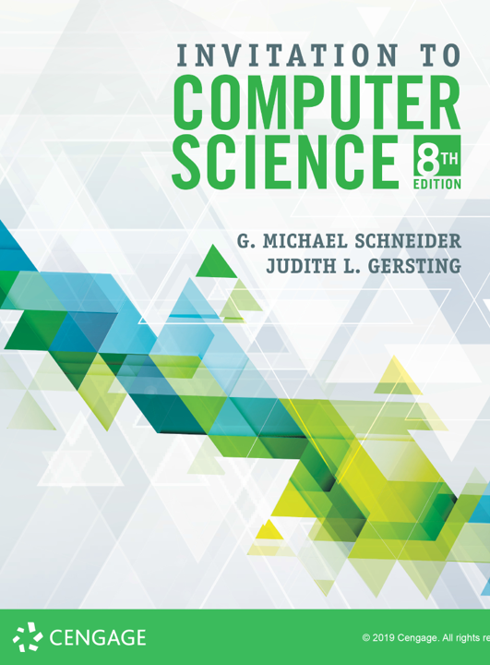
Language Translation

Slide 2
ALERT
Assignment #5 is due Friday
Lab 9 is available on Blackboard and due next Wednesday
Assignment #6 is available on Blackboard and the course website. It is due next Friday

Slide 3
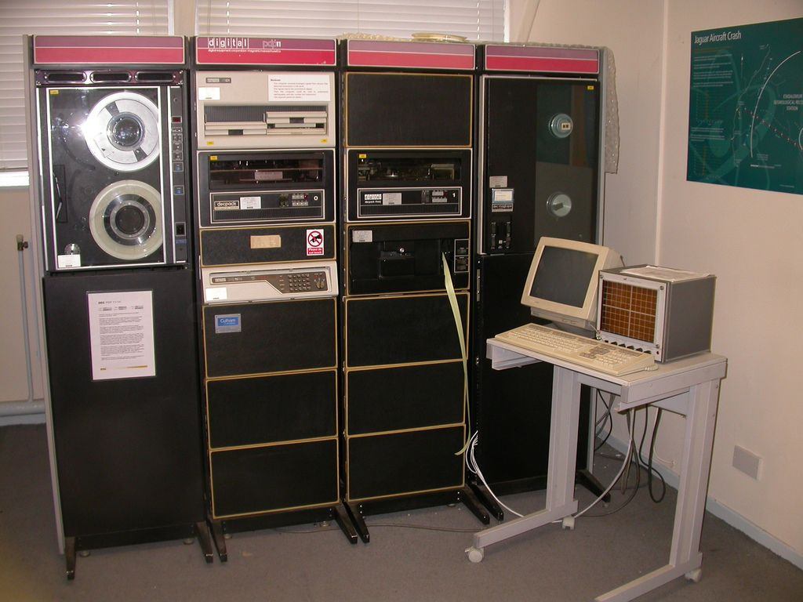
PdP-11
Part 1
Part 2
Part 3
Part 4

Slide 4
Introduction
A naked machine has no tools or programs to help the user
Write instructions in binary
Write data in binary
Load instructions into memory one cell at a time
Initiate program run
Too difficult for humans to do
We must build an interface to hide the details and make the computer easier to build

Slide 5
Assemblers and Assembly Language
Assembly language
Instructions map one-to-one to machine language
Symbolic op codes (not binary)
Symbolic addresses for instructions and data
Pseudo-ops for data generation and more (data in human-friendly terms)
Assembly = a low-level programming language
Java, C, Python = high-level programming languages

Slide 6
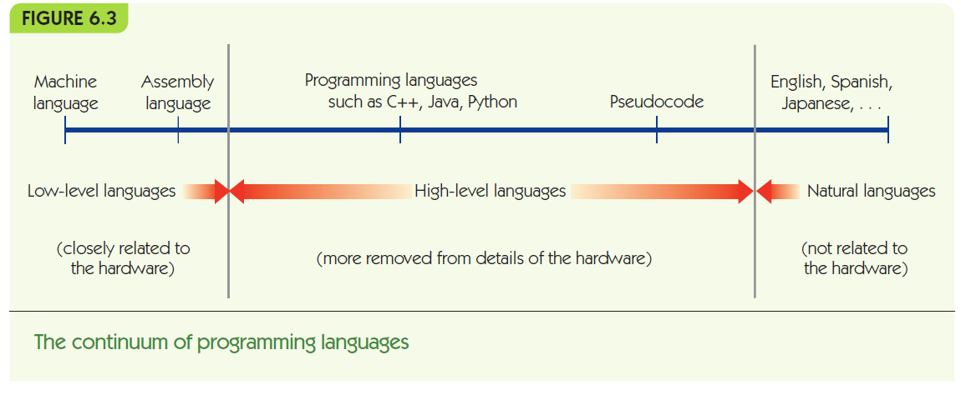

Slide 7
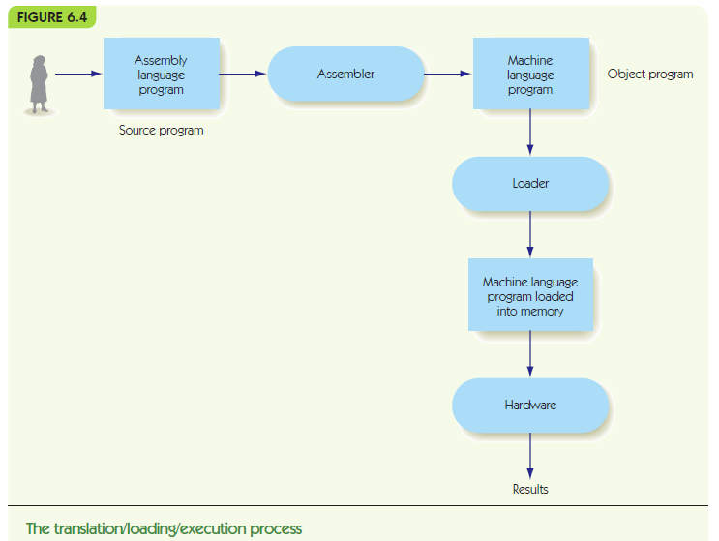

Slide 8
Assemblers and Assembly Language
Example Assembly language:
NEXT: LOAD X -- Put X into R
label: opcode address field -- comment
Label is optional name for this instruction’s location
Op code mnemonic and address field translate to machine language
Comments are ignored by assembler, just for human use

Slide 9
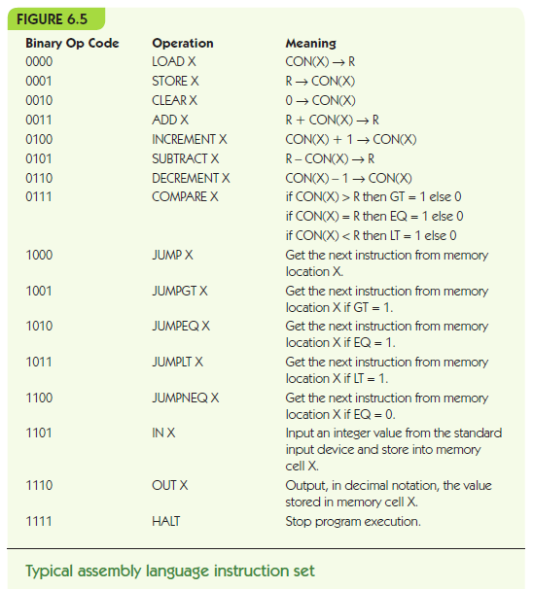

Slide 10
Assemblers and Assembly Language
Translation and loading:
Assembler translates to machine language
Convert symbolic op codes to binary equivalents
Convert symbolic labels to memory addresses
Perform pseudo-op actions
Write object file containing machine instructions
Loader gets program ready to run
Places instructions in memory
Triggers the hardware to run the program

Slide 11
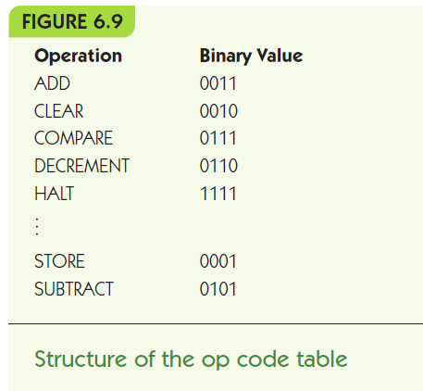
Assemblers and Assembly Language
Converting symbolic op codes to binary ones
Assembler maintains a table
Assembler looks up symbolic op codes in the table and substitutes the binary analogue
Use binary search to optimize table lookups

Slide 12
Assemblers and Assembly Language
Converting symbolic labels to memory addresses
Assembler needs two passes
looks over assembly code two times
First pass:
Keep a count of instructions from the start
Collect symbolic labels and add to symbol table along with location counter

Slide 13
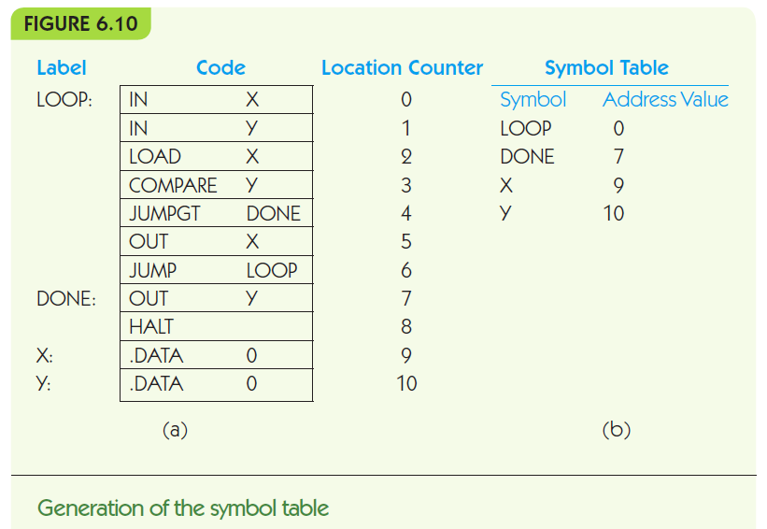

Slide 14
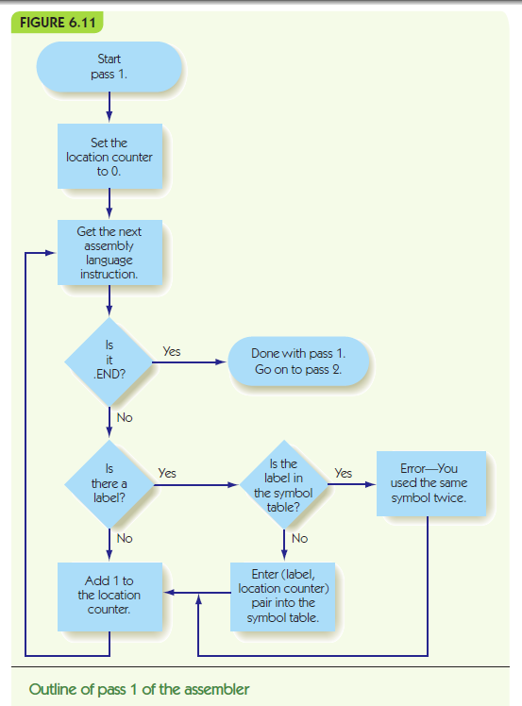

Slide 15
Assemblers and Assembly Language
Second pass:
Look up and replace op codes
Substitute label references with location from symbol table
Set up .DATA pseudo-ops with location and binary value
Write instructions to object file

Slide 16
