Slide 1
Machine Language
&
Assembly Language

Slide 2
ALERT
Exam I
Homework #5 is due Friday
Lab 9 due next Wednesday
Let's look at it...

Slide 3
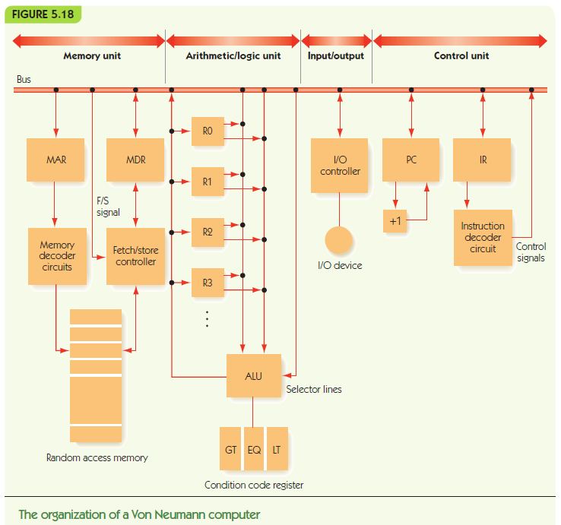

Slide 4
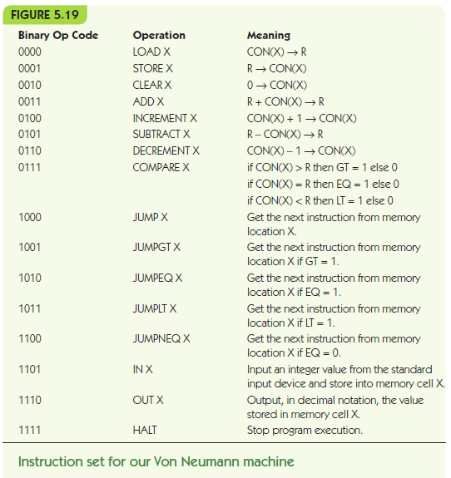

Slide 5
Machine Language - Binary
Address Contents
00000000 0000000000001100
00000001 0011000000001101
00000010 0001000000001110
00000011 0111000000010000
00000100 1001000000000111
00000101 0001000000001111
00000110 1000000000001010
00000111 0000000000010000
00001000 0101000000001110
00001001 0001000000001111
00001010 1110000000001111
00001011 1111000000000000
00001100 0000000000000110
00001101 0000000000000111
00001110 0000000000000000
00001111 0000000000000000
00010000 0000000000000000

Slide 6
Machine Language - Binary
Address Contents
00000000 0000000000001100
00000001 0011000000001101
00000010 0001000000001110
00000011 0111000000010000
00000100 1001000000000111
00000101 0001000000001111
00000110 1000000000001010
00000111 0000000000010000
00001000 0101000000001110
00001001 0001000000001111
00001010 1110000000001111
00001011 1111000000000000
00001100 0000000000000110
00001101 0000000000000111
00001110 0000000000000000
00001111 0000000000000000
00010000 0000000000000000
Do you know HEX?
0000 = 0
0001 = 1
0010 = 2
0011 = 3
0100 = 4
0101 = 5
0110 = 6
0111 = 7
1000 = 8
1001 = 9
1010 = A
1011 = B
1100 = C
1101 = D
1110 = E
1111 = F

Slide 7
Machine Language - Binary
Address Contents
00000000 0000000000001100
00000001 0011000000001101
00000010 0001000000001110
00000011 0111000000010000
00000100 1001000000000111
00000101 0001000000001111
00000110 1000000000001010
00000111 0000000000010000
00001000 0101000000001110
00001001 0001000000001111
00001010 1110000000001111
00001011 1111000000000000
00001100 0000000000000110
00001101 0000000000000111
00001110 0000000000000000
00001111 0000000000000000
00010000 0000000000000000
Do you know HEX?
0000 = 0
0001 = 1
0010 = 2
0011 = 3
0100 = 4
0101 = 5
0110 = 6
0111 = 7
1000 = 8
1001 = 9
1010 = A
1011 = B
1100 = C
1101 = D
1110 = E
1111 = F

Slide 8
Machine Language - Binary
Address Contents
00000000 0000000000001100
00000001 0011000000001101
00000010 0001000000001110
00000011 0111000000010000
00000100 1001000000000111
00000101 0001000000001111
06 800A
00000111 0000000000010000
00001000 0101000000001110
00001001 0001000000001111
00001010 1110000000001111
00001011 1111000000000000
00001100 0000000000000110
00001101 0000000000000111
00001110 0000000000000000
00001111 0000000000000000
00010000 0000000000000000
Do you know HEX?
0000 = 0
0001 = 1
0010 = 2
0011 = 3
0100 = 4
0101 = 5
0110 = 6
0111 = 7
1000 = 8
1001 = 9
1010 = A
1011 = B
1100 = C
1101 = D
1110 = E
1111 = F

Slide 9
Machine Language - Hexadecimal
Address Contents
00 000C
01 300D
02 100E
03 7010
04 9007
05 100F
06 800A
07 0010
08 500E
09 100F
0A E00F
0B F000
0C 0006
0D 0007
0E 0000
0F 0000
10 0000
Is this any better?

Slide 10
Machine Language - Hexadecimal
Address Contents
00 000C
01 300D
02 100E
03 7010
04 9007
05 100F
06 800A
07 0010
08 500E
09 100F
0A E00F
0B F000
0C 0006
0D 0007
0E 0000
0F 0000
10 0000
Is this any better?
What if we use op-codes?
0000 = 0 = LOAD
0001 = 1 = STORE
0010 = 2 = CLEAR
0011 = 3 = ADD
ETC.,…

Slide 11
Machine Language - Hexadecimal
Address Contents
00 000C
01 ADD 00D
02 100E
03 7010
04 9007
05 STORE 00F
06 800A
07 0010
08 500E
09 100F
0A E00F
0B F000
0C 0006
0D 0007
0E 0000
0F 0000
10 0000
Is this any better?
What if we use op-codes?
0000 = 0 = LOAD
0001 = 1 = STORE
0010 = 2 = CLEAR
0011 = 3 = ADD
ETC.,…

Slide 12
Machine Language with Mnemonics
00 LOAD 00C
01 ADD 00D
02 STORE 00E
03 COMPARE 010
04 JUMPGT 007
05 STORE 00F
06 JUMP 00A
07 LOAD 010
08 SUBTRACT 00E
09 STORE 00F
0A OUT 00F
0B HALT 000
0C 0006
0D 0007
0E 0000
0F 0000
10 0000
What does this buy us?
At what cost?

Slide 13
Machine Language with Mnemonics
00 LOAD 00C
01 ADD 00D
02 STORE 00E
03 COMPARE 010
04 JUMPGT 007
05 STORE 00F
06 JUMP 00A
07 LOAD 010
08 SUBTRACT 00E
09 STORE 00F
0A OUT 00F
0B HALT 000
0C 0006
0D 0007
0E 0000
0F 0000
10 0000
}
Why didn’t I
substitute
for these?

Slide 14
Machine Language with Mnemonics
00 LOAD 00C
01 ADD 00D
02 STORE 00E
03 COMPARE 010
04 JUMPGT 007
05 STORE 00F
06 JUMP 00A
07 LOAD 010
08 SUBTRACT 00E
09 STORE 00F
0A OUT 00F
0B HALT 000
0C 0006
0D 0007
0E 0000
0F 0000
10 0000
Let’s write the remaining
constants in decimal form
with no leading zeros.

Slide 15
Proto-Assembly Language
0 LOAD 12
1 ADD 13
2 STORE 14
3 COMPARE 16
4 JUMPGT 7
5 STORE 15
6 JUMP 10
7 LOAD 16
8 SUBTRACT 14
9 STORE 15
10 OUT 15
11 HALT
12 6
13 7
14 0
15 0
16 0
Let’s write the remaining
constants in decimal form
with no leading zeros.
Note: the assembler will then
have to translate decimal
numbers back into binary.

Slide 16
Proto-Assembly Language
0 LOAD 12
1 ADD 13
2 STORE 14
3 COMPARE 16
4 JUMPGT 7
5 STORE 15
6 JUMP 10
7 LOAD 16
8 SUBTRACT 14
9 STORE 15
10 OUT 15
11 HALT
12 6
13 7
14 0
15 0
16 0
Now, let’s try to read this
program and understand
what it does.

Slide 18
Proto-Assembly Language
0 LOAD 12
1 ADD 13
2 STORE 14
3 COMPARE 16
4 JUMPGT 7
5 STORE 15
6 JUMP 10
7 LOAD 16
8 SUBTRACT 14
9 STORE 15
10 OUT 15
11 HALT
12 6
13 7
14 0
15 0
16 0
Now, let’s try to read this
program and understand
what it does.

Slide 19
Proto-Assembly Language
0 LOAD 12
1 ADD 13
ADD ??
2 STORE 14
3 COMPARE 16
4 JUMPGT 7
5 STORE 15
6 JUMP 10
7 LOAD 16
8 SUBTRACT 14
9 STORE 15
10 OUT 15
11 HALT
12 6
13 7
14 0
15 0
16 0
Suppose we want to add
an instruction…

Slide 20
Assembly Language
0 LOAD 12
1 ADD 13
2 STORE 14
3 COMPARE 16
4 JUMPGT 7
5 STORE 15
6 JUMP 10
7 LOAD 16
8 SUBTRACT 14
9 STORE 15
10 OUT 15
11 HALT
12 6
13 7
14 0
15 0
16 0

Slide 21
Assembly Language
0 LOAD A
1 ADD 13
2 STORE 14
3 COMPARE 16
4 JUMPGT 7
5 STORE 15
6 JUMP 10
7 LOAD 16
8 SUBTRACT 14
9 STORE 15
10 OUT 15
11 HALT
A: 6
13 7
14 0
15 0
16 0

Slide 22
Assembly Language
LOAD A
ADD B
STORE C
COMPARE ZERO
JUMPGT NEGATE
STORE D
JUMP OUTPUT
NEGATE: LOAD ZERO
SUBTRACT C
STORE D
OUTPUT: OUT D
HALT
A: 6
B: 7
C: 0
D: 0
ZERO: 0

Slide 23
Assembly Language
.BEGIN
LOAD A
ADD B
STORE C
COMPARE ZERO
JUMPGT NEGATE
STORE D
JUMP OUTPUT
NEGATE: LOAD ZERO
SUBTRACT C
STORE D
OUTPUT: OUT D
HALT
A: .DATA 6
B: .DATA 7
C: .DATA 0
D: .DATA 0
ZERO: .DATA 0
.END

Slide 24
Assembly Language
.BEGIN
LOAD A
ADD B
STORE C
COMPARE ZERO
JUMPGT NEGATE
STORE D
JUMP OUTPUT
NEGATE: LOAD ZERO
SUBTRACT C
STORE D
OUTPUT: OUT D
HALT
A: .DATA 6
B: .DATA 7
C: .DATA 0
D: .DATA 0
ZERO: .DATA 0
.END
Assembler Responsibilities
Mnemonics → Binary
Decimal → Binary
Labels → Addresses
Pseudo-ops

Slide 25
Java Version
int a = 6;
int b = 7;
int c, d;
c = a + b;
if (c >= 0) {
d = c;
} else {
d = -c;
}
System.out.println(d);

Slide 26
Assembly Language Examples
Simple examples:
x = y + 3
input a and b
while a > b do
print a
a = a – 2
LOAD Y
ADD THREE
STORE X
… -- Data comes after HALT
X: .DATA 0 -- X is initially 0
Y: .DATA 5 – Y is initially 5
THREE: .DATA 3 –The constant 3
IN A
IN B
LOOP1: LOAD A A: .DATA 0
COMPARE B B: .DATA 0
JUMPLT LOOP1END TWO: .DATA 2
JUMPEQ LOOP1END
OUT A
LOAD A
SUBTRACT TWO
STORE A
JUMP LOOP1
LOOP1END: …

Slide 28
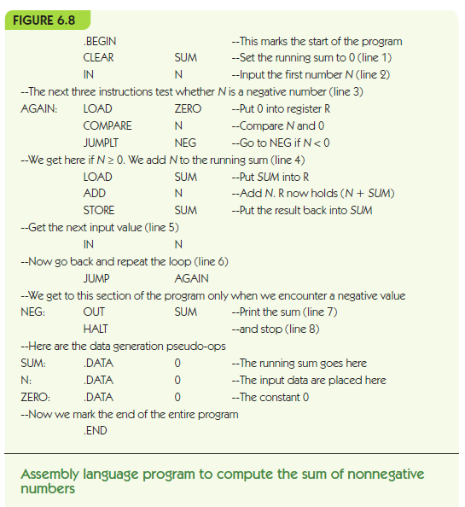

Slide 29
More Examples
.BEGIN
CLEAR RESULT
LOAD FIRST
STORE COUNTER
LOOP: LOAD FINAL
COMPARE COUNTER
JUMPGT FINISH
LOAD RESULT
ADD COUNTER
STORE RESULT
INCREMENT COUNTER
JUMP LOOP
FINISH: HALT
FIRST: .DATA 1
FINAL: .DATA 7
COUNTER: .DATA 0
RESULT: .DATA 0
.END
.BEGIN
LOOP: LOAD LIMIT
COMPARE RESULT
JUMPGT DONE
JUMPEQ DONE
LOAD SECOND
STORE FIRST
LOAD RESULT
STORE SECOND
LOAD FIRST
ADD SECOND
STORE RESULT
JUMP LOOP
DONE: LOAD SECOND
STORE RESULT
HALT
FIRST: .DATA 1
SECOND: .DATA 1
RESULT: .DATA 2
LIMIT: .DATA 20
.END

Slide 30
The End

