Slide 1
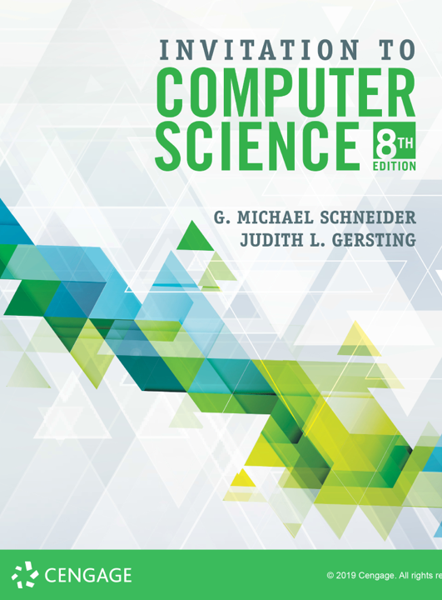
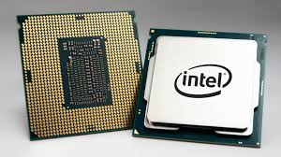
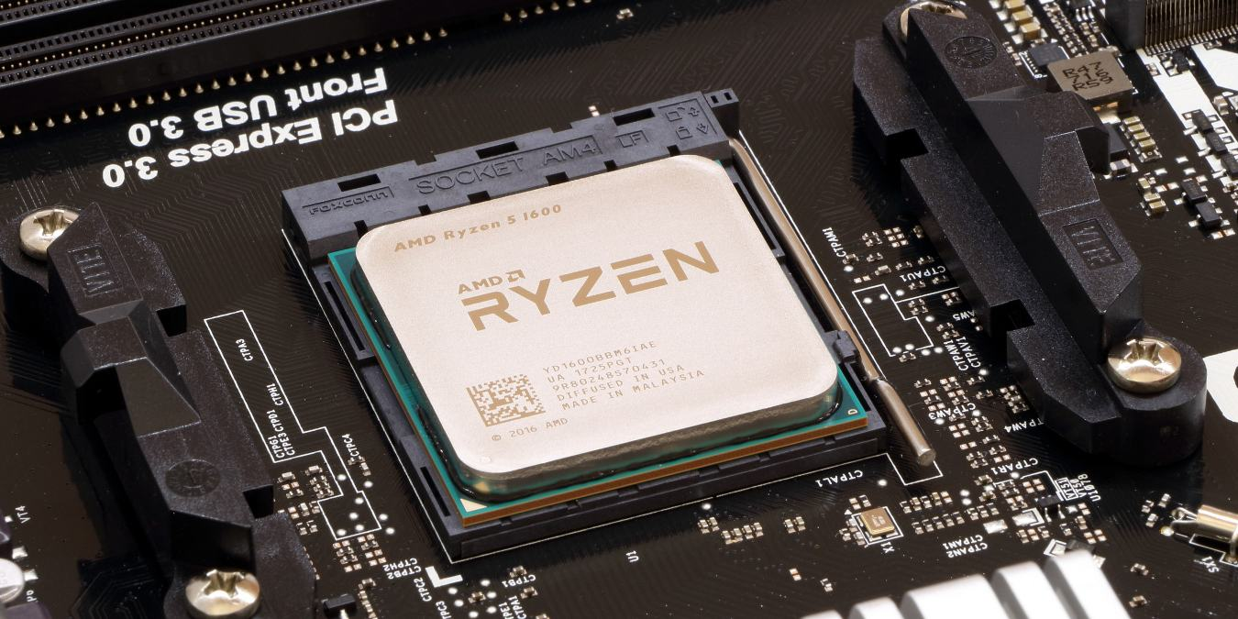
The CPU
(ALU & CU)

Slide 2
ALERT
Assignment 4 is due today.
Lab 7 is now available on Brightspace. It is due next Monday
Lab 8 is now available on Brightspace. It is due next Wednesday
No new Homework this week: study for the midterm!
HW #5 will be available on Wednesday and due 10/11

Slide 3
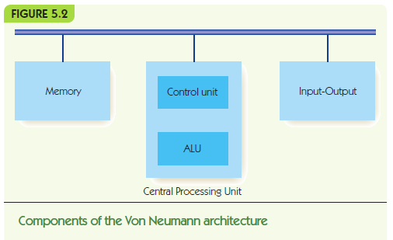

Slide 4
The Components of a Computer System The Arithmetic/Logic Unit
The ALU is part of the processor
It contains circuits for arithmetic:
addition, subtraction, multiplication, division
It contains circuits for comparison and logic:
equality, and, or, not
It contains registers: super-fast, dedicated memory connected to circuits
It contains data paths: how information flows in ALU
from registers to circuits
from circuits back to registers

Slide 5
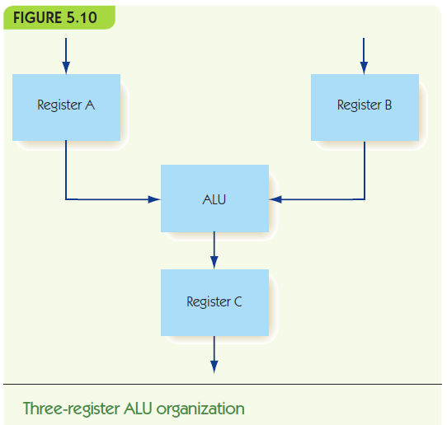

Slide 6
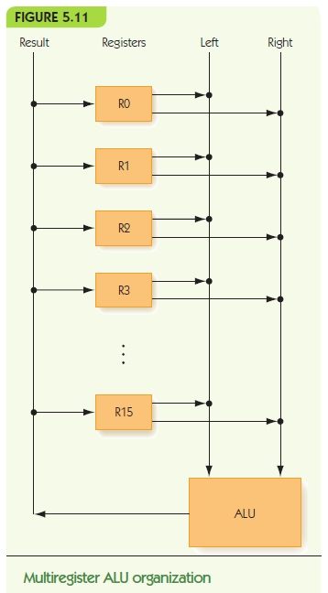

Slide 7
The Components of a Computer System The ALU (continued)
How to choose which operation to perform?
Option 1: decoder signals one circuit to run
Option 2: run all circuits, multiplexor selects one output from all circuits
In practice, option 2 is usually chosen

Slide 8
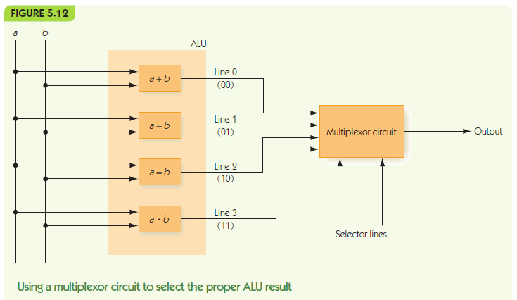

Slide 9
The Components of a Computer System The ALU (continued)
How to choose which operation to perform?
Option 1: decoder signals one circuit to run
Option 2: run all circuits, multiplexor selects one output from all circuits
In practice, option 2 is usually chosen
Information flow:
Data comes in from outside ALU to registers
Signal comes to multiplexor, which operation
Result goes back to register, and then to outside

Slide 10
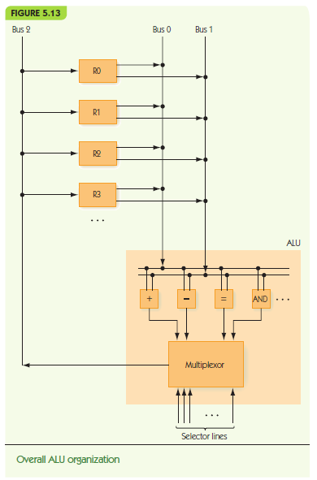

Slide 11
The Components of a Computer System The Control Unit
Stored program characteristic:
Programs are encoded in binary and stored in computer’s memory
Control unit fetches instructions from memory, decodes them, and executes them
Instructions encoded:
Operation code (op code) tells which operation
Addresses tell which memory addresses/registers to operate on

Slide 13
The Components of a Computer System The Control Unit (continued)
Machine language:
Binary strings that encode instructions
Instructions can be carried out by hardware
Sequences of instructions encode algorithms
Instruction set:
The instructions implemented by a particular chip
Each kind of processor speaks a different language

Slide 14
The Components of a Computer System The Control Unit (continued)
RISC machines and CISC machines
Reduced instruction set computers:
small instruction sets
each instruction highly optimized
easy to design hardware
Complex instruction set computers:
large instruction set
single instruction can do a lot of work
complex to design hardware
Modern hardware: some RISC and some CISC

Slide 15
The Components of a Computer System The Control Unit (continued)
Kinds of instructions:
Data transfer, e.g., move data from memory to register
Arithmetic/Logic, e.g., add, and, etc.
Comparison, compare two values
Branch, change to a non-sequential instruction
Branching allows for conditional and loop forms
E.g., JUMPLT a = If previous comparison of A and B found A < B, then jump to instruction at address a

Slide 16
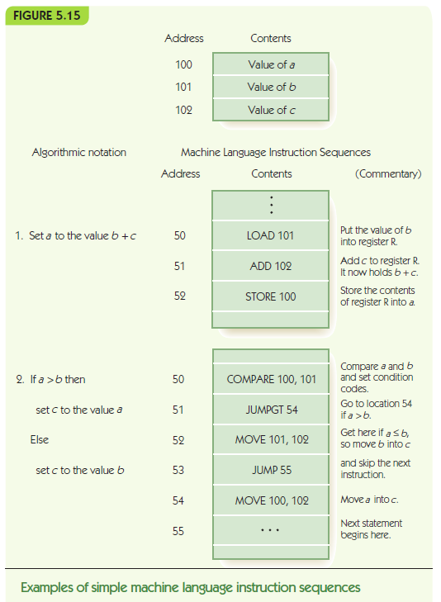

Slide 17
The Components of a Computer System The Control Unit (continued)
Control unit contains:
Program counter (PC) register: holds address of next instruction
Instruction register (IR): holds encoding of current instruction
Instruction decoder circuit
Decodes op code of instruction, and signals helper circuits, one per instruction
Helpers send addresses to proper circuits
Helpers signal ALU, I/O controller, memory

Slide 18
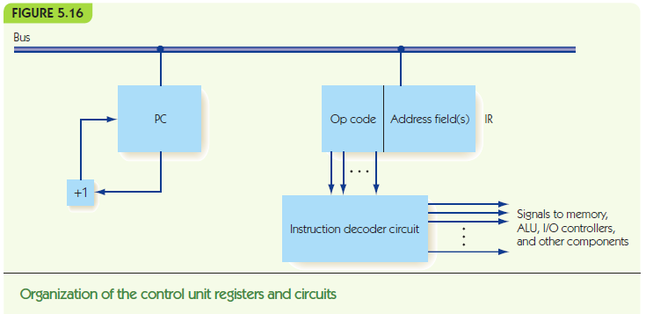

Slide 19
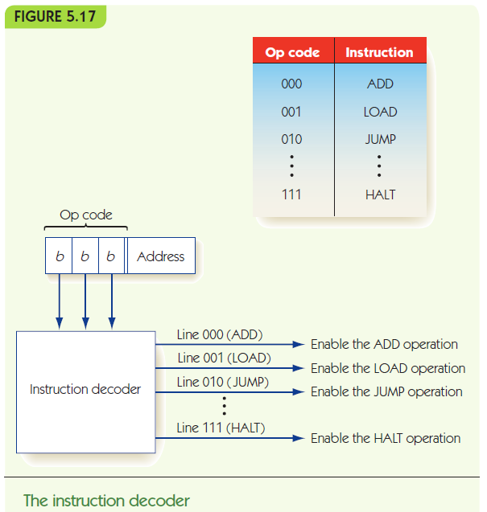

Slide 20
Putting the Pieces Together The Von Neumann Architecture
Combine previous pieces: Von Neumann machine

Slide 21
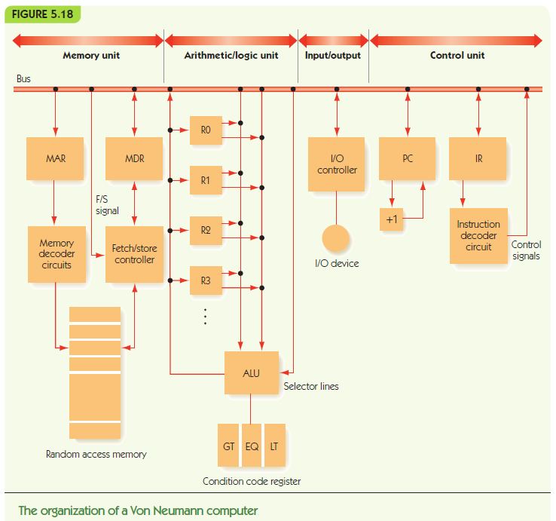

Slide 22
Putting the Pieces Together The Von Neumann Architecture
Fetch-Execute Algorithm (what the CU does)
Address in PC is copied to MAR
Instruction is fetched into MDR
MDR copied to IR
PC++
Opcode in IR is decoded
Operands interpreted & ALU circuits activated
Instruction executed
Results updated (registers, memory, PC, etc.)

Slide 24
ALERT
Lab 8 is on Brightspace: due Wednesday
Homework #5 will be available on Brightspace and the course website on Wednesday. It is due 10/11

Slide 25
Putting the Pieces Together The Von Neumann Architecture
Notation for computer’s behavior:
CON(A) | Contents of memory cell A
A → B | Send value in register A to register B (special registers: PC, MAR, MDR, IR, ALU, R, GT, EQ, LT, +1)
FETCH | Initiate a memory fetch operation
STORE | Initiate a memory store operation
ADD | Instruct the ALU to select the output of the adder circuit
SUBTRACT | Instruct the ALU to select the output of the subtract circuit

Slide 26
Instruction Set for Von Neumann Machine

Slide 27
Instruction Set for Von Neumann Machine

Slide 28
Putting the Pieces Together The Von Neumann Architecture
LOAD X meaning CON(X) → R
IR_{addr} → MAR Send address X to MAR
FETCH Initiate Fetch, data to MDR
MDR → R Move data in MDR to R
STORE X meaning R → CON(X)
IR_{addr} → MAR Send address X to MAR
R → MDR Send data in R to MDR
STORE Initiate store of MDR to X

Slide 29
Putting the Pieces Together The Von Neumann Architecture
ADD X meaning R + CON(X) → R
IR_{addr} → MAR Send address X to MAR
FETCH Initiate Fetch, data to MDR
MDR → ALU Send data in MDR to ALU
R → ALU Send data in R to ALU
ADD Select ADD circuit as result
ALU → R Copy selected result to R
JUMP X meaning get next instruction from X
IR_{addr} → PC Send address X to PC

Slide 30
Putting the Pieces Together The Von Neumann Architecture
COMPARE X meaning:
if CON(X) > R then GT = 1 else 0
if CON(X) = R then EQ = 1 else 0
if CON(X) < R then LT = 1 else 0
IR_{addr} → MAR Send address X to MAR
FETCH Initiate Fetch, data to MDR
MDR → ALU Send data in MDR to ALU
R → ALU Send data in R to ALU
SUBTRACT Evaluate CON(X) – R
Sets EQ, GT, and LT

Slide 31
Putting the Pieces Together The Von Neumann Architecture
JUMPGT X meaning:
if GT = 1 then jump to X
else continue to next instruction
IF GT = 1 THEN IR_{addr} → PC

Slide 32
The Components of a Computer System Input/Output and Mass Storage
Input/Output (I/O) connects the processor to the outside world:
Humans: keyboard, monitor, etc.
Data storage: hard drive, DVD, flash drive
Other computers: network
RAM = volatile memory (gone without power)
Mass storage systems = nonvolatile memory
Direct access storage devices (DASDs)
Sequential access storage devices (SASDs)

Slide 33
The Components of a Computer System I/O and Mass Storage (continued)
DASDs
Hard drives, CDs, DVDs contain disks
Tracks: concentric rings around disk surface
Sectors: fixed size segments of tracks, unit of retrieval
Time to retrieve data based on:
seek time
latency
transfer time
Other non-disk DASDs: flash memory, optical

Slide 34
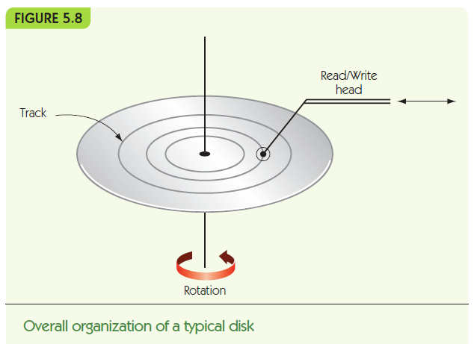

Slide 35
The Components of a Computer System I/O and Mass Storage (continued)
DASDs and SASDs are orders of magnitude slower than RAM: (microseconds or milliseconds)
I/O Controller manages data transfer with slow I/O devices, freeing processor to do other work
Controller sends an interrupt signal to processor when I/O task is done

Slide 36
