Slide 1
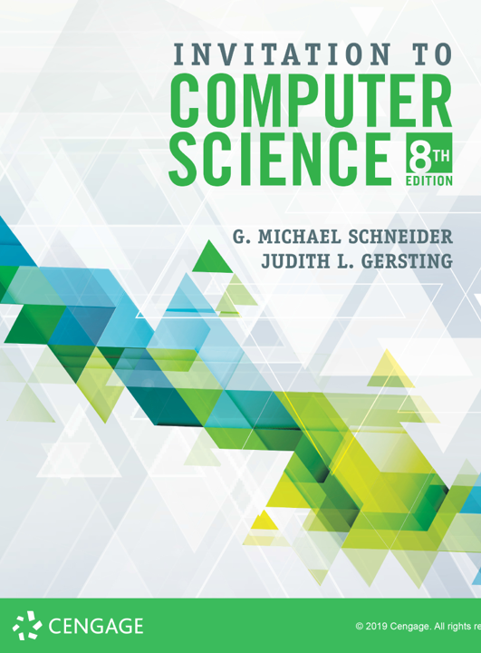
The Von Neumann Architecture

Slide 2
ALERTs
Assignment 4 is due Friday.
Lab 7 is now available on Brightspace. It is due next Monday
Lab 8 is now available on Brightspace. It is due next Wednesday

Slide 3
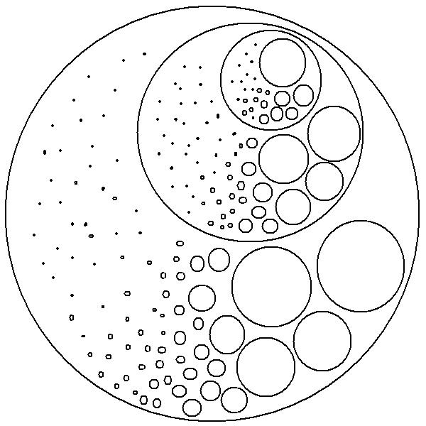
Excuse me, Can you tell me how to get to...
So, how do we build an entire computer out of gates?
We don't, any more than we build one out of transistors...
Abstraction!
We will use a bottom-up approach to build functional units out of which a computer can be constructed.

Slide 4
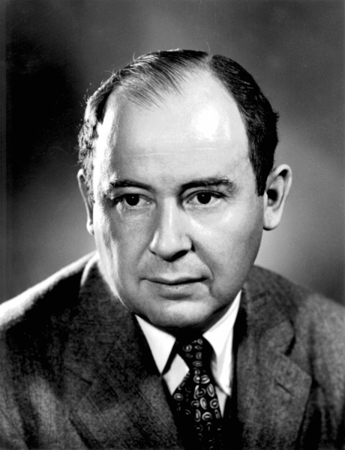
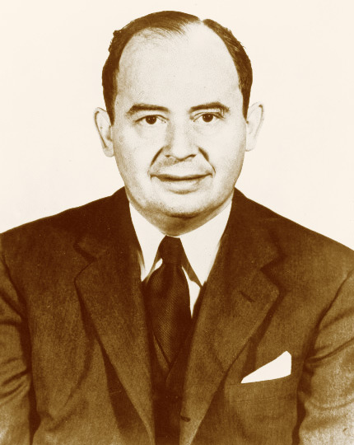
The Von Neumann Architecture
John Von Neumann
“If people do not believe that mathematics is simple, it is only because they do not realize how complicated life is.”

Slide 5
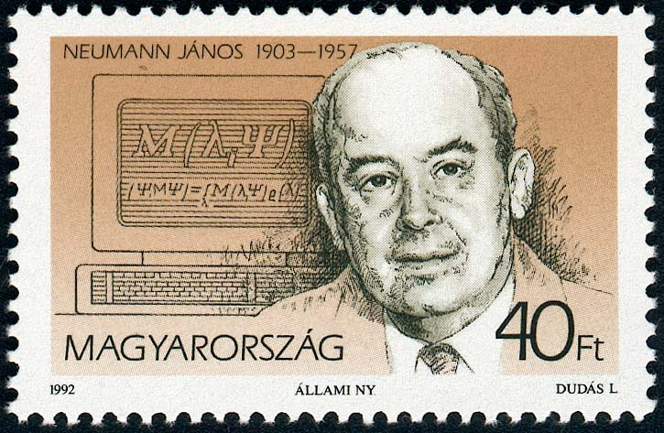
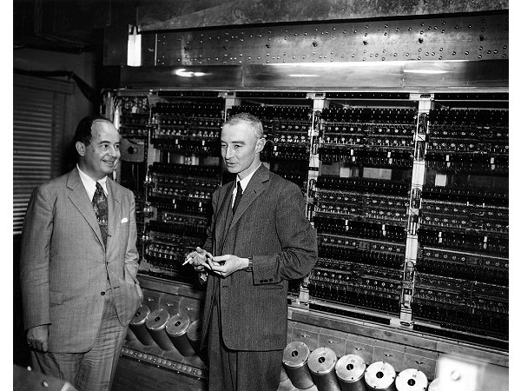
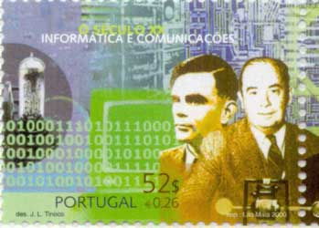
The Von Neumann Architecture
John Von Neumann
John von Neumann (left) and Manhattan Project leader J. Robert Oppenheimer, in front of Princeton’s Institute for Advanced Study (IAS) computer

Slide 6
The Components of a Computer System
Von Neumann architecture
Foundation for nearly all modern computers
Characteristics:
Central Processing Unit (CPU)
arithmetic/logic unit (ALU)
control unit
RAM: random access memory
I/O: input/output
Stored program concept
Sequential execution of instructions

Slide 7
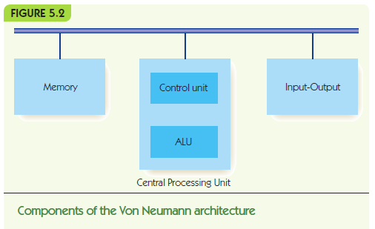

Slide 8
Memory and Cache
Memory: functional unit for data storage/retrieval
Random access memory (RAM)
Organized into cells, each given a unique address
Equal time to access any cell
Cell values may be read and changed
Cell size/memory width typically 8 bits
Maximum memory size/address space is 2^{N}, where N is length of address

Slide 9
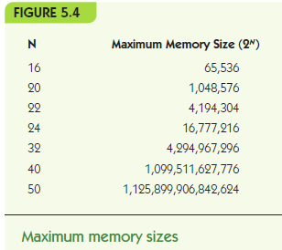
1 KB = 1 kilobyte
2¹⁰ = 1024 ~ 10³
1 MB = 1 megabyte
2²⁰ = 1,048,576 ~ 10⁶
1 GB = 1 gigabyte
2³⁰ = 1,073.741,824 ~ 10⁹
1 TB = 1 terabyte
2⁴⁰ = 1,099,511,627,776 ~ 10¹²
1 PB = 1 petabyte
2⁵⁰ = 1,125,899,906,842,624 ~ 10¹⁵
1 EB = 1 exabyte
2⁶⁰ = 1,152,921,504,606,846,976 ~ 10¹⁸
1 ZB = 1 zettabyte
2⁷⁰ ~ 10²¹
1 YB = 1 yottabyte
2⁸⁰ ~ 10²⁴

Slide 10
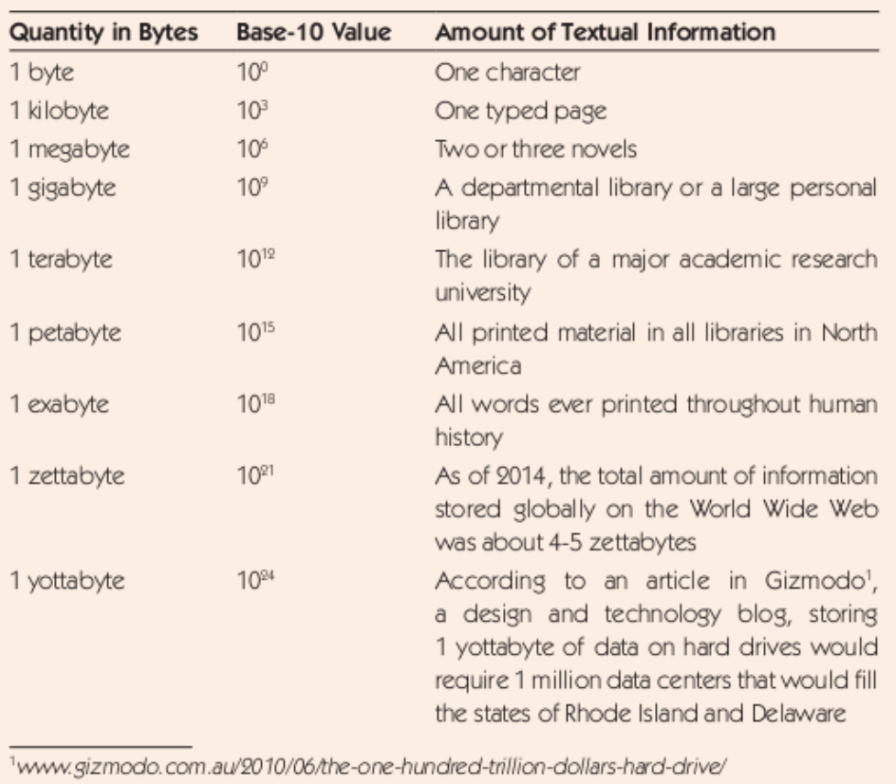

Slide 11
Memory Circuits
The circuits we've seen so far have all be examples of what are called combinatorial circuits
These perform computations that are functions of inputs to outputs
These kinds of circuits can't be used to store data, since they are feeding signals in a forward path through the electronics
Sequential circuits are designed to store bits (0s and 1s) over time, so support operations that store and fetch
Storing a 1 is called 'set'
Storing a 0 is called 'reset'
An SR-Flip Flop is a circuit that implements this idea

Slide 12
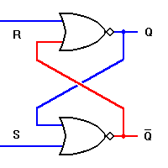
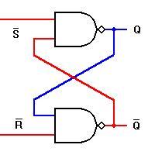
SR-Flip Flop
S R | Q Q’
0 0 1 0 0 1 1 1 | Q Q’ 0 0 1 0 0
SET
RESET
S R | Q Q’
1 1 0 1 1 0 0 0 | Q Q’ 0 0 1 1 1
SET
RESET

Slide 13
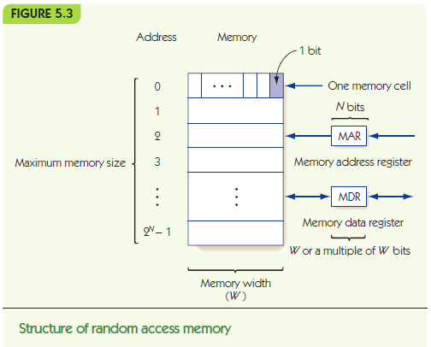

Slide 14
Memory and Cache (continued)
Fetch: retrieve from memory (nondestructive)
Store: write to memory (destructive)
Memory access time
time required to fetch/store
Modern RAM requires 5-10 nanoseconds
MAR holds memory address to access
MDR receives data from fetch, holds data to be stored

Slide 15
Memory and Cache (continued)
Memory system circuits: decoder and fetch/store controller
Decoder converts MAR into signal to a specific memory cell
One-dimensional versus two-dimensional memory organization
Fetch/Store controller = traffic cop for MDR
Takes in a signal that indicates fetch or store
Routes data flow to/from memory cells and MDR

Slide 16
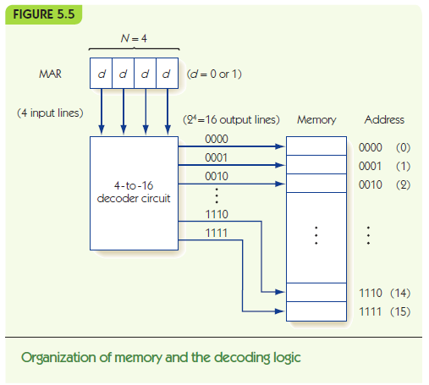

Slide 17
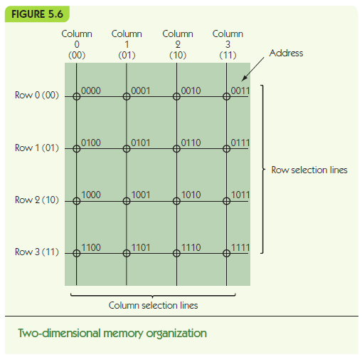

Slide 18
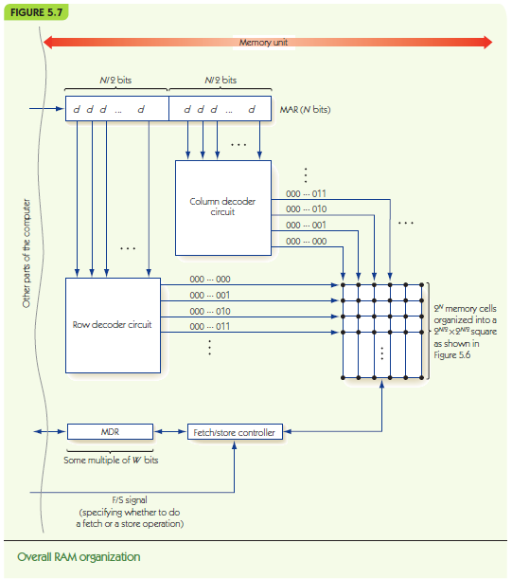

Slide 19
Memory and Cache (continued)
RAM speeds increased more slowly than CPU speeds
Cache memory is fast but expensive
Principle of locality:
Values close to recently-accessed memory are more likely to be accessed
Load neighbors into cache and keep recent there
Cache hit rate: percentage of times values are found in cache

