Slide 1
Logic, Gates,
& Circuits

Slide 2
ALERTs
Assignment 3 is due today
Lab 6 is due Monday
Assignment 4 is available on Brightspace and the course web site. It is due next Friday (9/27)

Slide 3
What is Logic?
A logic statement is a sentence or assertion that can either be true or false
For example:
"Abraham Lincoln was the last Czar of Russia"
"I have three children"
2 + 2 = 4
x > 10
t = "AATC" or (t = "TCCG" and s = "CTA")
if mammal(X) then hasFur(X)
Statements can be combined by Boolean operators, like in the last two examples
Logic shows up in algorithms as the test conditions for if statements and while loops

Slide 4
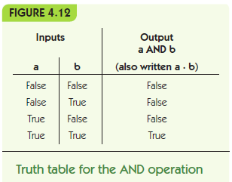
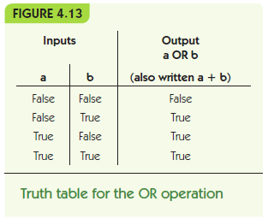
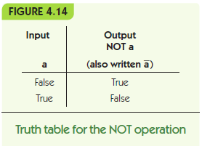

Slide 5
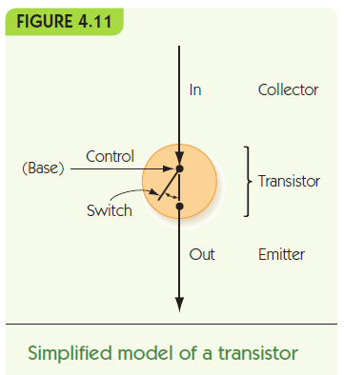
Physics Meets Logic
Transistors
Solid-state switches
Change on/off when given power on control line
Extremely small (billions per chip)
Enable computers that work with gigabytes of data

Slide 6
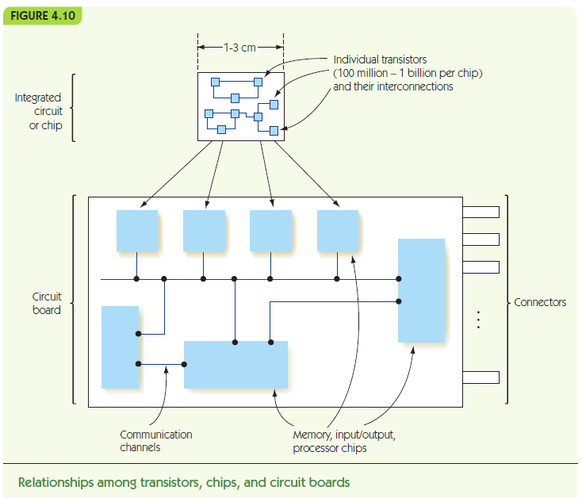

Slide 7
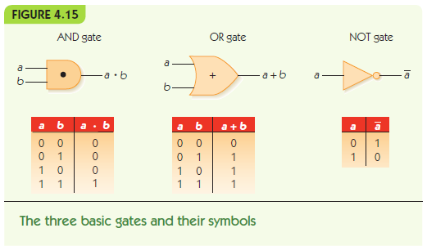
Boolean Logic and Gates
Gate: an electronic device that operates on inputs to produce outputs
Each gate corresponds to a Boolean operator

Slide 8
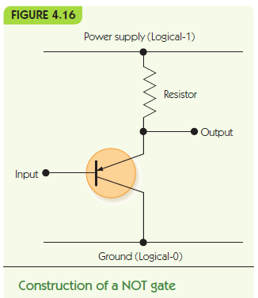
Boolean Logic and Gates
Gates are built from transistors
NOT gate: 1 transistor
AND gate: 3 transistors
OR gate: 3 transistors
NAND and NOR: 2 transistors

Slide 9
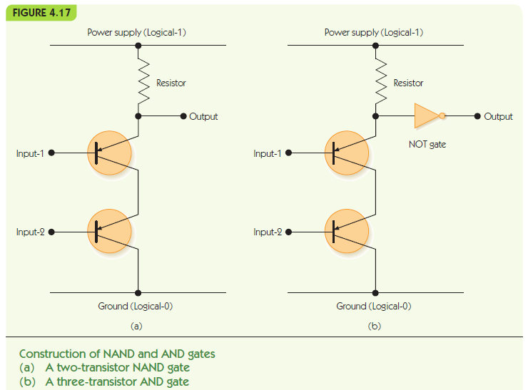

Slide 10
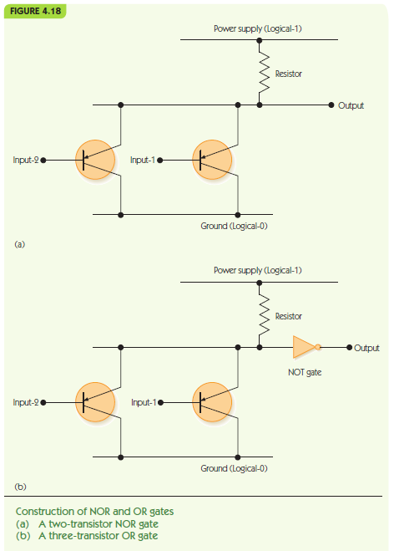

Slide 11
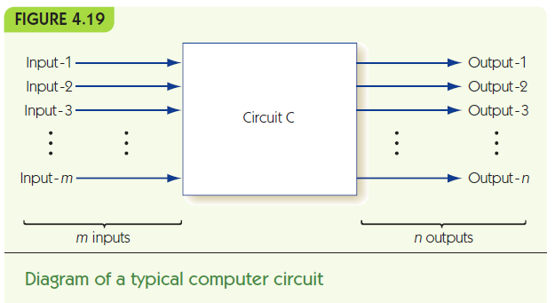
Building Computer Circuits
Circuit: has input wires, contains gates connected by wires, and has output wires
Outputs depend only on current inputs: no state

Slide 12
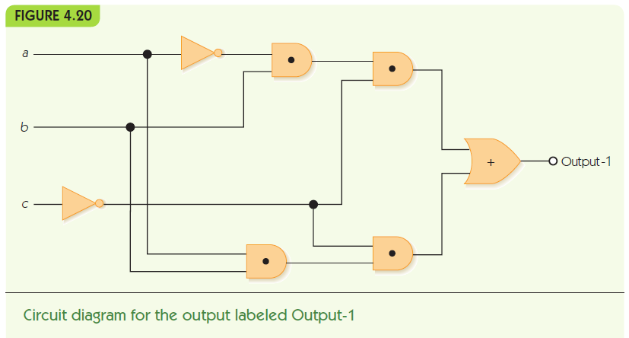

Slide 13
Building Computer Circuits
To convert a circuit to a Boolean expression:
Start with output and work backwards
Find next gate back, convert to Boolean operator
Repeat for each input, filling in left and/or right side
To convert a Boolean expression to a circuit:
Similar approach
To build a circuit from desired outcomes:
Use standard circuit construction algorithm:
e.g., sum-of-products algorithm

Slide 14
m
p
x
q
y
n
Output =
x + y
p • q + y
m • b • q + y
~a • b • ~c + n • q
~a • b • ~c + y
~a • b • ~c + a • b • ~c

Slide 15
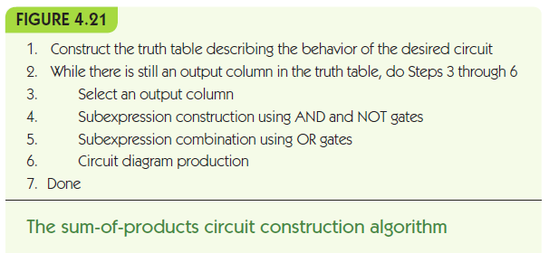

Slide 16
Building Computer Circuits
Example from text
Build truth table:
a | b | c | Output1 | Output2
0 | 0 | 0 | 0 | 1
0 | 0 | 1 | 0 | 0
0 | 1 | 0 | 1 | 1
0 | 1 | 1 | 0 | 1
1 | 0 | 0 | 0 | 0
1 | 0 | 1 | 0 | 0
1 | 1 | 0 | 1 | 1
1 | 1 | 1 | 0 | 0

Slide 17
Building Computer Circuits
Example from text
Find true rows for Output1
a | b | c | Output1 | Output2
0 | 0 | 0 | 0 | 1
0 | 0 | 1 | 0 | 0
0 | 1 | 0 | 1 | 1
0 | 1 | 1 | 0 | 1
1 | 0 | 0 | 0 | 0
1 | 0 | 1 | 0 | 0
1 | 1 | 0 | 1 | 1
1 | 1 | 1 | 0 | 0

Slide 18
Building Computer Circuits
Example from text
For each true row AND inputs to make expression
a = 0, b = 1, c = 0: (~a • b • ~c)
a = 1, b = 1, c = 0: (a • b • ~c)
Combine row subexpressions with OR
(~a • b • ~c) + (a • b • ~c)
Build circuit from expression
(and repeat for other output)

Slide 21
ALERTs
Assignment 4 is available on Brightspace and the course web site. It is due Friday (9/27)
Lab 7 is now available on Brightspace. It is due next Monday (9/30)
The first midterm is Friday, October 4.

Slide 22
Building Computer Circuits
Full adder circuit
Input is two unsigned N-bit numbers
Output is one unsigned N-bit number, the result of adding inputs together
Example:
Start with one-bit adder (1-ADD)
 |  |  |  | 1
 | 0 | 0 | 1 | 0 | 1
+ | 0 | 1 | 0 | 0 | 1
 | 0 | 1 | 1 | 1 | 0

Slide 23
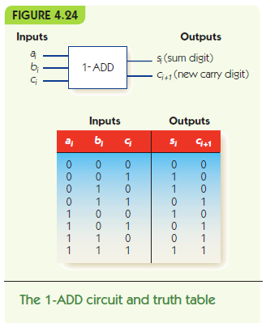

Slide 24
Building Computer Circuits
Sum digit, s_{i}, has Boolean expression:
(~a_{i} • ~b_{i} • c_{i}) + (~a_{i} • b_{i} • ~c_{i}) +
(a_{i} • ~b_{i} • ~c_{i}) + (a_{i} • b_{i} • c_{i})
Carry digit, c_{i+1}, has Boolean expression:
(~a_{i} • b_{i} • c_{i}) + (a_{i} • ~b_{i} • c_{i}) +
(a_{i} • b_{i} • ~c_{i}) + (a_{i} • b_{i} • c_{i})

Slide 25
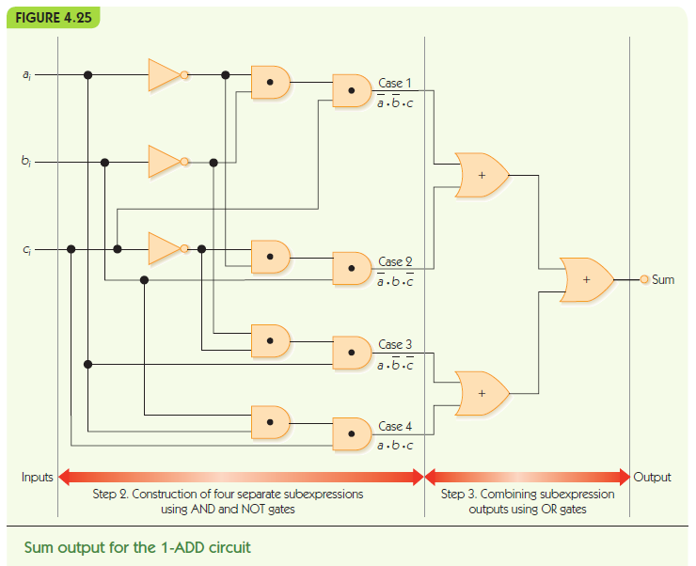

Slide 26
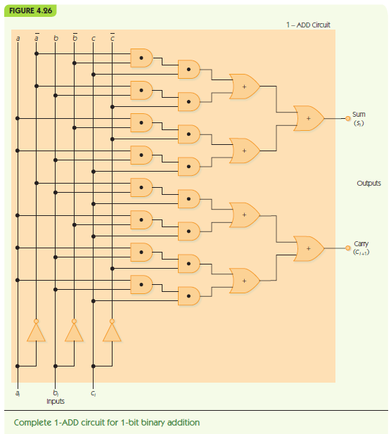

Slide 27
Building Computer Circuits
N-bit adder circuit
Input: a₀a₂…a_{n-1} and b₀b₂…b_{n-1}, where a_{i} and b_{i} are individual bits
a₀ and b₀ are least significant digits: ones place
Pair up corresponding bits: a₀ with b₀, a₁ with b₁, etc.
Run 1-ADD on a₀ and b₀, with fixed carry in c₀ = 0
Feed carry out c₁ to next 1-ADD and repeat

Slide 28
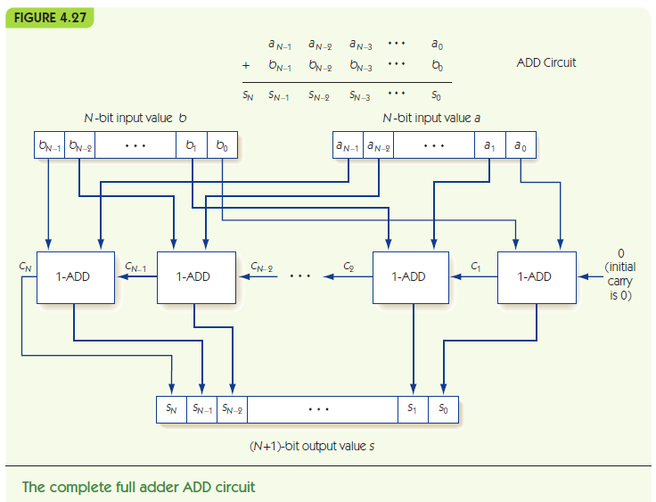

Slide 29
Control Circuits
Control circuits make decisions, determine order of operations, select data values
Multiplexor selects one from among many inputs
2^{N} input lines
N selector lines
1 output line
Each input line corresponds to a unique pattern on selector lines
That input value is passed to output

Slide 30
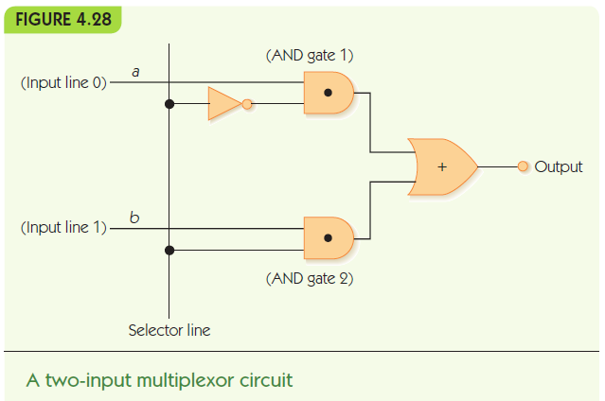

Slide 31
Control Circuits
Decoder sends a signal out only one output, chosen by its input
N input lines
2^{N} output lines
Each output line corresponds to a unique pattern on input lines
Only the chosen output line produces 1, all others output 0

Slide 32
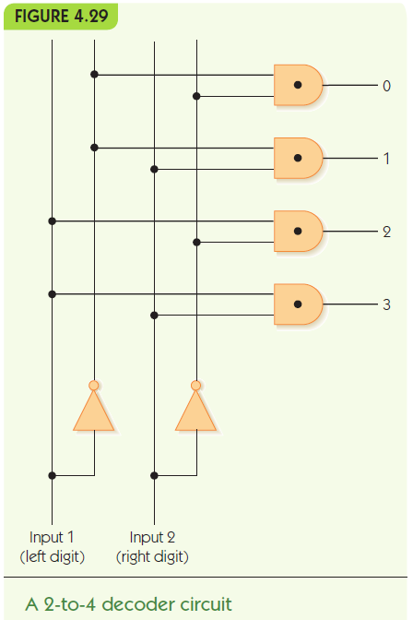

Slide 33
Control Circuits
Decoder circuit uses
To select a single arithmetic instruction, given a code for that instruction
Code activates one output line, that line activates corresponding arithmetic circuit
Multiplexor circuit uses
To choose one data value from among a set, based on selector pattern
Many data values flow into the multiplexor, only the selected one comes out

Slide 34
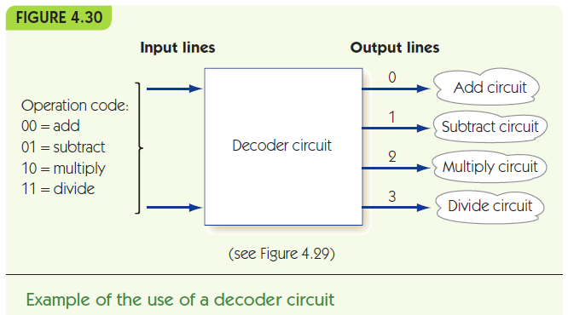

Slide 35
