Slide 1
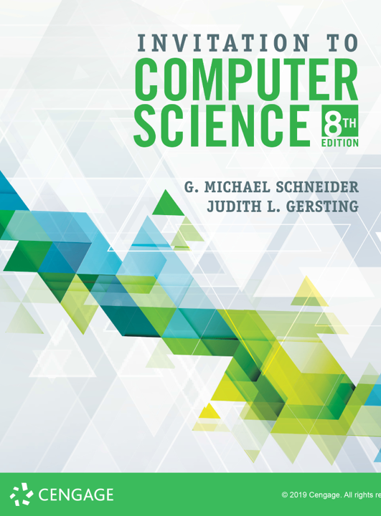
Data: Representation

Slide 2
ALERTs
Lab 4 is due today
Lab 5 is now available on Brightspace. It is due this Wednesday (9/18)
Assignment 3 is available on Brightspace & the course web site. It is due this Friday (9/20).
Lab 6 is now available on Brightspace. It is due next Monday (9/23)

Slide 3
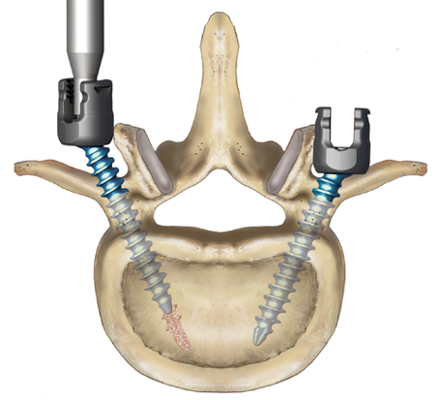
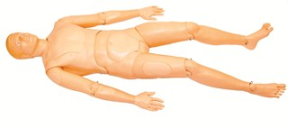
What does this mean?
10110001
Unsigned Integer: 177
Sign & Magnitude Integer: -49
2s-Complement Integer: -79
Extended ASCII Character: ±
Hexadecimal Number: B1
Denali Monoaxial/Polyaxial ATR™ Set Screw
Moose Racing Air Filter
Laerdal Medical ‘Extri Kelly’ trauma mannequin

Slide 4
Data Representation
Motivating Principles
Symbols have NO inherent meaning!! They only mean what we choose them to mean
The representations that we choose often determine the algorithms available to us
Interpretation is key

Slide 5
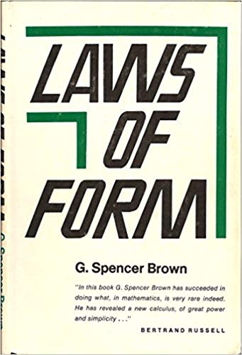
Digital Computers
Are built upon and operate by the simple concept of choice, or the ability to distinguish
And not only that, but the most primitive sort of choice or distinction: that between two alternatives
on / off − true / false
open / closed − positive / negative
WHY?
It is as simple as you can get!
Mathematically
Engineering Principle: It is better to design a complex system out of simple components than out of complex ones

Slide 6
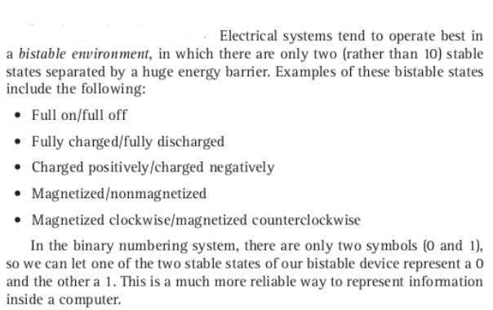
Binary Codes
In a computer, all data is represented in binary codes
e.g., sequences of 0s and 1s
All hardware components operate in a ‘bistable environment’
Why 0 & 1?
→ historical accident

Slide 7
Positive Integers: Radix Notation
Binary Decimal Binary Decimal
0 0 10000 16
1 1 10001 17
10 2 10010 18
11 3 10011 19
100 4 10100 20
101 5 10101 21
110 6 10110 22
111 7 10111 23
1000 8 11000 24
1001 9 11001 25
1010 10 11010 26
1011 11 11011 27
1100 12 11100 28
1101 13 11101 29
1110 14 11110 30
1111 15 11111 31

Slide 8
What is Radix?
So if in decimal notation 3972 represents the number three thousand nine hundred seventy two, what does 101101 represent in binary?
Let's start with that first part:
3972 = 3 * 1000 + 9 * 100 + 7 * 10 + 2 * 1
= 3 * 10³ + 9 * 10² + 7 * 10¹ + 2 * 10⁰
Each digit is a multiple of a power of the base, which is 10
Ok, great. Then in binary, which is base-2, we get
101101 = 1 * 2⁵ + 0 * 2⁴ + 1 * 2³ + 1 * 2² + 0 * 2¹ + 1 * 2⁰
= 1 * 32 + 0 * 16 + 1 * 8 + 1 * 4 + 0 * 2 + 1 * 1
= 32 + 8 + 4 + 1
= 45

Slide 9
Decimal Addition
What is 4256 + 981?
4256
+981
7
What is 6 + 1?
How do you know that?
Math facts are memorized!
What do we do with 5 + 8?
We need to carry the one...
1
1
2
5
3

Slide 10
Binary Addition
What is 1011 + 110?
1011
+110
1
What is 1 + 0?
What are the binary math facts?
0 + 0 = 0 0 + 1 = 1 1 + 0 = 1 1 + 1 = 10
1 + 1 + 1 = 11
What do we do with 1 + 1?
We still need to carry the one...
1
1
10
0
0

Slide 11
Signed Integers
What if we want to represent negative numbers?
Just add a minus sign out front? -6₁₀ = -110₂
No, since in a binary code we can only have two symbols...
Sign & Magnitude
add a sign bit to the left: 0 is positive, 1 is negative
0110 = 6 1110 = -6
One’s Complement
flip all the bits
0110 = 6 1001 = -6
Two’s Complement
flip all the bits and add one (weird...)
0110 = 6 1010 = -6

Slide 12
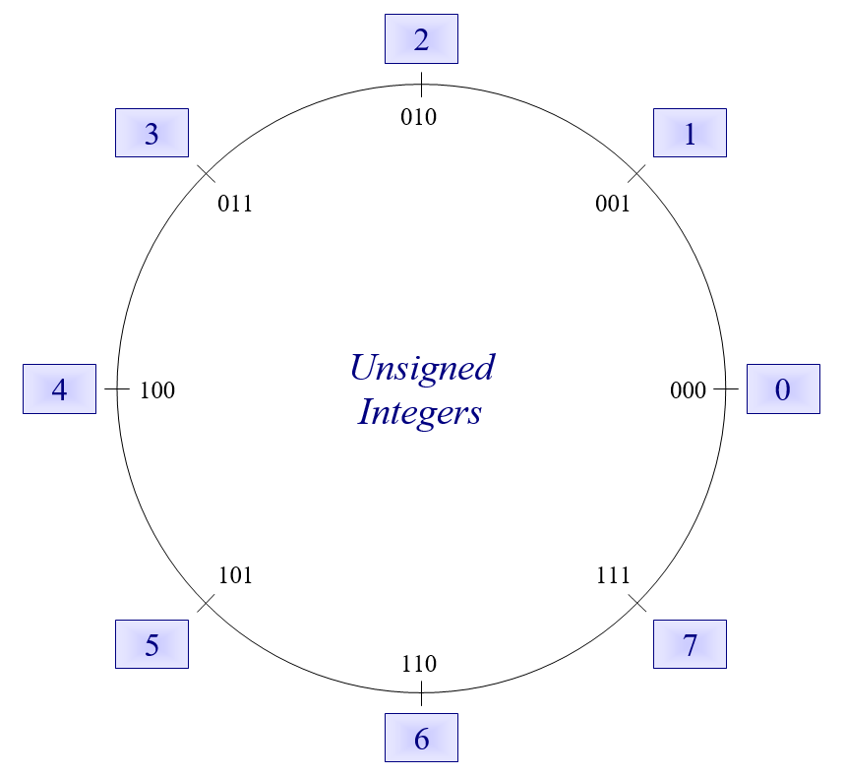

Slide 14
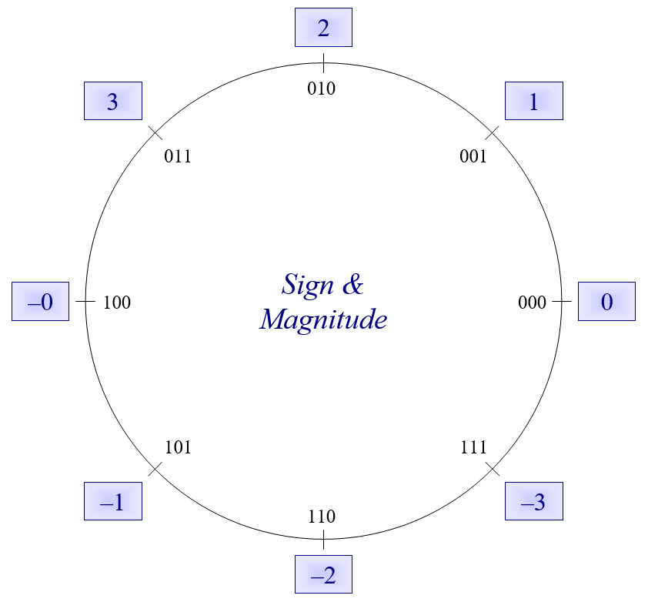

Slide 15
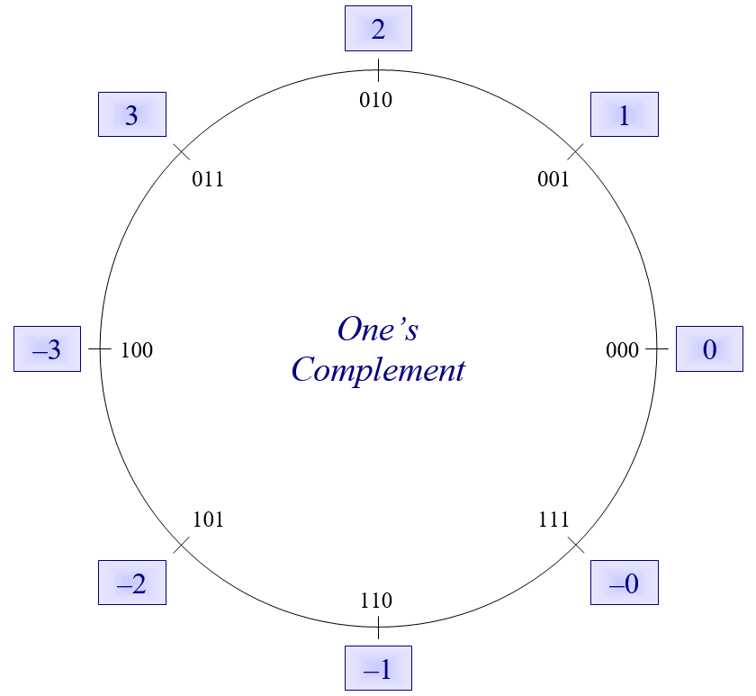

Slide 16
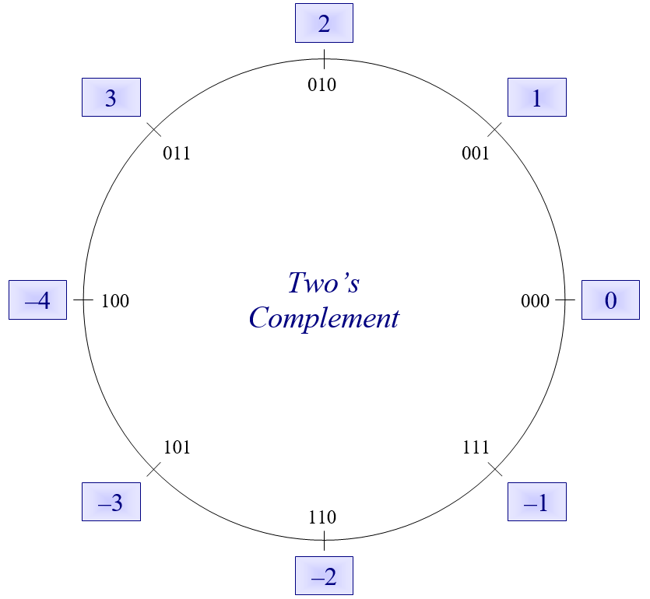

Slide 18
ALERTs
Lab 5 is due today
Assignment 3 is available on Brightspace & the course web site. It is due on Friday (9/20).
Lab 6 is now available on Brightspace. It is due next Monday (9/23)
Assignment 4 is available on Brightspace & the course web site. It is due next Friday (9/27)

Slide 19
Real Numbers, well sort of...
IEEE 754 Standard for Floating Point Representation
Based on scientific notation
Avogadro's Number = 602,214,076,000,000,000,000,000 or six hundred two sextillion and some change
That's awkward to write and work with, so if we move the decimal point (i.e., floating point) to the left 23 spaces we can write the number as 6.02214076 x 10²³
Or even 6.022 x 10²³ if we want a more concise, but less precise way of saying it
The exponent on 10 indicates the number of positions the point was moved (positive for left, and negative for right)

Slide 20
Real Numbers, well sort of...
How does this relate to IEEE 754 and binary numbers?
We can something similar with binary, as long as we remember a few things
Just like decimal digits to the right of the decimal point continue to be powers of 10 (just negative powers),
458.367 = 4 * 10² + 5 * 10¹ + 8 * 10⁰ + 3 * 10⁻¹ + 6 * 10⁻² + 7 * 10⁻³
458.367 = 4.58367 x 10²
Binary digits to the right of the binary point continue to be powers of 2
1011.011 = 1 * 2³ + 0 * 2² + 1 * 2¹ + 1 * 2⁰ + 0 * 2-1 + 1 * 2⁻² + 1 * 2⁻³
= 8 + 2 + 1 + ¼ + 1/8 = 11 3/8
1011.011 = 1.011011 x 2³

Slide 21
Real Numbers, well sort of...
These scientific notation representations have four components
Decimal: 4.58367 x 10²
Binary: 1.011011 x 2³
Decimal Binary
A whole number: 4 1
A mantissa: .58367 .011011
A base: 10 2
An exponent: 2 3
Of these, we only have to worry about the last 3 in binary
Why?

Slide 22
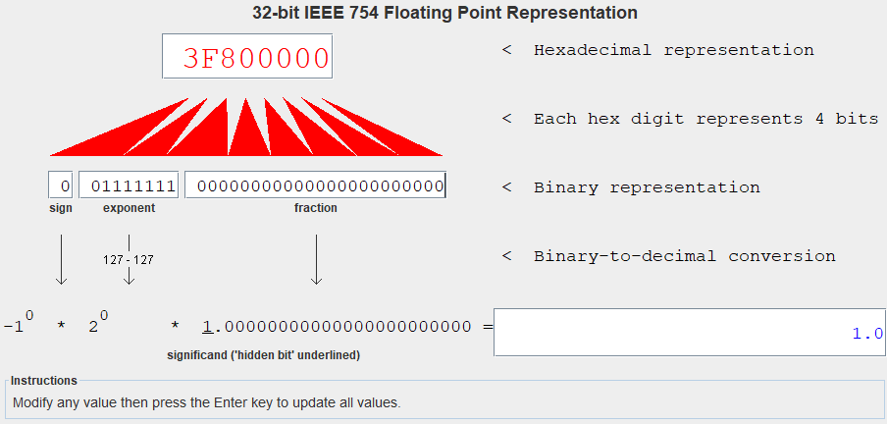
Mars Demo

Slide 23
Text: ASCII & Unicode
https://www.ascii-code.com/
http://www.unicode.org/standard/WhatIsUnicode.html

Slide 24
Sound

Slide 25
Digitization of analog data
Digitize: to convert to a digital form
Sampling: record sound wave values at fixed, discrete intervals
To reproduce sound, approximate using samples
Quality determine by:
Sampling rate: number of samples per second
More samples = more accurate wave form
Bit depth: number of bits per sample
More bits = more accurate amplitude

Slide 26
Sound

Slide 27
Images
Image sampling: record color or intensity at fixed, discrete intervals in two dimensions
Pixels: individual recorded samples
RGB encoding scheme:
Colors are combinations of red, green, and blue
One byte each for red, green, and blue
Raster graphics store picture as two-d grid of pixel values

Slide 28
Images
Matt Parker

