Slide 1
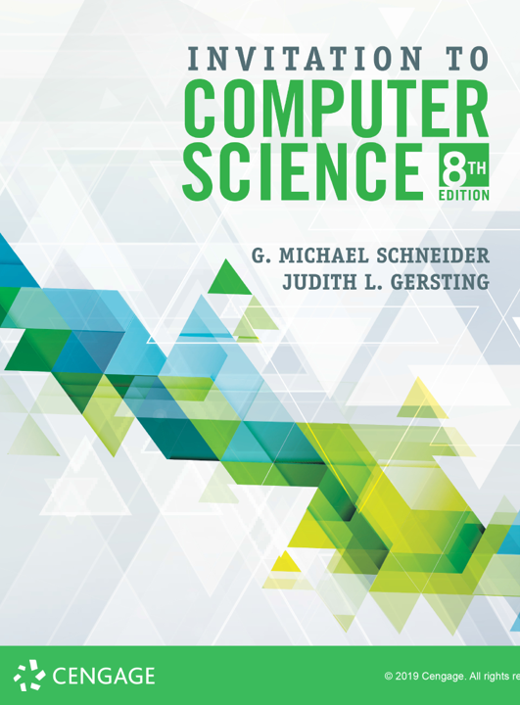
Complexity &
Big-Oh

Slide 2
ALERT
Assignment 2 is due today.
Lab 4 is now available on Brightspace. It is due next Monday, 9/16
Assignment 3 is available on Brightspace and the course web site. It is due next Friday, 9/20.
Lab 5 is now available on Brightspace. It is due next Wednesday, 9/18
Syllabus review...

Slide 3
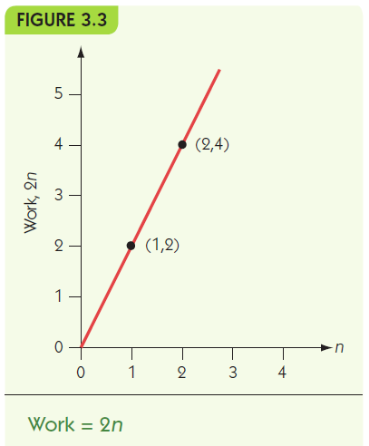
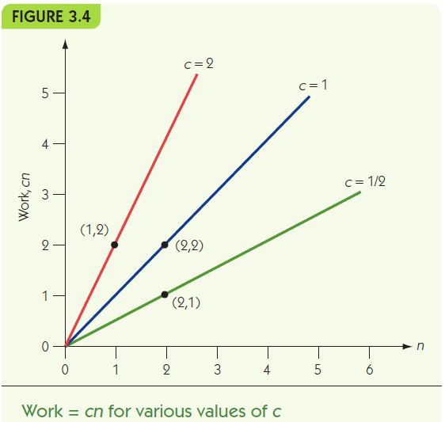
Measuring Efficiency Order of Magnitude—Order n
Order of magnitude n, Θ(n): the set of functions that grow in a linear fashion

Slide 4
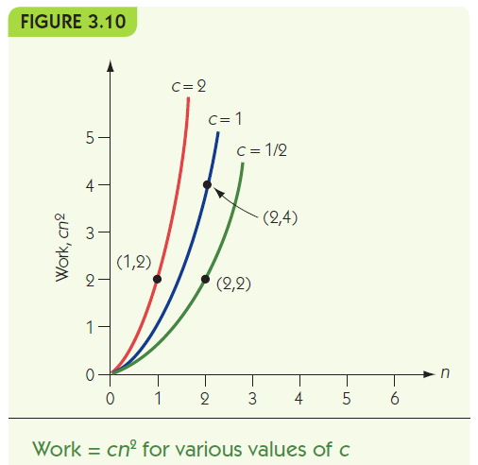
Measuring Efficiency Order of Magnitude—Order n²
Order n², Θ(n²):
the set of functions
whose growth is on the
order of n²

Slide 5
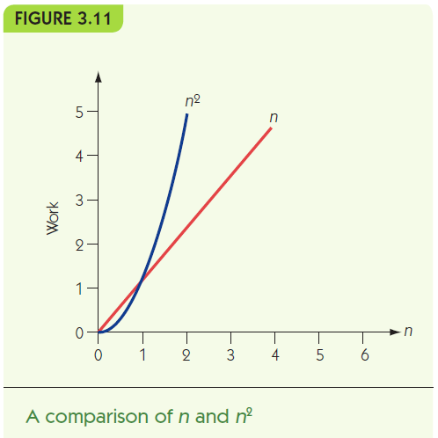
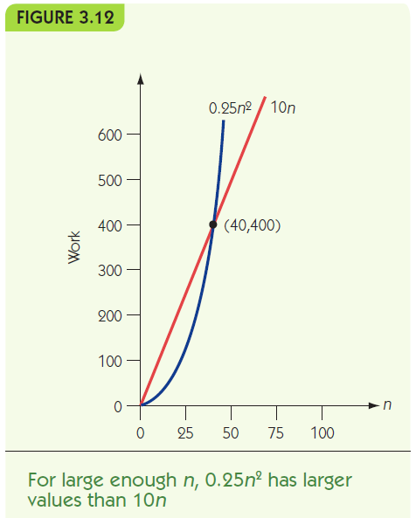
Measuring Efficiency Order of Magnitude—Order n² (continued)
Eventually, every function with order n² has greater values than any function with order n

Slide 6
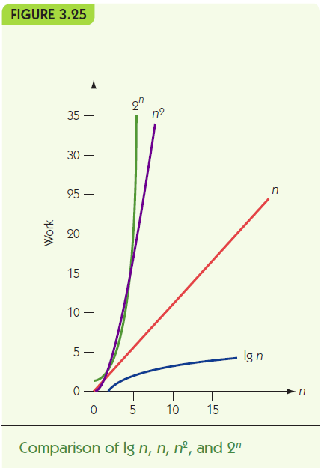

Slide 7
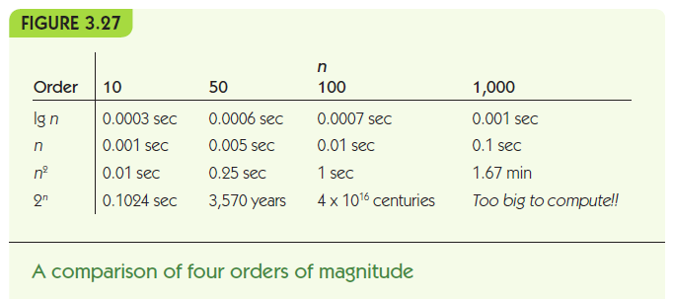

Slide 8
Analysis of Algorithms Data Cleanup Algorithms
“Given a collection of age data, where erroneous zeros occur, find and remove all the zeros from the data, reporting the number of legitimate age values that remain”
Illustrates multiple solutions to a single problem
Use of analysis to compare algorithms

Slide 9
Analysis of Algorithms Data Cleanup Algorithms (continued)
Shuffle-left algorithm:
Search for zeros from left to right
When a zero is found, shift all values to its right one cell to the left IS THIS RIGHT?
Example: [55, 0, 32, 19, 0, 27]
Finds 0 at position 2: [55, 32, 19, 0, 27, 27]
Finds 0 at position 4: [55, 32, 19, 27, 27, 27]

Slide 10
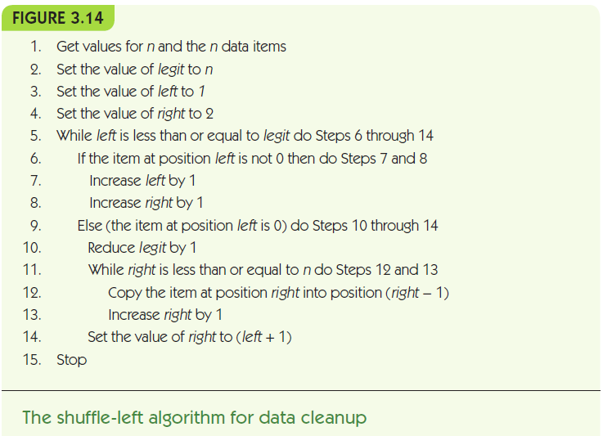

Slide 11
Analysis of Algorithms Data Cleanup Algorithms (continued)
Analysis of shuffle-left for time efficiency
Count comparisons looking for zero AND movements of values
Best case: no zeros occur, check each value and nothing more: Θ(n)
Worst case: every value is a zero, move n-1 values, then n-2 values, etc.: Θ(n²)
Analysis of shuffle-left for space efficiency
Uses no significant space beyond input

Slide 12
Analysis of Algorithms Data Cleanup Algorithms (continued)
Copy-over algorithm:
Create a second, initially empty, list
Look at each value in the original
If it is non-zero, copy it to the second list
Example: [55, 0, 32, 19, 0, 27]
answer = [55] 4. answer = [55, 32, 19]
answer = [55] 5. answer = [55, 32, 19]
answer = [55, 32] 6. answer = [55, 32, 19, 27]

Slide 13
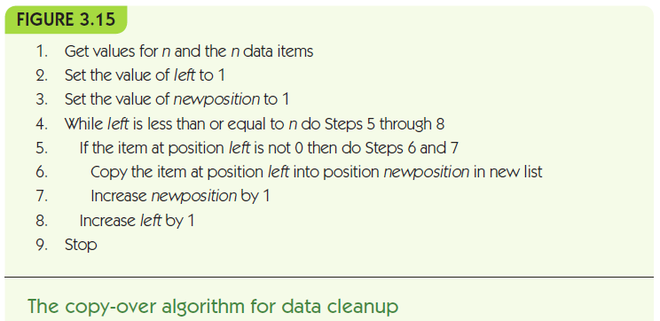

Slide 14
Analysis of Algorithms Data Cleanup Algorithms (continued)
Time efficiency for copy-over
Best case: all zeros, checks each value but doesn’t copy it: Θ(n)
Worst case: no zeros, checks each value and copies it: Θ(n)
Space efficiency for copy-over
Best case: all zeros, uses no extra space
Worst case: no zeros, uses n extra spaces

Slide 15
Analysis of Algorithms Data Cleanup Algorithms (continued)
Converging-pointers algorithm:
Keep track of two pointers at the data
Left pointer moves left to right and stops when it sees a zero value
Right pointer stays put until a zero is found
Then its value is copied on top of the zero, and it moves one cell to the left
Stop when the left crosses the right

Slide 16
Analysis of Algorithms Data Cleanup Algorithms (continued)
Example: [55, 0, 32, 19, 0, 27]
[55, 0, 32, 19, 0, 27]
L R
[55, 0, 32, 19, 0, 27]
L R
[55, 27, 32, 19, 0, 27]
L R
[55, 27, 32, 19, 0, 27]
LR

Slide 17
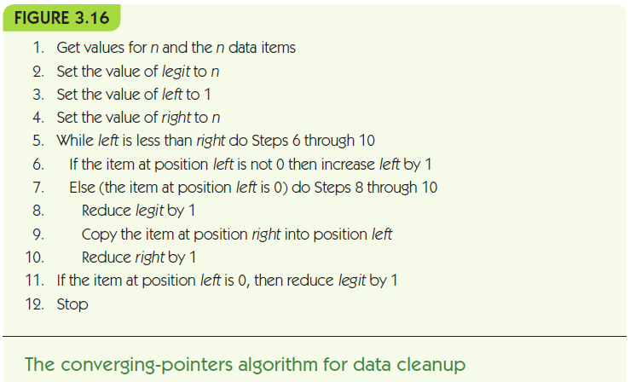

Slide 18
Analysis of Algorithms Data Cleanup Algorithms (continued)
Time efficiency for converging-pointers
Best case: no zeros, left pointer just moves across to pass the right pointers, examines each value: Θ(n)
Worst case: all zeros, examines each value and copies a value over it, right pointer moves left towards left pointer: Θ(n)
Space efficiency for converging-pointers
No significant extra space needed

Slide 19
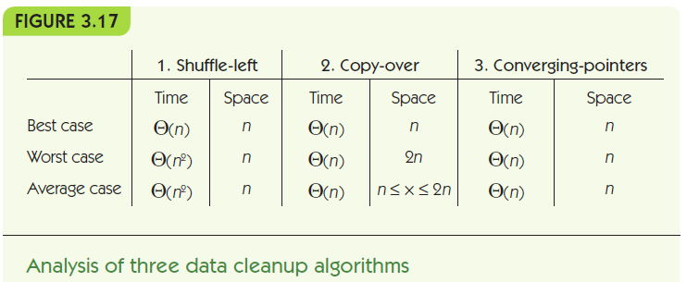

Slide 20
