Slide 1
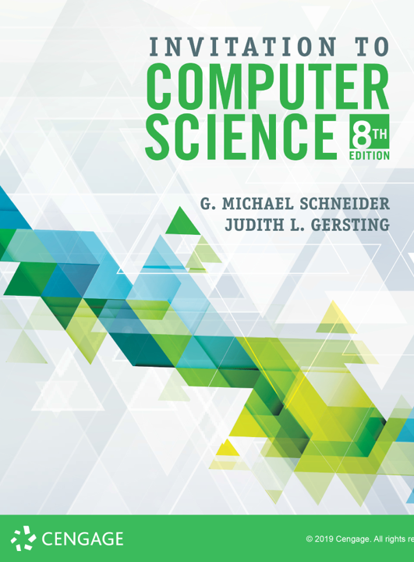
Algorithms: Time & Space Efficiency

Slide 2
ALERT
Return Assignment 1 & Lab 2
observations
Assignment 2 is available on Brightspace and the course web site. It is due on Friday, 9/13.
Lab 4 is now available on Brightspace. It is due next Monday, 9/16.
Assignment 3 is available on Brightspace and the course web site. It is due next Friday, 9/20.
Lab 5 is available on Brightspace, due next Wednesday, 9/18.

Slide 3
qUESTIONS
How do we know if our algorithms are correct?
How do we know if our algorithms are good?
What do we mean by “good”?
Given multiple algorithms for solving a problem, which one should we choose?
Correctness (required)
Elegance (what’s that?)
Efficiency
Simplicity
Extendability
Maintenance
Others?

Slide 4
Resources
Given a problem, how do we determine the resources necessary to its solution?
This is a very hard question!! Why?
For each problem there are many algorithms that solve it
e.g., Sorting: bubble, selection, heap, quick, merge, etc.
For each algorithm there are many ways to implement it
e.g., Bubble sort: wikipedia.com
For each implementation there are many platforms on which to execute it (both in terms of hardware and software)
e.g., Java, Python, Windows, MacOS, Linux, iOS, Android
For each platform there are many environmental factors that can influence performance
e.g., memory, clock speed, OS load, other running programs

Slide 5
Efficiency
What does efficiency mean?
Judicious use of resources
Not at all costs!
What resources?
Space: Random Access Memory (RAM)
Time: CPU cycles
Which is more important?
Time!!!
Why?
Let’s take a detour...

Slide 6
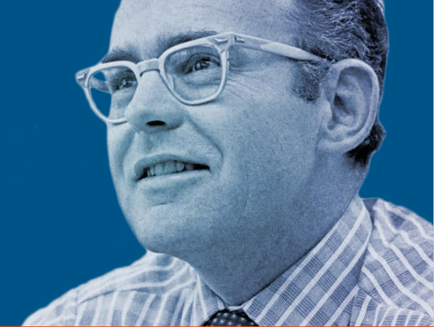
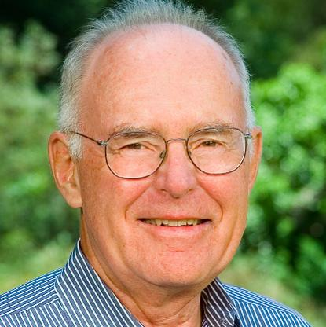
Gordon Moore
Co-founder of Intel
Worth just under $10 billion today
Moore’s Law (1965)
“The observation that the number of transistors in a dense integrated circuit doubles about every two years.”
https://www.intel.com/content/www/us/en/silicon-innovations/moores-law-technology.html

Slide 7
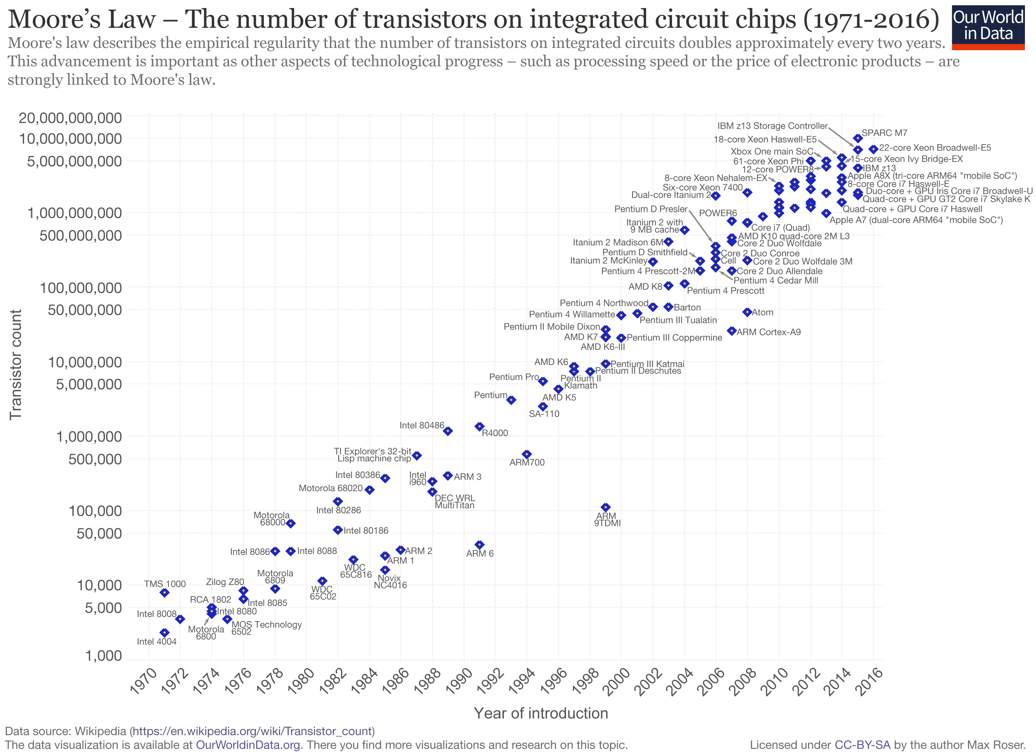

Slide 8
Efficiency
What does efficiency mean?
Judicious use of resources
Not at all costs!
What resources?
Space: Random Access Memory (RAM)
Time: CPU cycles
Which is more important?
Time!!!
Why?
Let’s take a detour...
Unfortunately, measuring time is much, much harder than measuring space...

Slide 9
The Method
Empirical vs. Theoretical
Empirical
Real time measurements
Tedious
Can be difficult to develop a model from the data
Theoretical
Mathematical analysis
Tedious
Requires specialized skills and can be difficult
The Middle Road
Simulate execution & count steps (sound familiar? Labs 2-4)
Identify critical operations & only count those
Analyze the structure of the algorithm to estimate time

