Slide 1
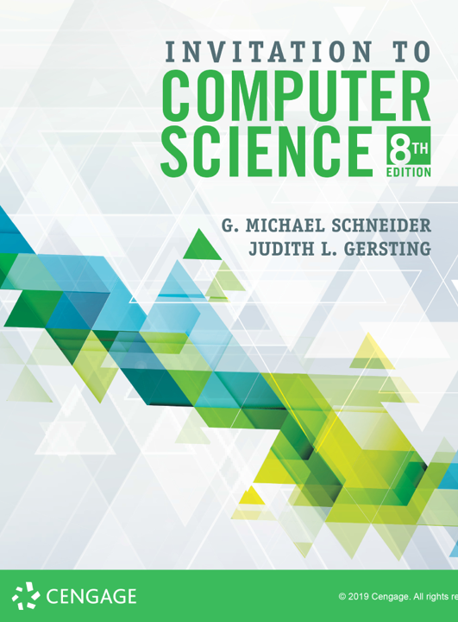
Algorithms: Representation, Discovery,
& Design

Slide 2
ALERT
Lab 3 is due Wednesday. Make sure you get started in time to ask questions.
Assignment 2 is available on Brightspace and the course web site. It is due next Friday (9/13)

Slide 3
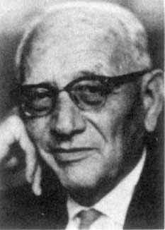
George Pólya
“It is better to solve one problem five different ways,
than to solve five problems one way.”
“Pedantry and mastery are opposite attitudes toward rules. To apply a rule to the letter, rigidly, unquestioningly, in cases where it fits and in cases where it does not fit, is pedantry. … To apply a rule with natural ease, with judgment, noticing the cases where it fits, and without ever letting the words of the rule obscure the purpose of the action or the opportunities of the situation, is mastery.”

Slide 4
Elementary Issues
How to represent and communicate algorithms?
What strategies are available for
discovering & designing algorithms?

Slide 5
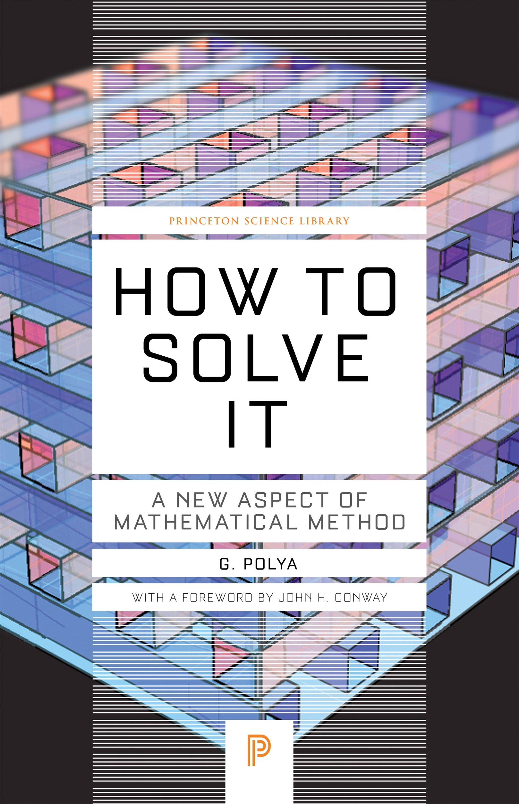
Algorithmic Problem Solving
Understand the Problem
Devise a Plan
Carry Out the Plan
Look Back
(See PDF handout on Blackboard)

Slide 6
Example
Line up randomly
Goal: end up sorted chronologically by birthday
Constraint: you may only speak (verbally or by gestures) to the person on your left, but you may listen to the person on your right
Problem Solve!

Slide 7
Abstraction & Top-Down Design
Complexity: handling it by hiding it (or deferring it)
Abstraction: separating high level concerns from low-level implementations
Strategy: use a variation of divide & conquer
  Decompose
  Solve
  Combine
  Natural & Cohesive sub-problems
  Don’t forget Turing’s building blocks

Slide 8
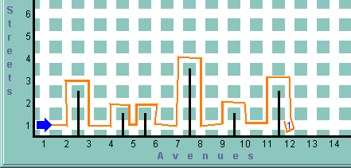
Karel the Robot: Runs a steeplechase
Next time...

