Slide 1
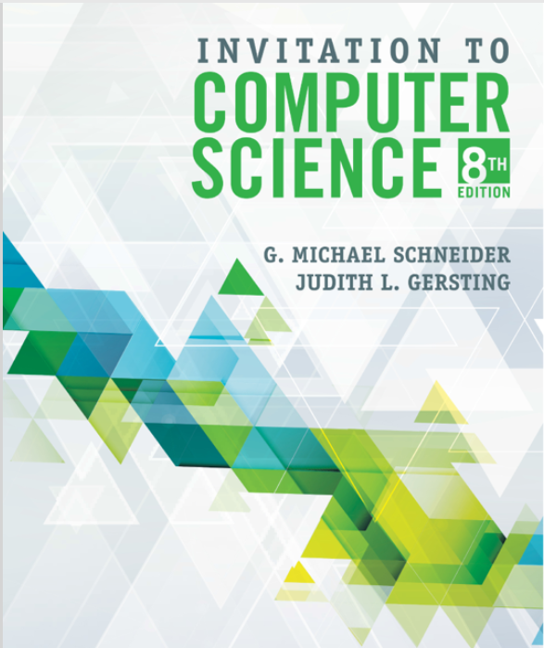
COMP 1500
David J Stucki
MWF 11:30-12:25
Comm 111
Introductions
Syllabus
Brightspace & Web Site
Software
Q & A

Slide 2
Lab 2
Lab software
Mechanics of doing labs
Lab assignment
Submit hard copy
Due: Next Wednesday (no class Monday, so don't procrastinate)

Slide 3
What is Computer Science?
Misconceptions
Computer science is:
The study of computers…
Git out yer magnifying glasses!
The study of how to write computer programs
The study of the uses and applications of computers and software
Information Technology: certifications, etc., …

Slide 4
What is Computer Science?
"Computer Science is no more about computers
than astronomy is about telescopes,
biology is about microscopes, or
chemistry is about beakers and test tubes."
Michael R. Fellows and Ian Parberry Computing Research News, 5(1):7, 1993

Slide 5
The Definition of Computer Science
Computer science is the study of algorithms, including:
Their formal and mathematical properties
Their hardware realizations
Their linguistic realizations
Their applications
ACM Curriculum (https://csed.acm.org/)

Slide 6
The Definition of Algorithm
Merriam-Webster
OED
Algorithm
Informally, “an ordered sequence of instructions that is guaranteed to solve a specific problem.”
Alan Turing: Building Blocks of Algorithms
Sequence: specifying computational order
Selection: making decisions
Iteration: repeating tasks

Slide 9
Formal Definition of Algorithm
A well-ordered collection of unambiguous and effectively computable operations that, when executed, produces a result and halts in a finite amount of time

Slide 10
Formal Definition of Algorithm
A well-ordered collection of unambiguous and effectively computable operations that, when executed, produces a result and halts in a finite amount of time

Slide 11
A well-ordered collection of unambiguous and effectively computable operations that, when executed, produces a result and halts in a finite amount of time
Well-ordered collection
This is where Turing’s building blocks come in…
Upon completion of an operation we always know which operation to do next
The ordering of operations must be unambiguous
Control constructs must have well-defined behavior
No “I’m feeling lucky” jump instructions
Go back and do it again (Do what again?)
Start over (From where?)

Slide 12
A well-ordered collection of unambiguous and effectively computable operations that, when executed, produces a result and halts in a finite amount of time
Unambiguous operation
May only have one possible interpretation
Can be understood by the computing agent without having to be further defined or simplified—no knowledge gap
Primitive operations: simple, built-in

Slide 13
A well-ordered collection of unambiguous and effectively computable operations that, when executed, produces a result and halts in a finite amount of time
Effectively computable operations
It must also be doable (also called feasible) by the computing agent
Negative examples
Compute largest prime
Sum all perfect squares
Compute the mean/median/min/max of empty set
Write program A which reads any program B and dataset C and which halts IFF B doesn’t halt on input C
Find all TCP/IP routes between otterbein.edu and google.com and then take quickest route

Slide 14
A well-ordered collection of unambiguous and effectively computable operations that, when executed, produces a result and halts in a finite amount of time
Produces a result
Duh…
Result may be a number, text, a light, picture, sound, or a change in the computing agent’s environment

Slide 15
A well-ordered collection of unambiguous and effectively computable operations that, when executed, produces a result and halts in a finite amount of time
Halts
No infinite loops
Usually a mistake
Operating systems & event-driven software…

Slide 16
Why Algorithms?
The Importance of Algorithmic Problem Solving
“Industrial revolution” of 19th century
Mechanized and automated repetitive physical tasks
“Computer revolution” of the 20th and 21st centuries
Mechanized and automated repetitive mental tasks
Through algorithms and computer hardware

Slide 17
Organization of the Text
Computer science is the study of algorithms including: | Levels of the text:
1. Their formal and mathematical properties, | Level 1: The Algorithmic Foundations of Computer Science
2. Their hardware realizations, | Level 2: The Hardware World Level 3: The Virtual Machine
3. Their linguistic realizations, | Level 4: The Software World
4. Their applications. | Level 5: Applications Level 6: Social Issues

Slide 18
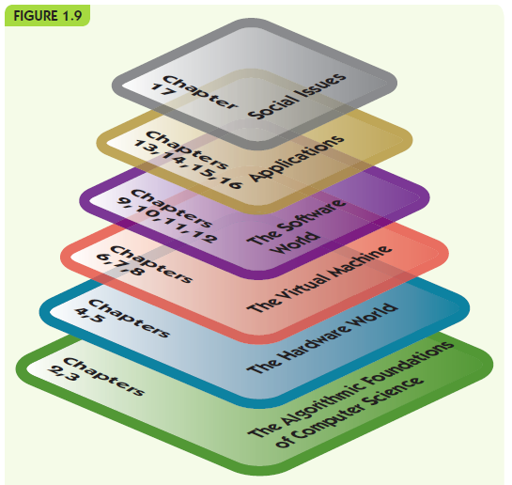
What does this graphic tell you about the relationships between the layers?

Slide 19
Next Time...
History of Computing documentary:
The Machine that Changed the World—Giant Brains

