Slide 1
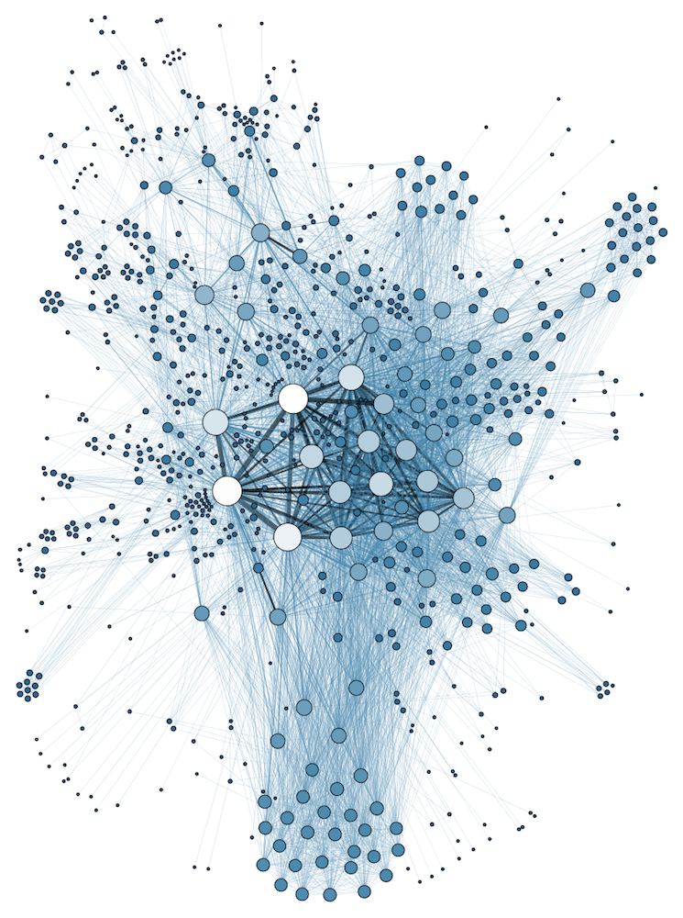
COMP 1100 Data Modeling & Management
David J Stucki
Otterbein University
Notes:
Bring Wirth & playing cards

Slide 2
ALERTS
ER Diagram HW is due Thursday by the end of class
Read Hoberman chapters 7-9

Slide 3
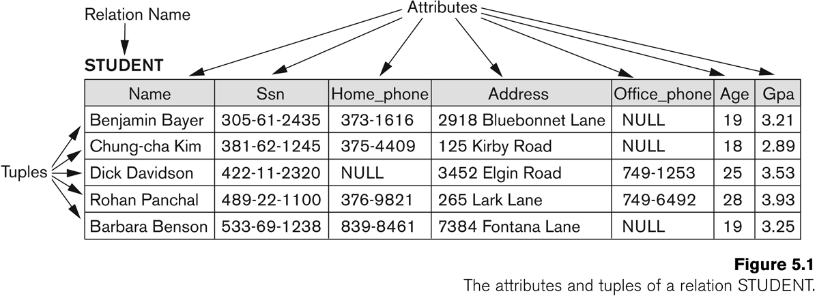
Relational Model Concepts
Fundamental concept: the relation
The Relational Model represents an entire database as a collection of relations
Idea of a relation: A table of values
Each row is some collection of facts about an entity
Each column is a single attribute about the entities in the table

Slide 4
Relational Model Concepts
Tuple – one row of a relation
Attribute – one column of a relation
Relation – the whole table
Domain of an Attribute – all the values that attribute can have

Slide 5
Domain
All the possible values an attribute can take
Atomic
Remember your mathematics?
Example domains:
US Phone Numbers: the set of all 10-digit phone numbers
Social Security Numbers: the set of all 9-digit numbers
Names: the set of all possible names
GPAs: the set of all possible values between 0.0 and 4.0
Data type: a format for a domain
US Phone Numbers: (ddd)ddd-dddd
GPAs: any real-valued number

Slide 6
Relation Schema
Denoted by R(A₁, A₂, ...,A_{n})
Consists of a relation name and a list of attributes
Description of what the relation should contain
STUDENT relation:
STUDENT(Name, SSN, Address, GPA)
Can also include data type:
STUDENT(Name:String, SSN:Social_Security_Nums, Address: String, GPA: Real)
Degree (or arity) of a relation
Number of attributes n of its relation schema

Slide 7
Relation
A particular set of tuples for a given relation schema (also known as a relation state)
Set of n-tuples r = {t₁, t₂, ..., t_{m}}
The “state” of the relation is its current configuration (i.e. current contents)
Each tuple in the set is an ordered list of values
Each element of the tuple corresponds to a particular attribute for the relation

Slide 8
Characteristics of Relations
Ordering of tuples
Relation is a set
Sets have no order
Relation is not sensitive to ordering of tuples
Uniqueness of tuples
No duplicate tuples in a relation!
Unknown values
NULL value – used when value can’t be known or does not exist
Interpretation
Relation is an assertion of facts
Each tuple can be thought of as a fact about the world
Or as a predicate in first order logic

Slide 9
Characteristics of Relations
Order of attributes and values is not that important
As long as correspondence between attributes and values maintained
Alternative definition of a relation
Tuple considered as a set of (<attribute>, <value>) pairs
Each pair gives the value of the mapping from an attribute A_{i} to a value v_{i} from dom(A_{i})
Use the first definition of relation
Attributes and the values within tuples are ordered
Simpler notation
But alternative has application in later formalisms

Slide 10
Characteristics of Relations
Values in tuples
Each value in a tuple is atomic
Flat relational model
Composite and multivalued attributes not allowed
First normal form assumption
Multivalued attributes
Must be represented by separate relations
Composite attributes
Represented only by simple component attributes in basic relational model

Slide 11
Relational Model Constraints
A constraint is a restriction on the values in a database state
Implicit constraints (model-based constraints)
Inherent in the data model itself
E.g. no duplicate tuples in a relation
Explicit constraints (schema-based constraints)
Can be explicitly enforced/expressed in the schema
Application-based constraints (business rules)
Derived from miniworld represented by database
Cannot be explicitly enforced by the schema
Must be enforced by application programs themselves

Slide 12
Schema-based constraints
Domain constraints
Data type constraint
Each attribute in a tuple may only take on a value from the domain of that attribute

Slide 13
Schema-based constraints
Key constraints
Remember – each tuple in a relation must be unique
No duplicate tuples!
This means that no two tuples have the same combination of attributes for all of their attributes
Usually there is a subset of attributes that control uniqueness
We call this subset a superkey
Definition: Let SK be a subset of attributes of the relation R that form a superkey. Then for any two distinct tuples t1 and t2 in a relation state r of R:
t1[SK] != t2[SK]

Slide 14
Schema-based constraints
Superkeys can have redundant attributes
Ex: {First Name, Last Name, EmployeeID} could be a superkey
Don’t really need First Name and Last Name to be unique – EmployeeID is guaranteed to be unique
keys
A key is a minimal superkey
Remove one attribute from a key and it is no longer a superkey!
A key is always a superkey, but not all superkeys are keys
There can be more than one key in a relation
Ex: {Drivers License} {Student ID}
Common to identify one of these keys as as a primary key
Primary key uniquely identifies tuples in a relation to other relations and outside applications

Slide 15
Schema-based constraints
Constraints can apply not just to single relations
We need to be able to talk about constraints that cross relations
More Terminology!
Relational Database Schema
Set of relation schemas S = {R₁, R₂, ..., R_{m}}
Set of integrity constraints IC
Relational Database State
Set of relation states for a relational database such that all integrity constraints are satisfied
Invalid state – state that violates an integrity constraint

Slide 16
Schema-based constraints
Entity integrity constraint
No primary key can have a NULL value
Remember – primary key uniquely identifies a tuple!
Referential integrity constraint
Specified between two relations
A tuple in one relation that refers to a tuple in a second relation MUST refer to an existing tuple
You can’t put in “placeholder” references – every reference must be resolvable when you make the reference
Uses the concept of a foreign key

Slide 17
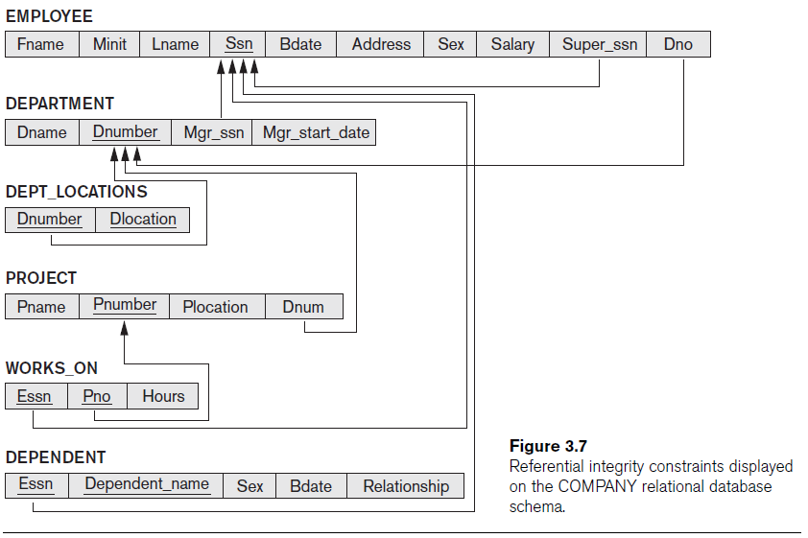
Schema-based constraints
Where do referential integrity constraints come from?
Connections in the data

Slide 18
Other constraints
Semantic integrity constraints
Constraints that come from outside the basic relationships between tuples
“Business rules”
“no employee can have a salary larger than their supervisor”
“no employee can log more than 60 hours of time in a week”
Usually modeled at the application level, but sometimes can be modeled in the database
“Triggers” – “when event X occurs perform action Y”
“Assertions” – “make sure that no matter what action X does, condition Y is always true”

Slide 19
Operations
The relational model has two types of operations:
Retrievals
Getting information out of the database
Updates
Adding/changing information in the database
Different kinds of updates:
INSERT
Add new tuple to a relation
DELETE
Remove a tuple from a relation
UPDATE
Change an attribute value in a tuple in a relation

Slide 20
Updates & Constraints
The DBMS must make sure that updates are not allowed to violate integrity constraints
Check to make sure that attributes in an INSERT do not violate constraints
DELETE can cause referential constraint violations
Removing a tuple being referred to by another tuple
UPDATE can cause referential constraint violations
Changing a primary key can cause all sorts of referential problems for any tuple referring to the updated tuple
Changing a foreign key can only happen if the tuple the foreign key refers to already exists

Slide 21
Next Time
Mapping ER Models to Relational Models

